Slide 1
Chapter 6
Advanced SQL

Slide 2
In this chapter, you will learn:
The various uses of database VIEWS
Extracting data from multiple table through the use of OUTER JOIN for matching and unmatched data
The use of Relational Set Operators
The HR database used in Chapter 3 is referred in this chapter

Slide 3
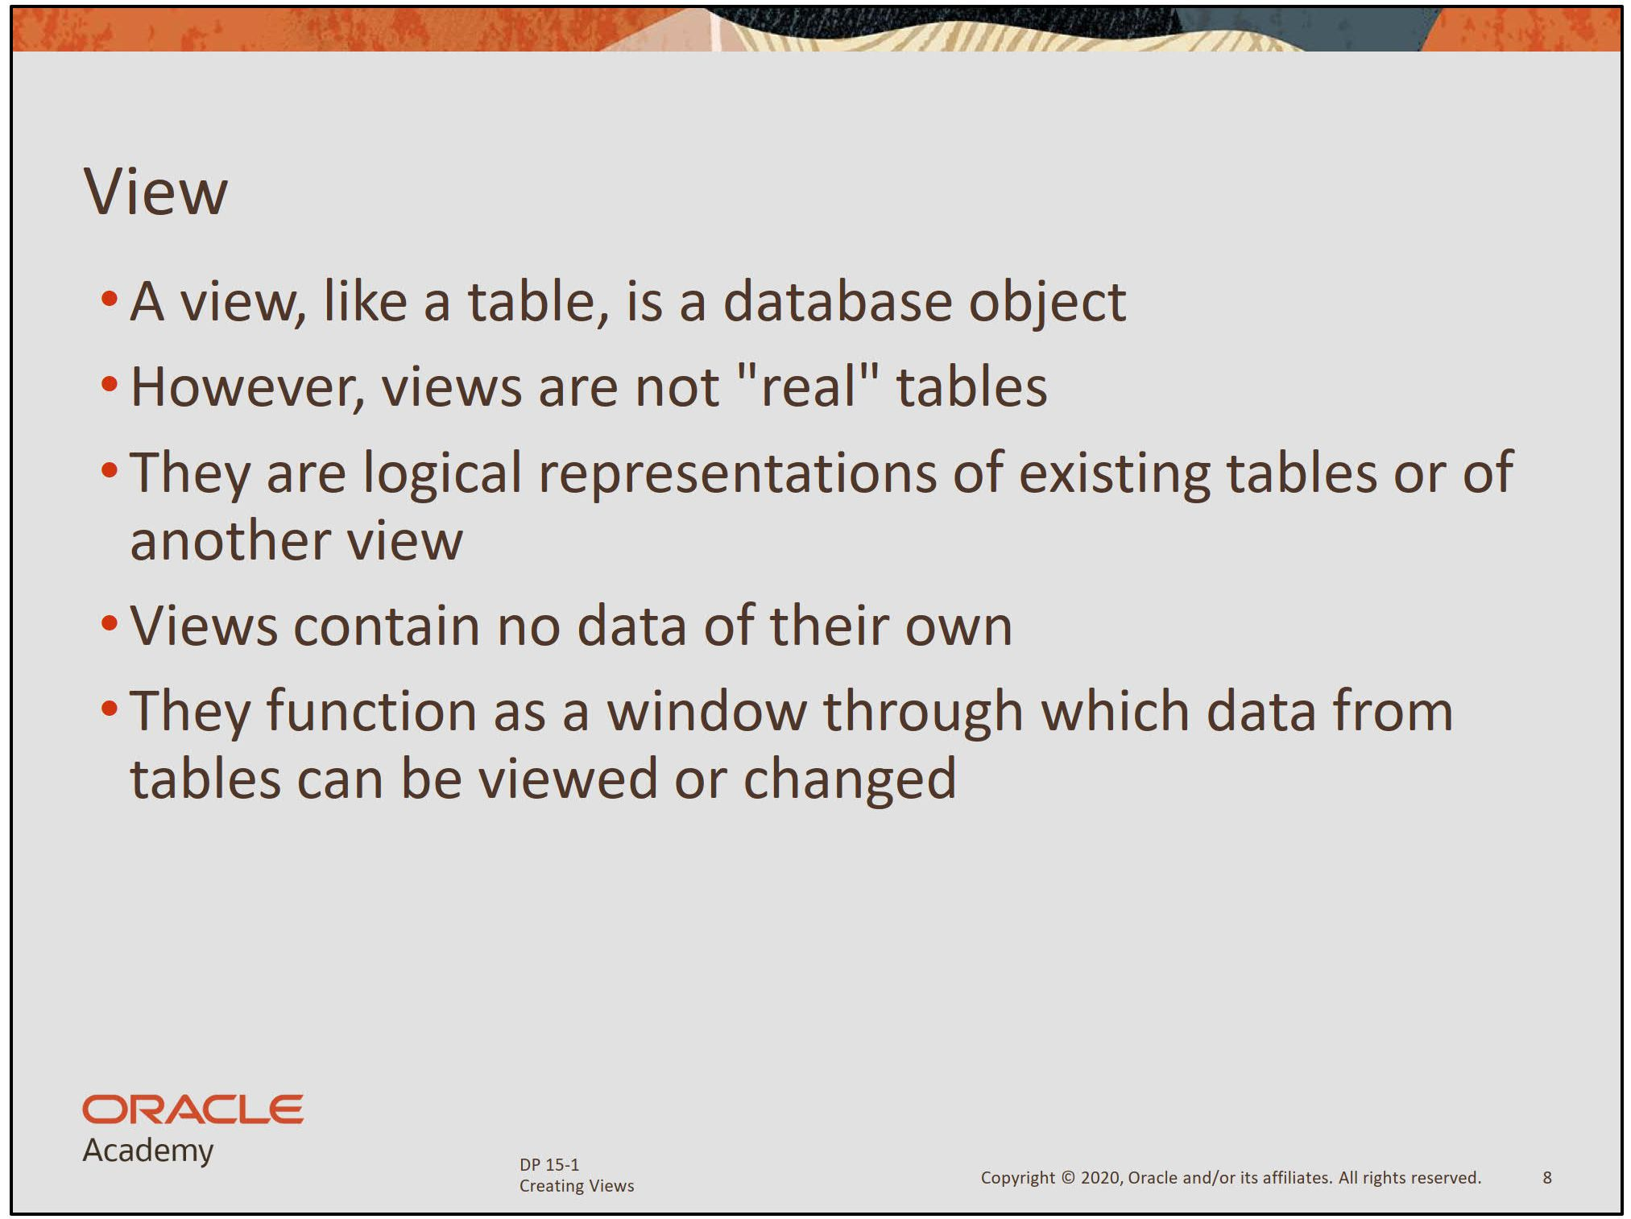

Slide 4
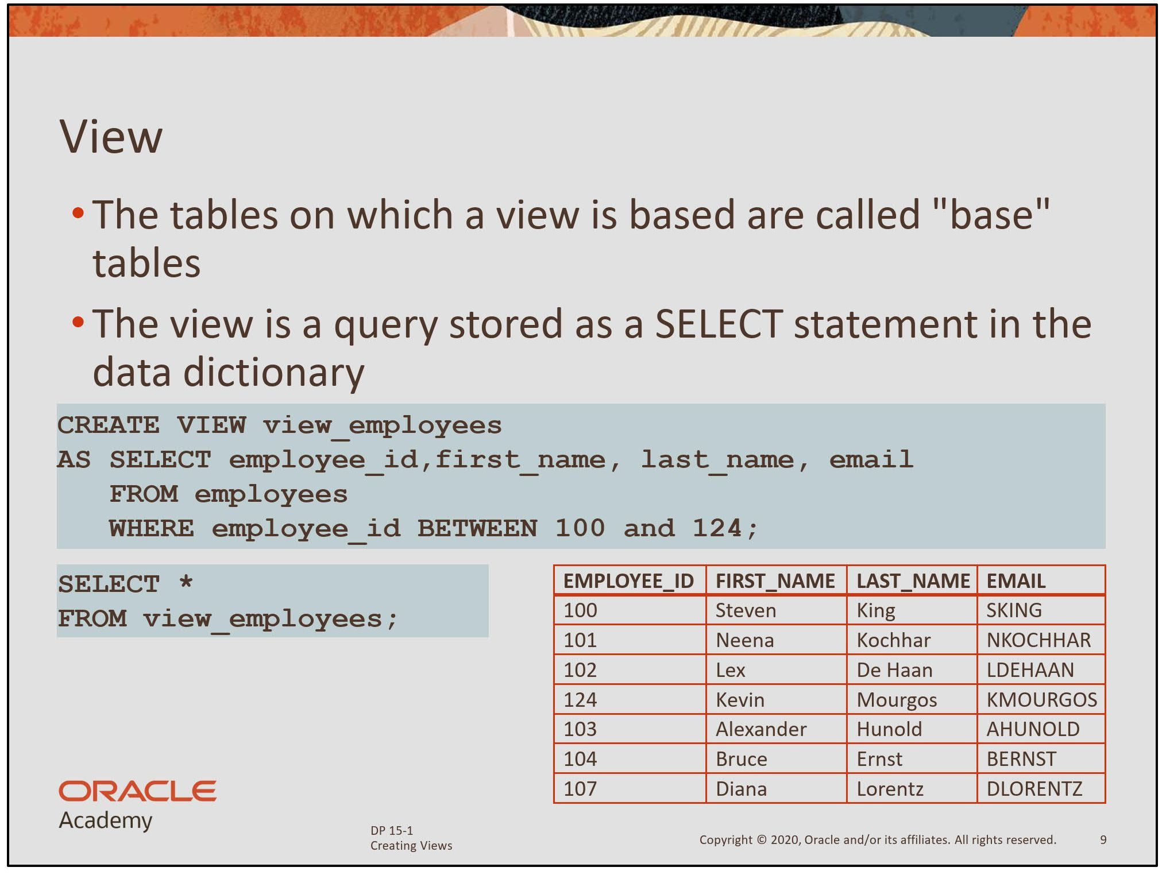

Slide 5
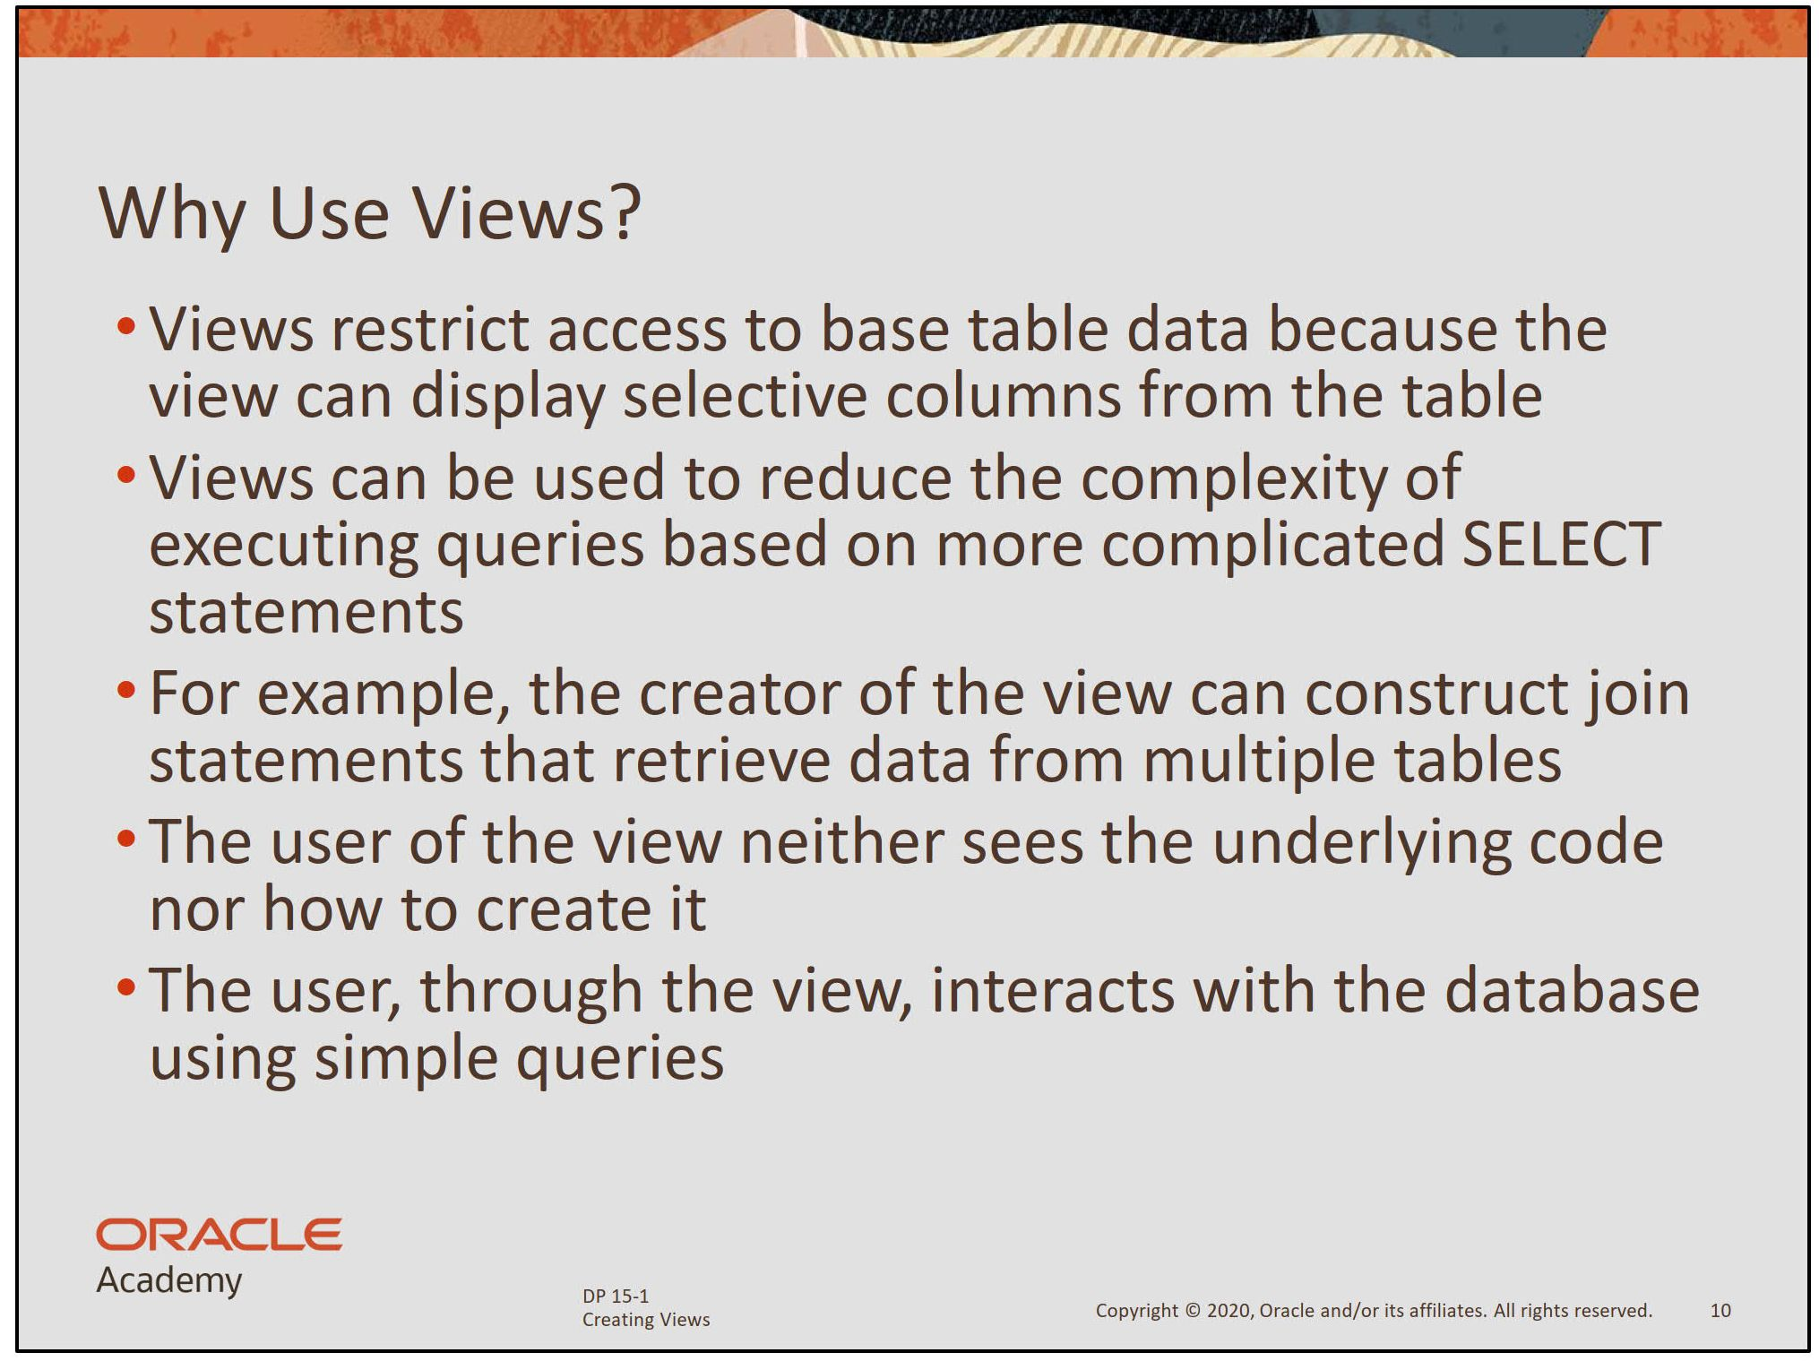

Slide 6
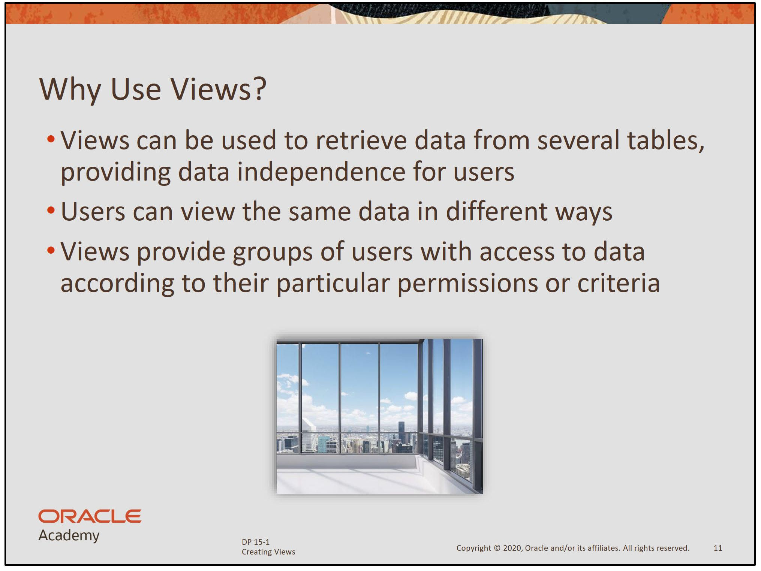

Slide 7
Advantages of Views
Security
Each user can be given permission to access the database only through a small set of views that contain the specific data the user is authorized to see.
Query Simplicity
A view can draw data from several different tables and present it as a single table, turning multi-table queries into single-table queries against the view.
Structural simplicity
Views can give a user a "personalized" view of the database structure, presenting the database as a set of virtual tables that make sense for that user.
Consistency
A view can present a consistent, unchanged image of the structure of the database, even if the underlying source tables are split, restructured, or renamed.
Data Integrity
If data is accessed and entered through a view, the DBMS can automatically check the data to ensure that it meets the specified integrity constraints.
Logical data independence.
View can make the application and database tables to a certain extent independent. If there is no view, the application must be based on a table.
Notes:
Views restrict access to the data because it displays selected columns from the table.
Views can be used to make simple queries to retrieve the results of complicated queries. For example, views can be used to query information from multiple tables without the user knowing how to write a join statement.
Views provide data independence for ad hoc users and application programs. One view can be used to retrieve data from several tables.
Views provide groups of users access to data according to their particular criteria.
For more information, see the “CREATE VIEW” section in Oracle Database SQL Language Reference for 10g or 11g database.

Slide 8
Disadvantages of Views
Performance
Views create the appearance of a table, but the DBMS must still translate queries against the view into queries against the underlying source tables. If the view is defined by a complex, multi-table query then simple queries on the views may take considerable time to process.
Update restrictions
When a user tries to update rows of a view, the DBMS must translate the request into an update on rows of the underlying source tables. This is possible for simple views, but more complex views are often restricted to read-only.

Slide 9
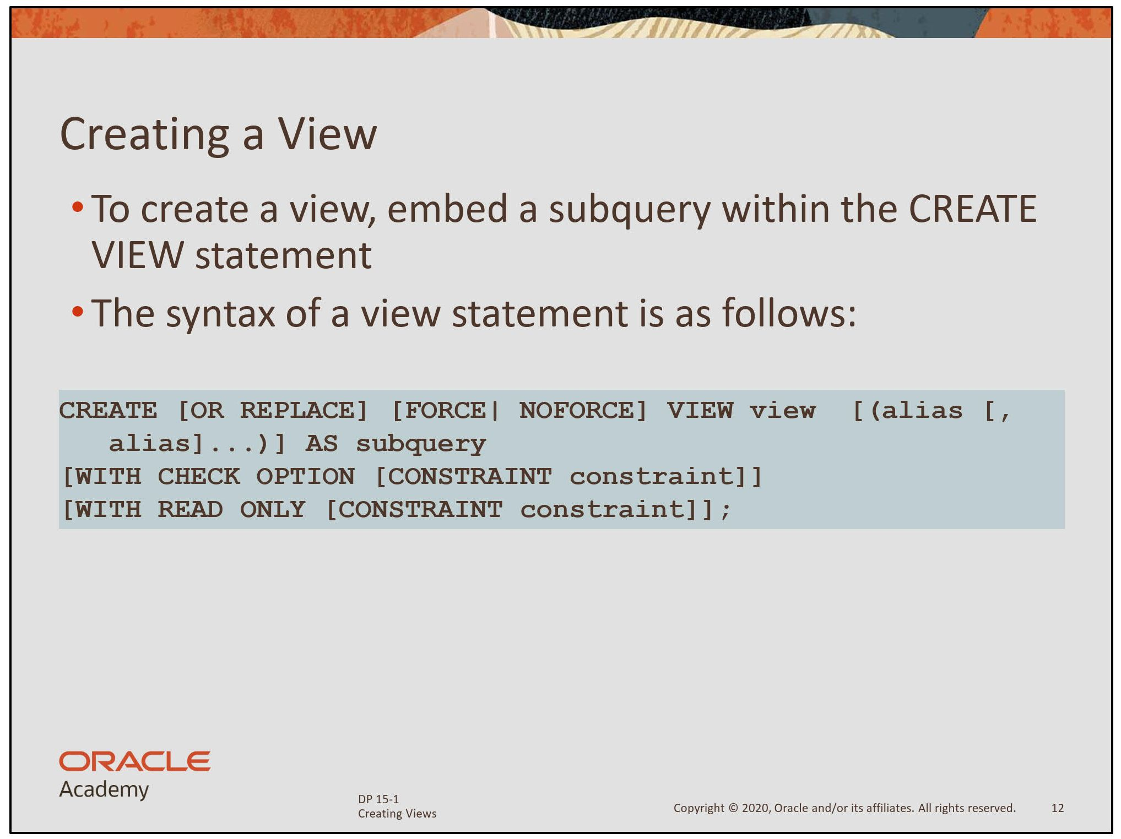

Slide 10
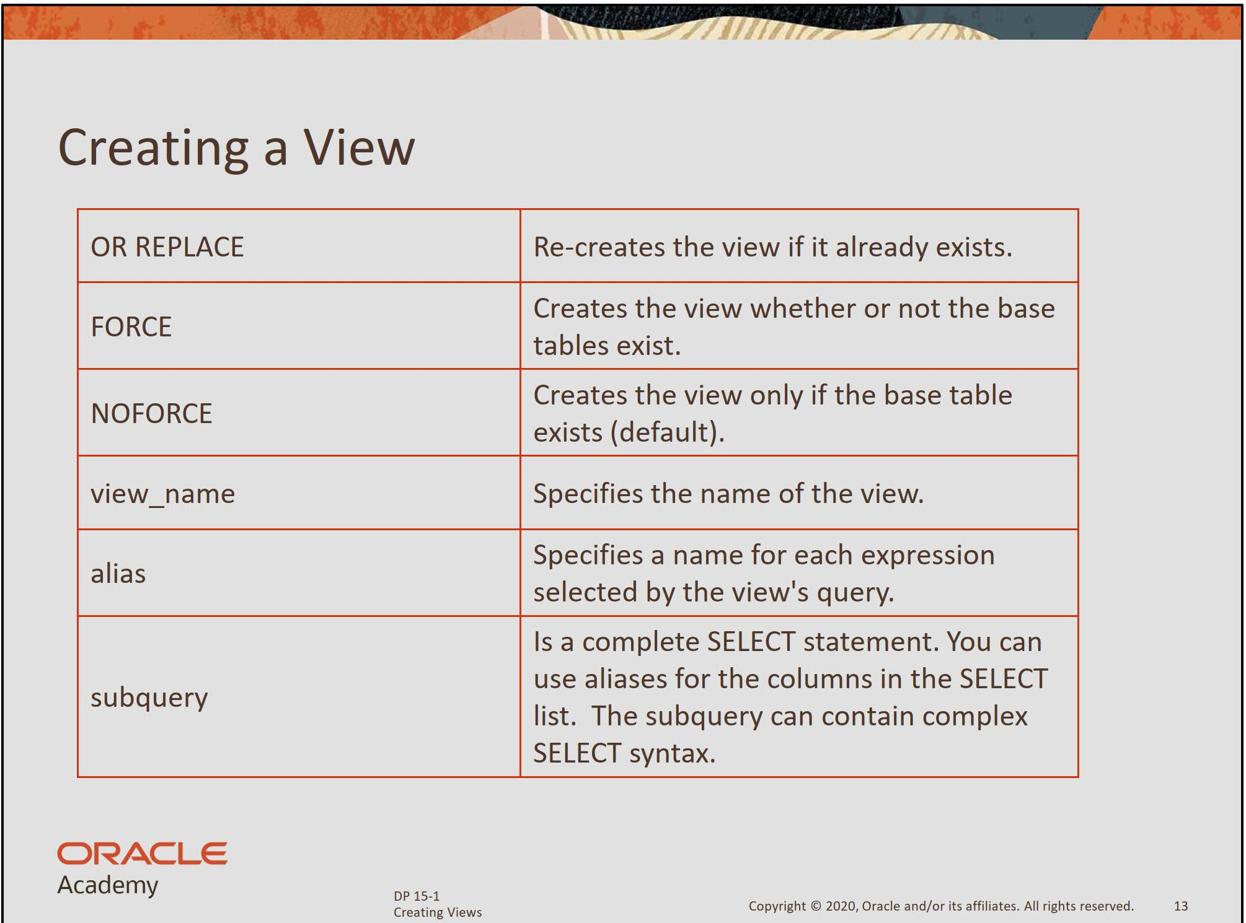

Slide 11
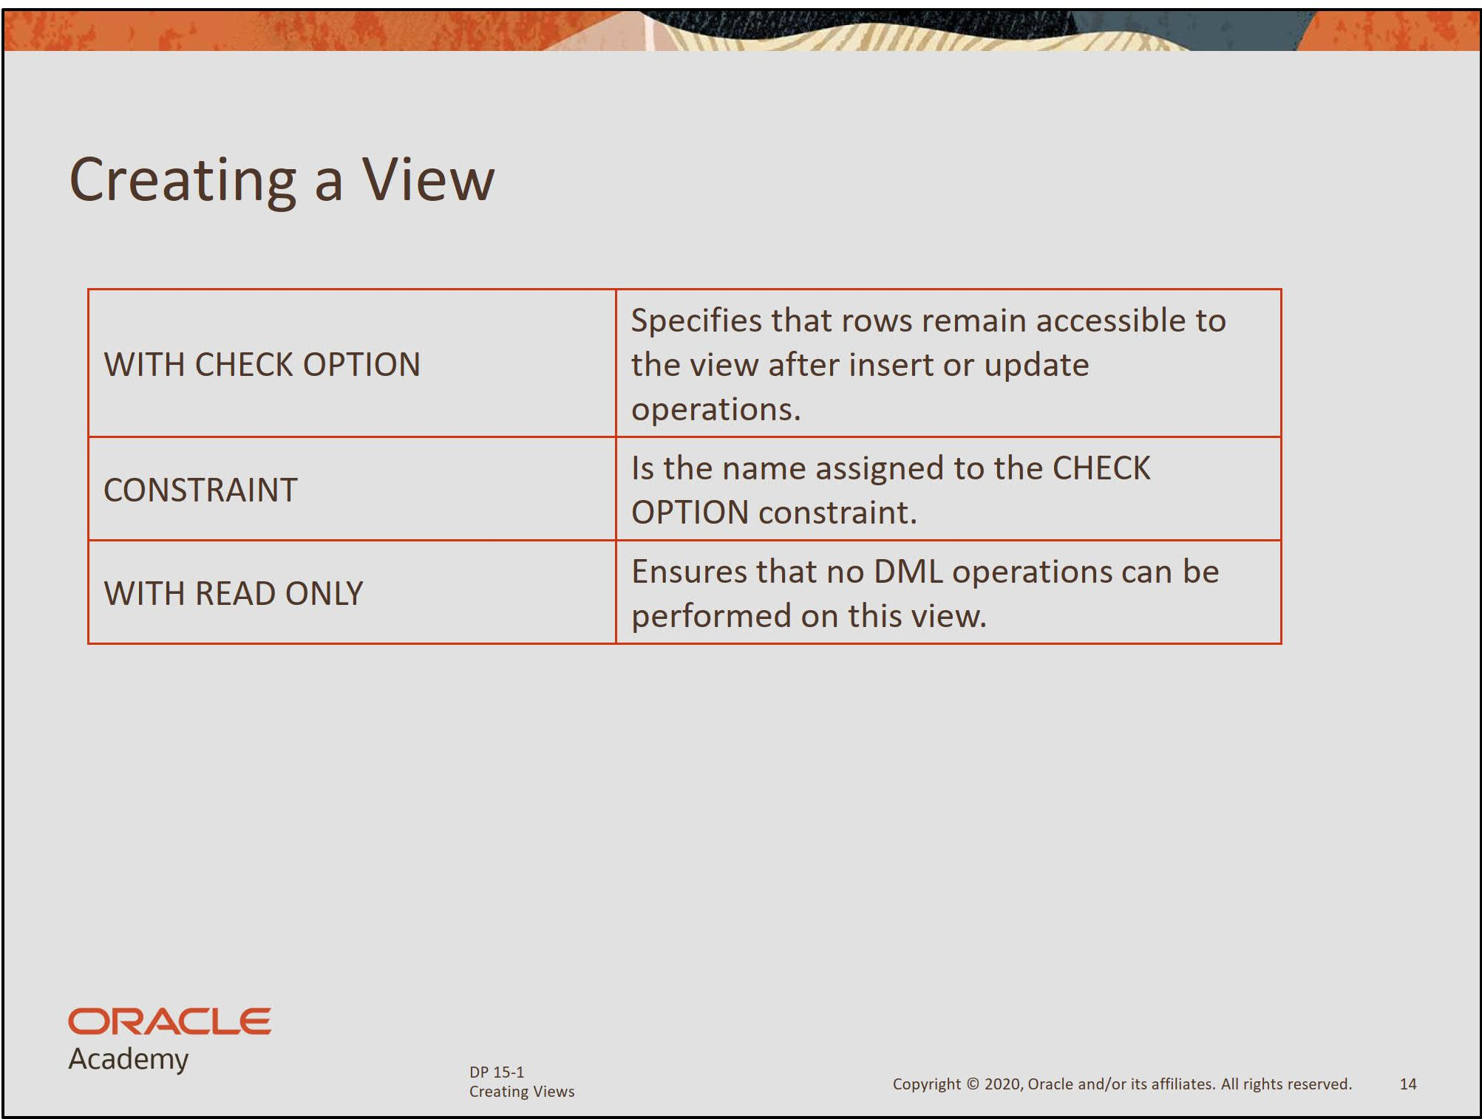

Slide 12
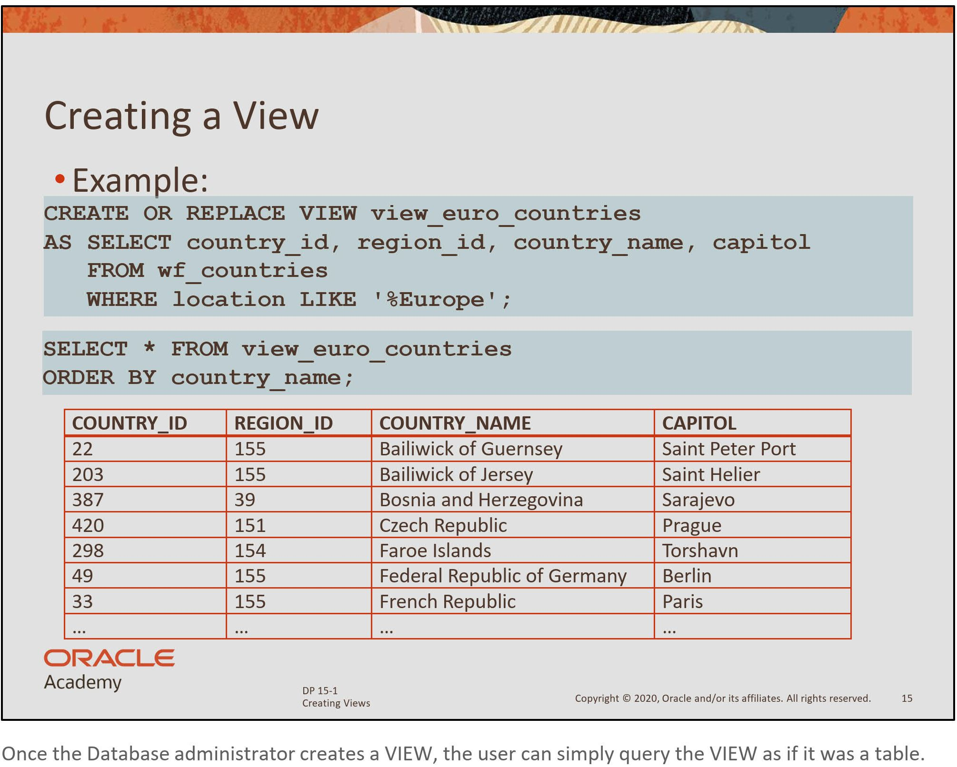

Slide 13
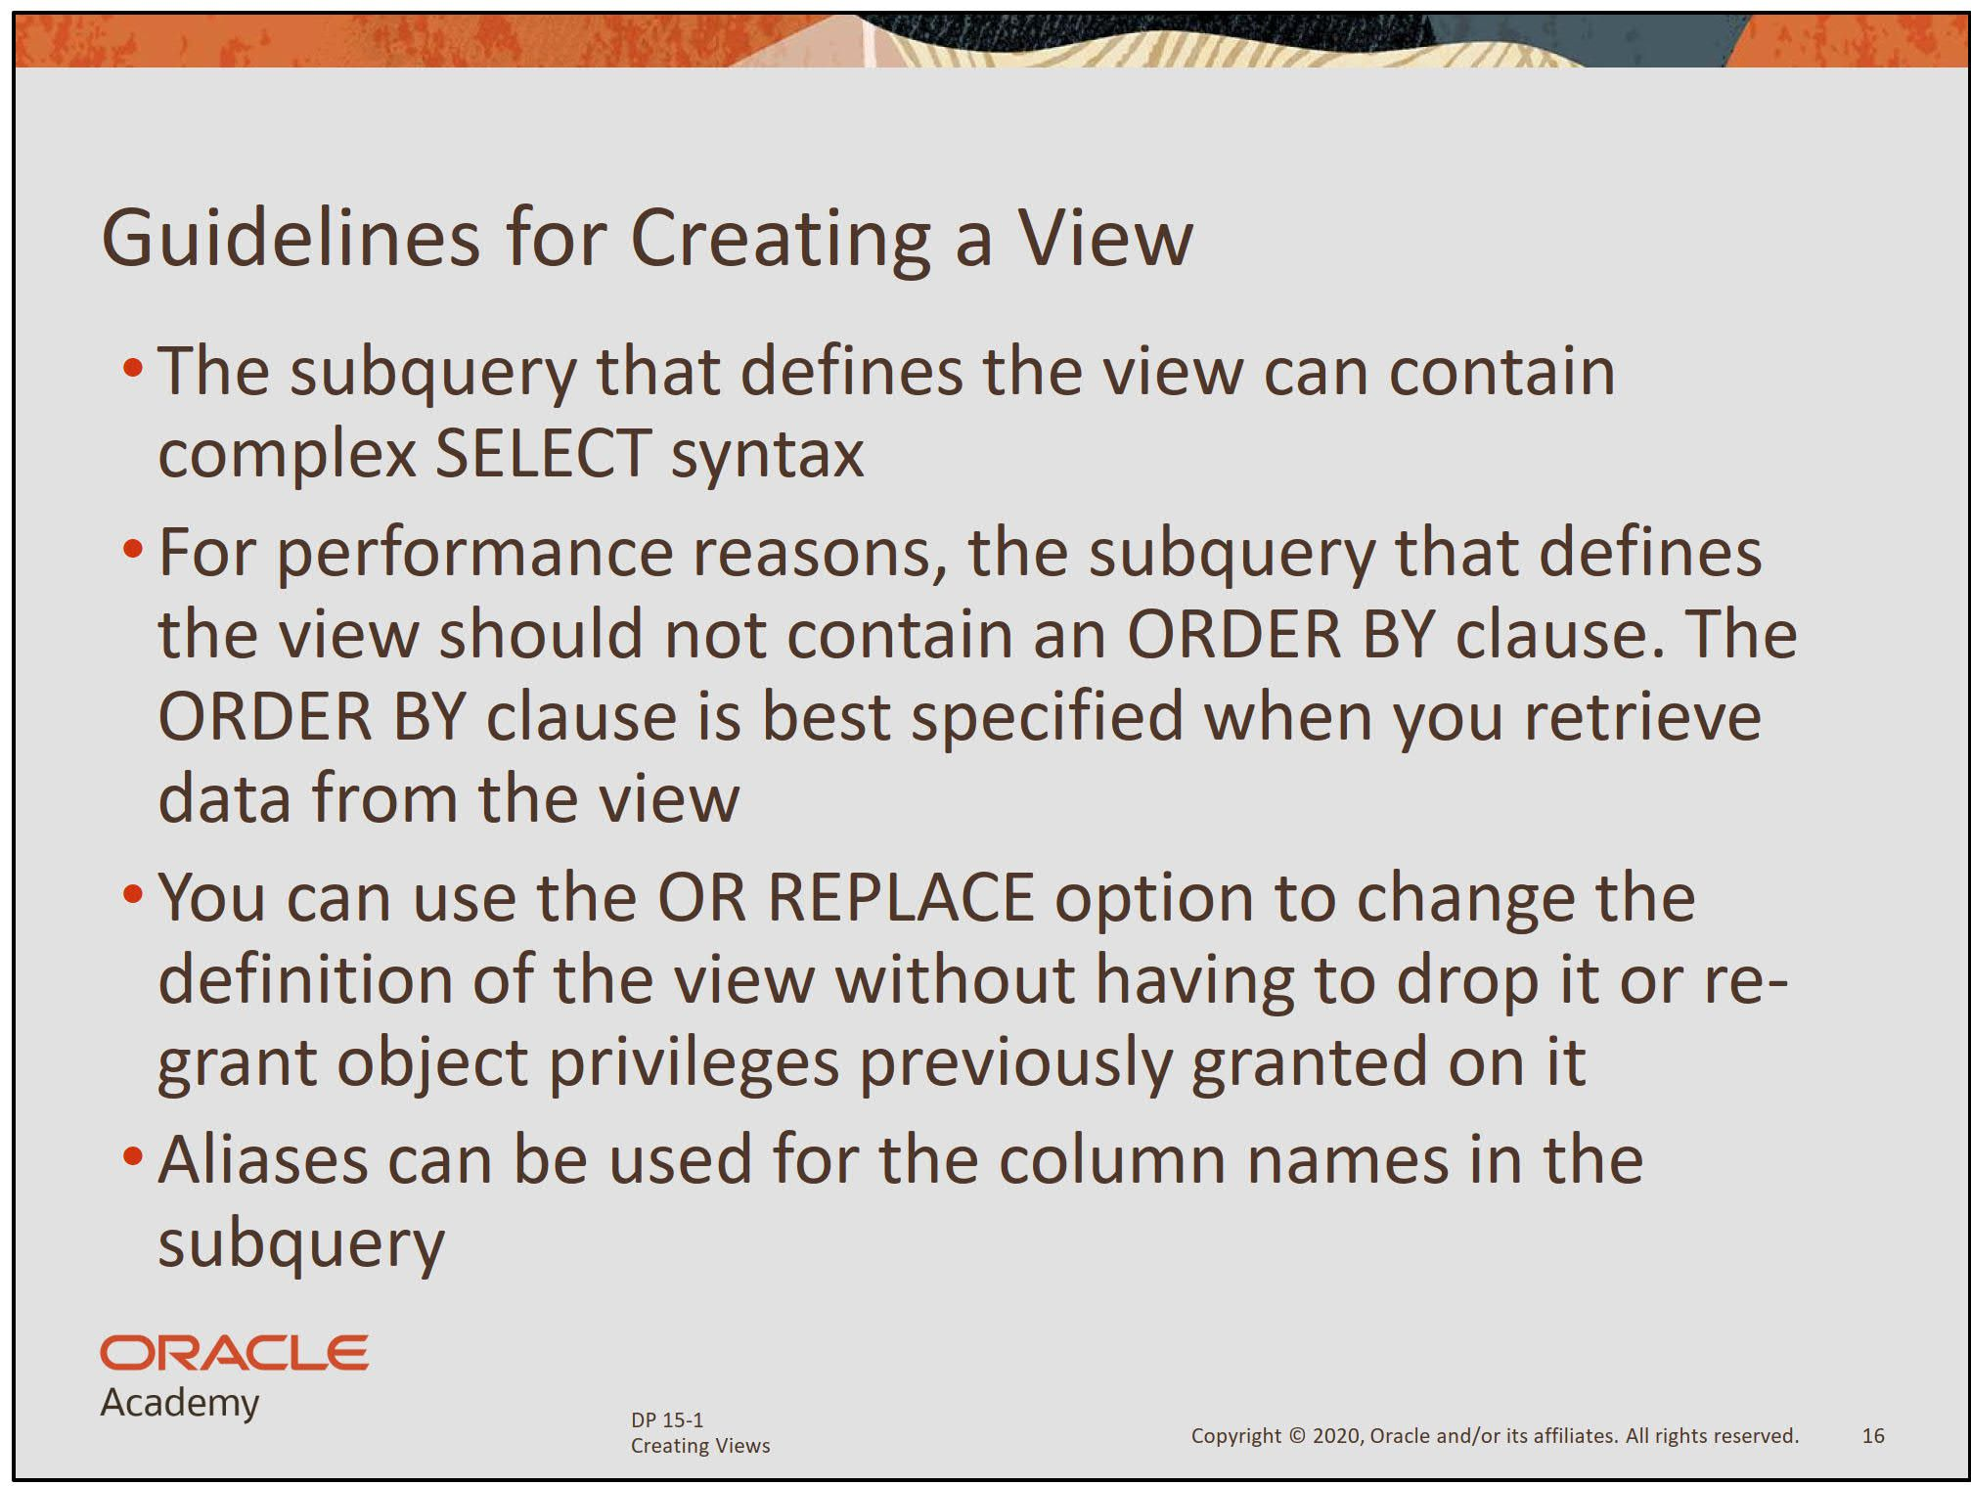

Slide 14
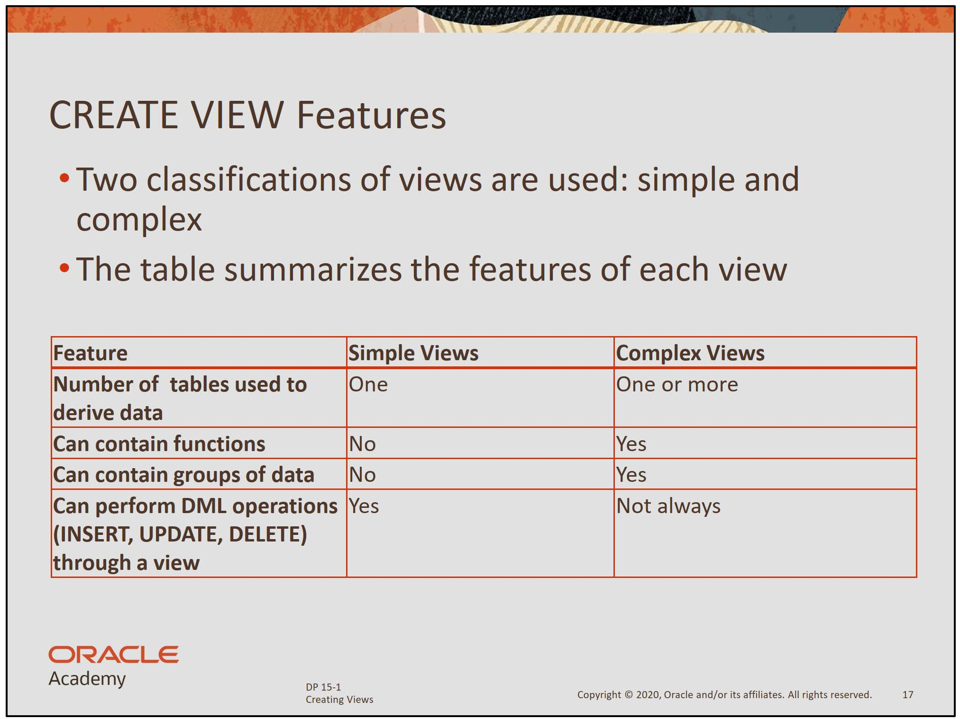

Slide 15
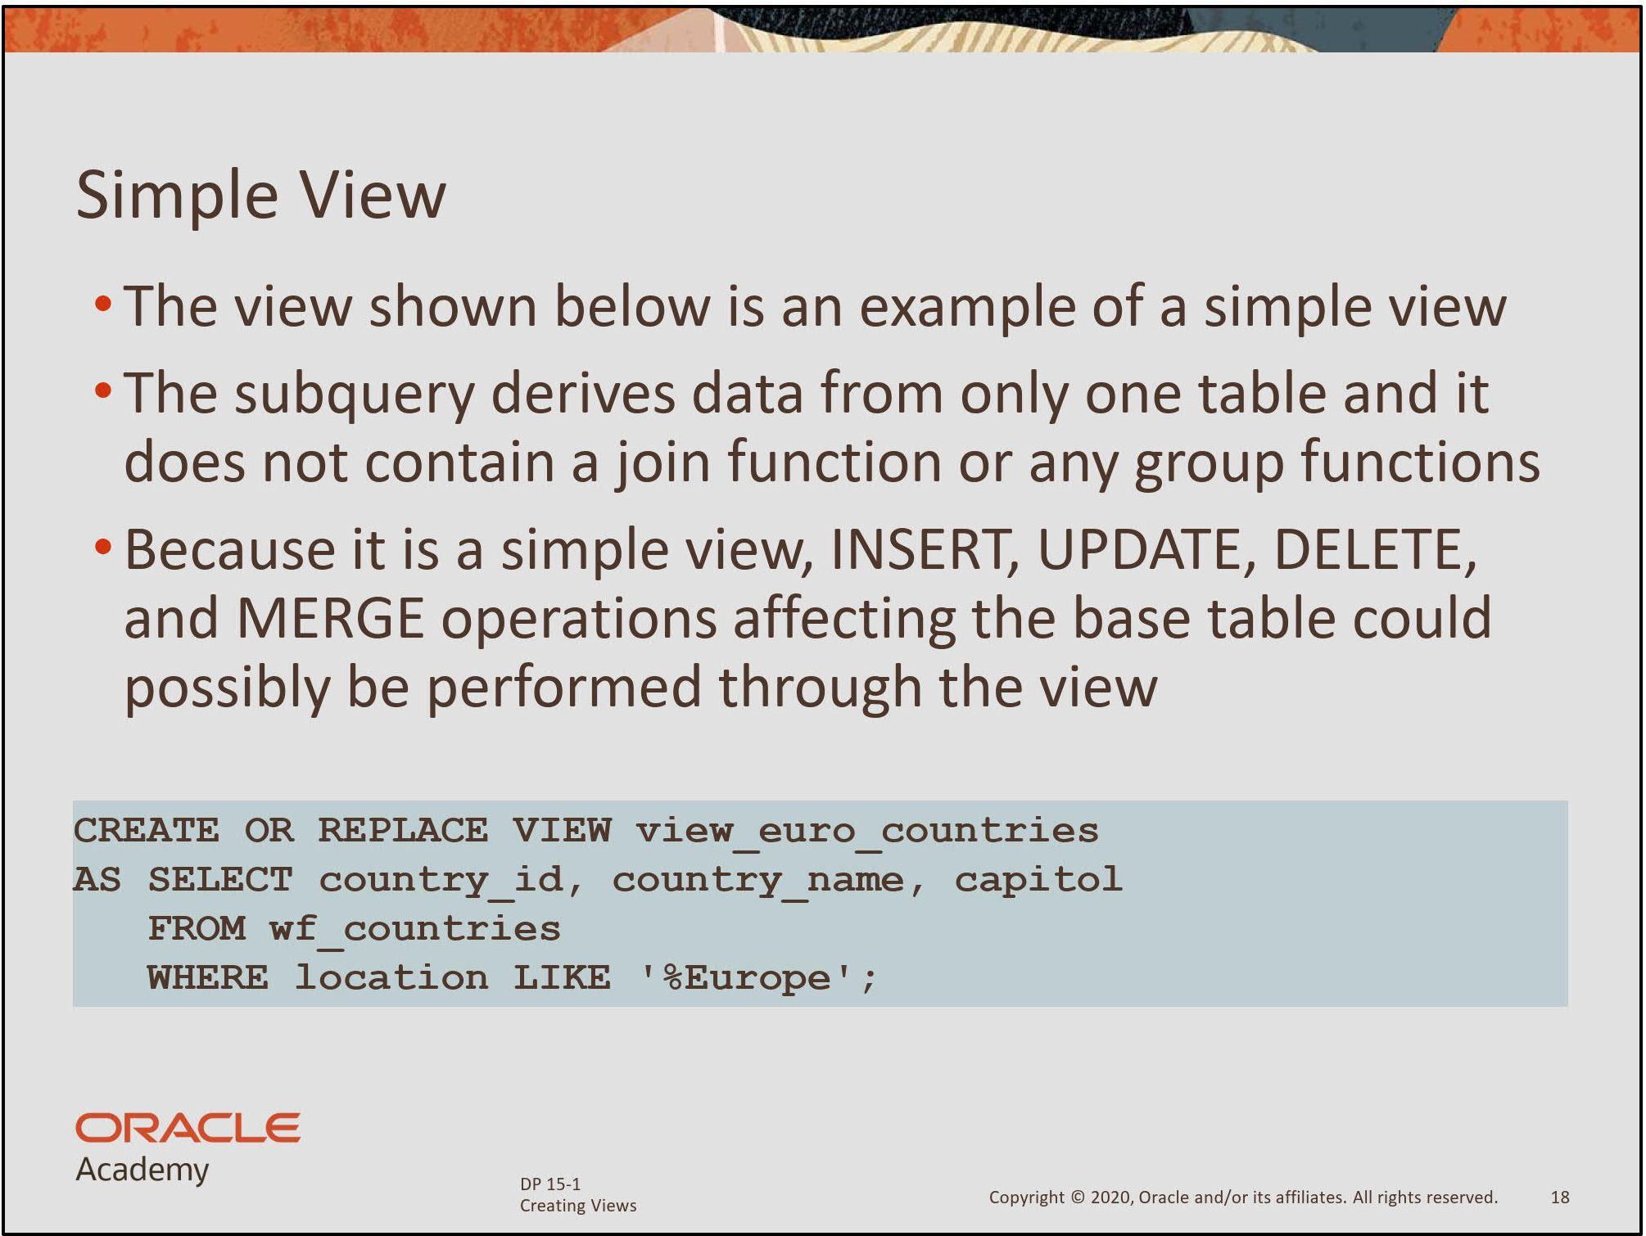

Slide 16
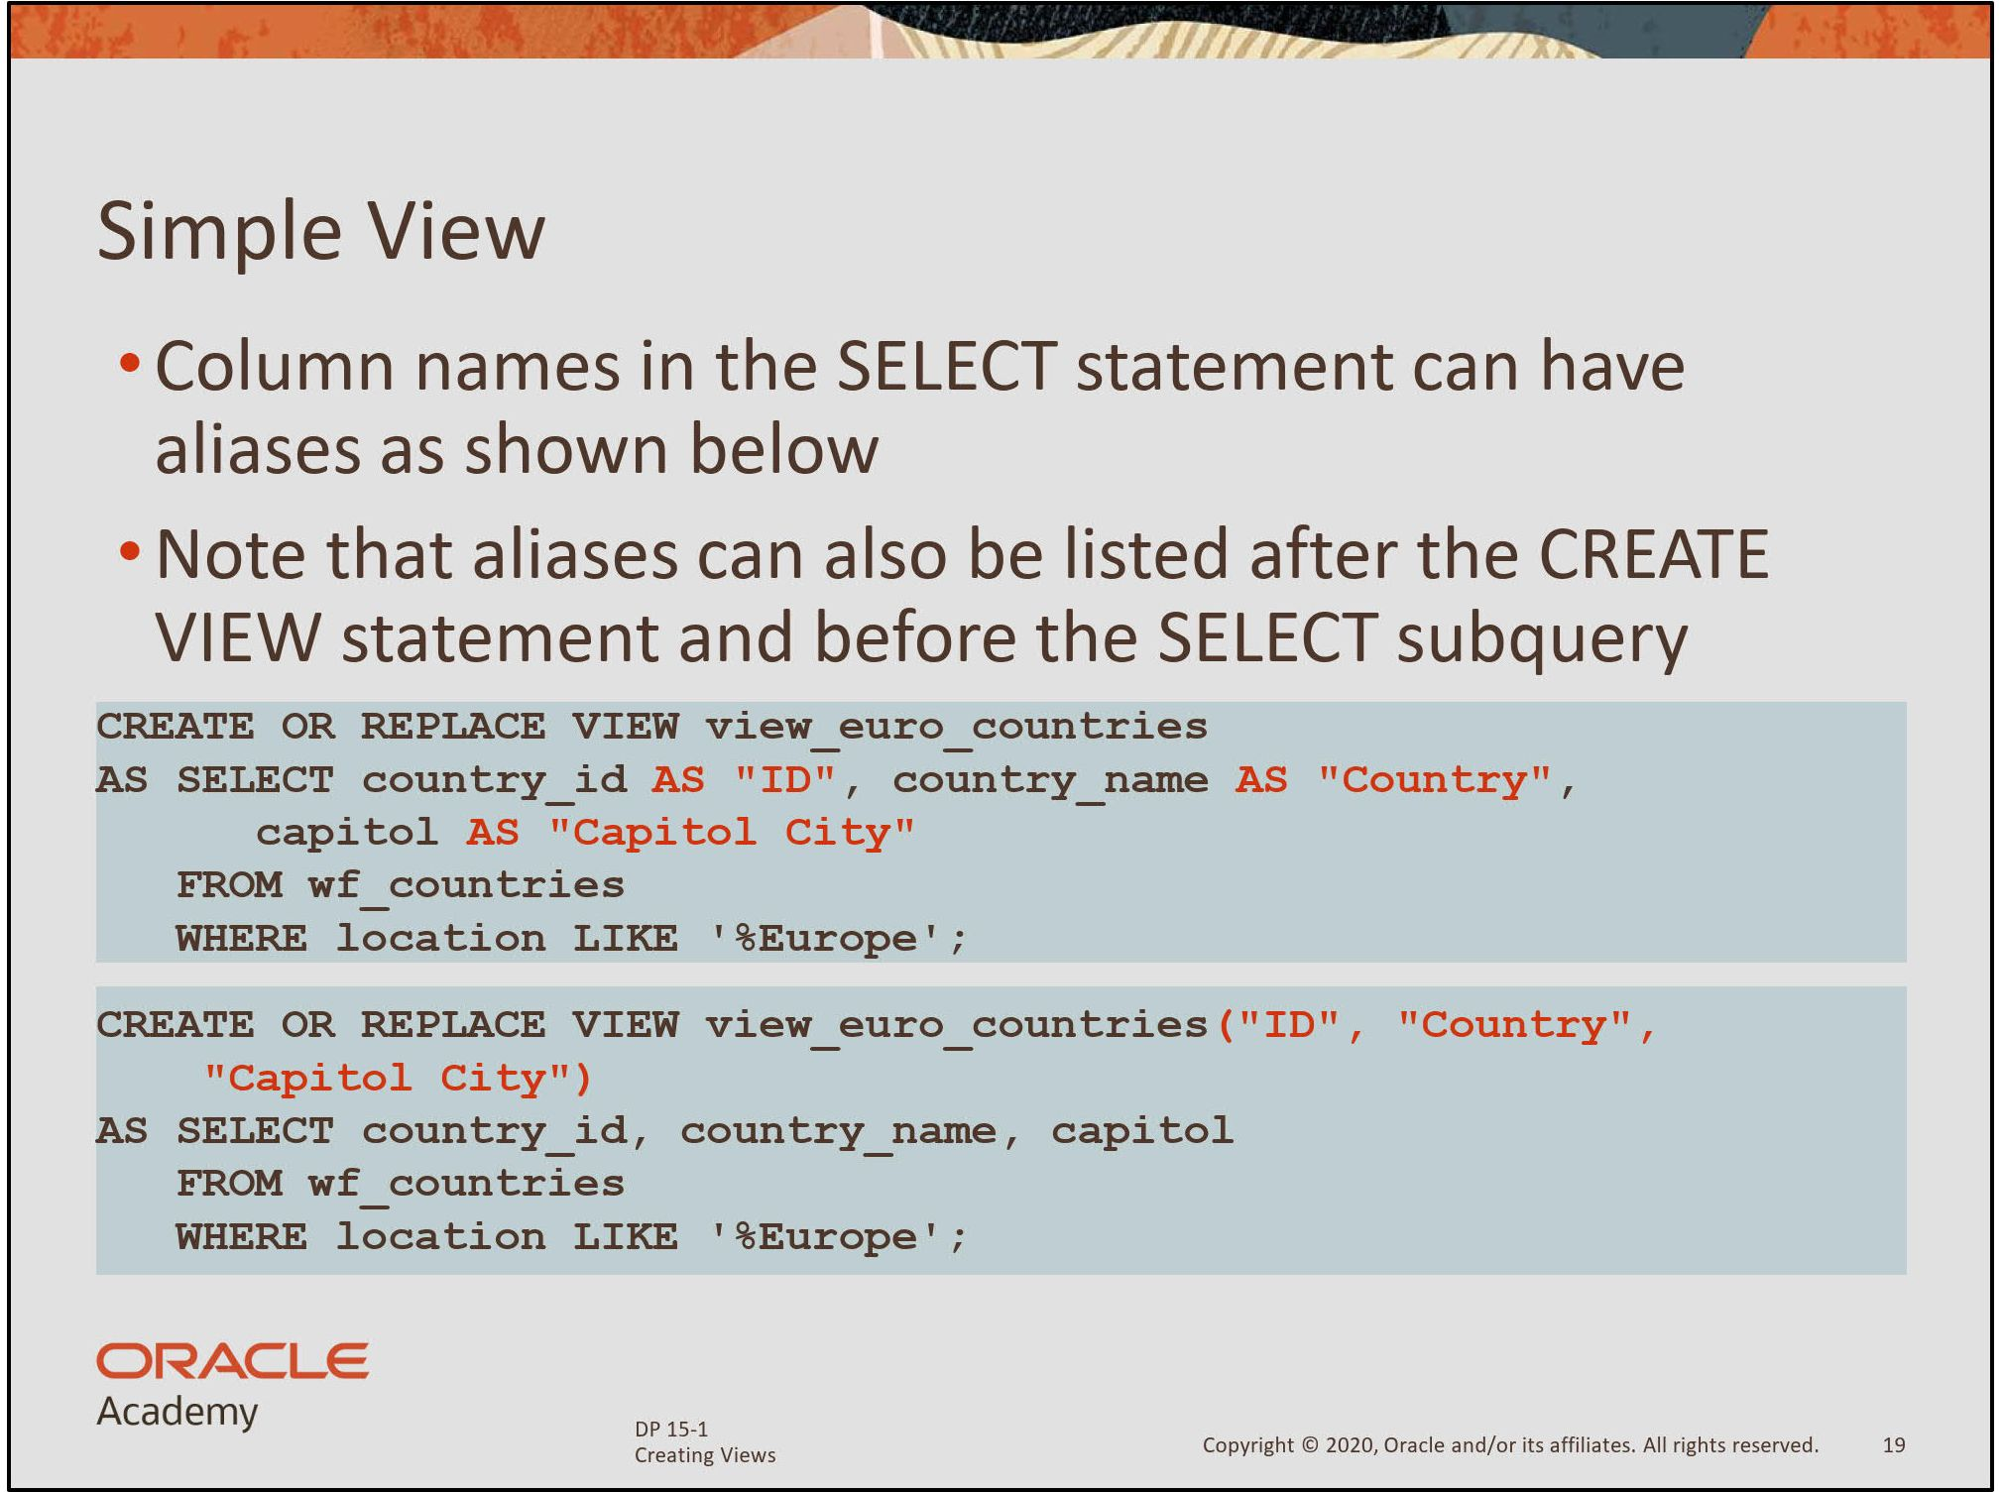

Slide 17
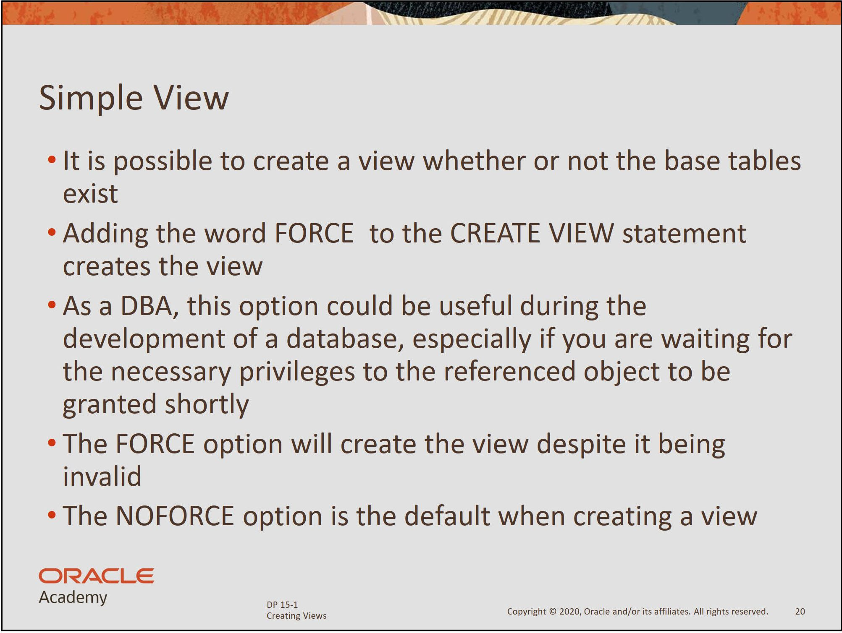

Slide 18
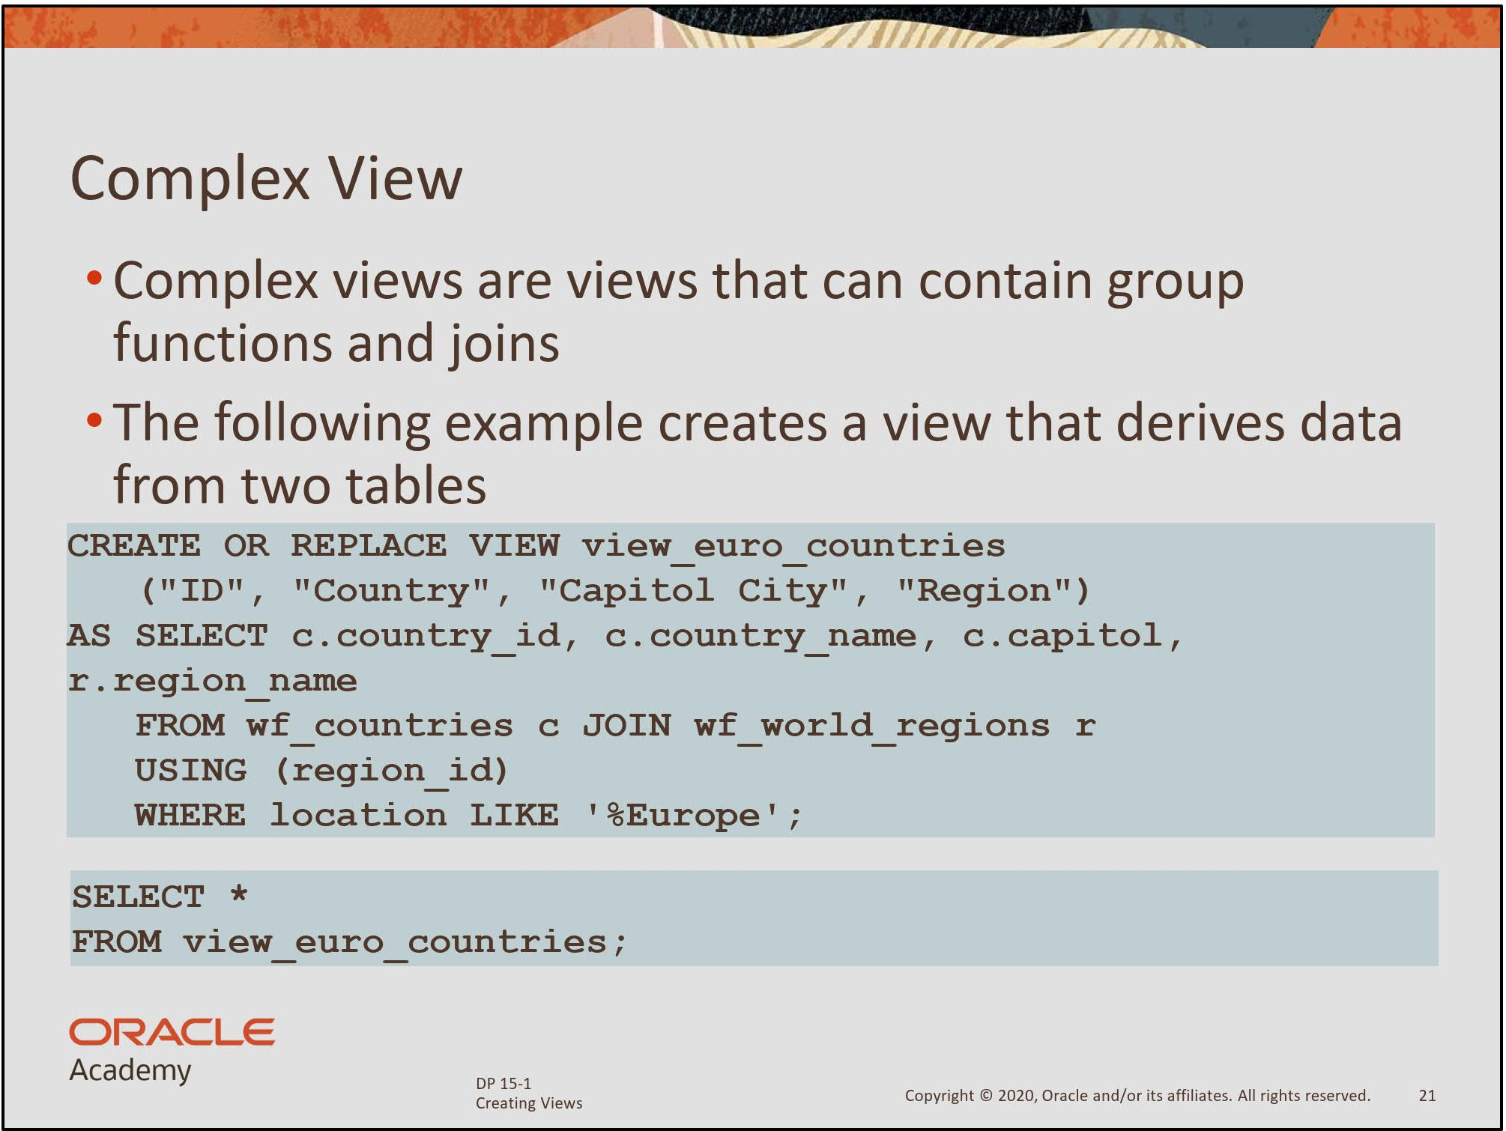

Slide 19
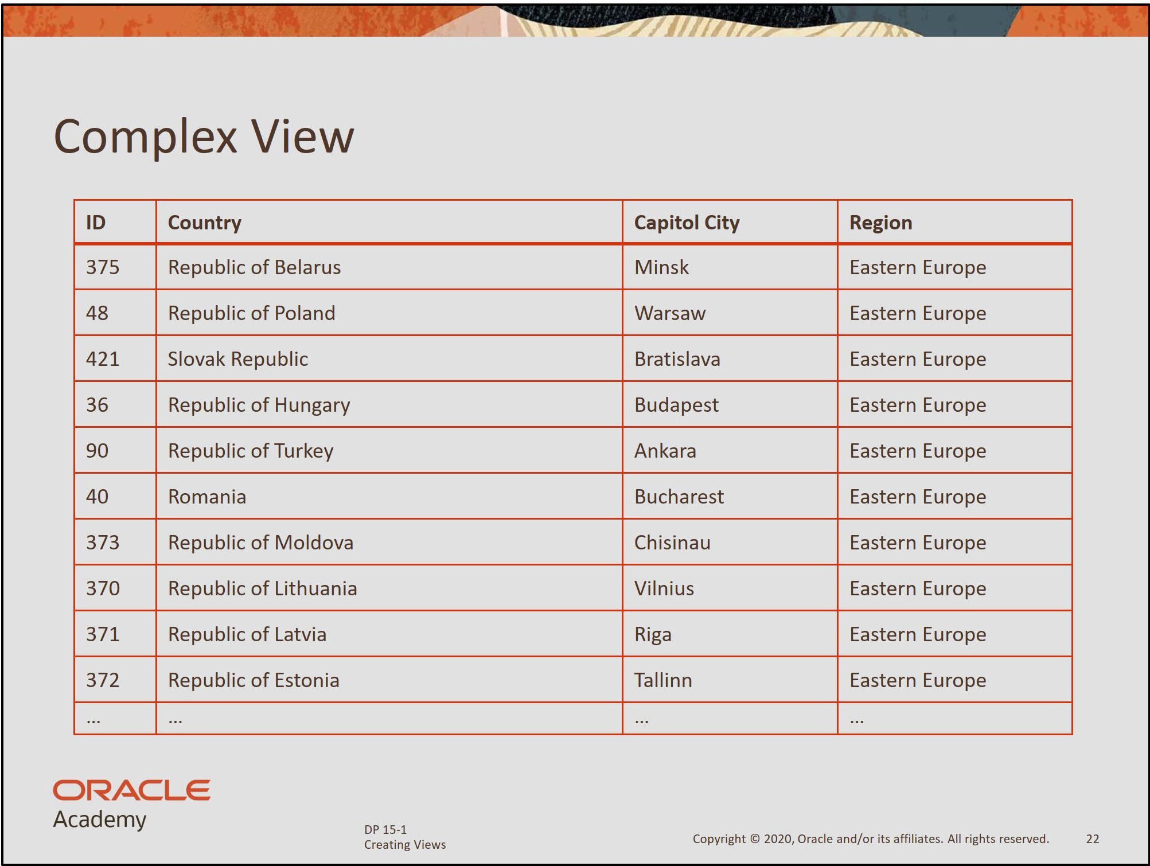

Slide 20
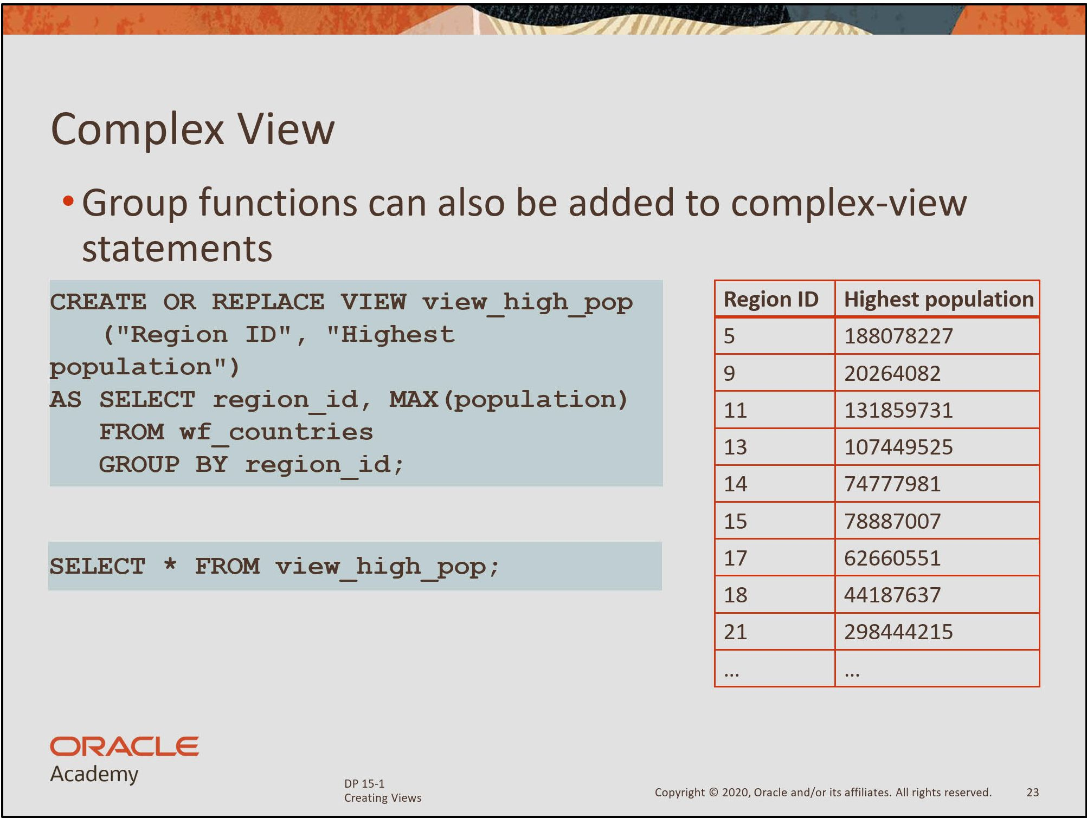

Slide 21
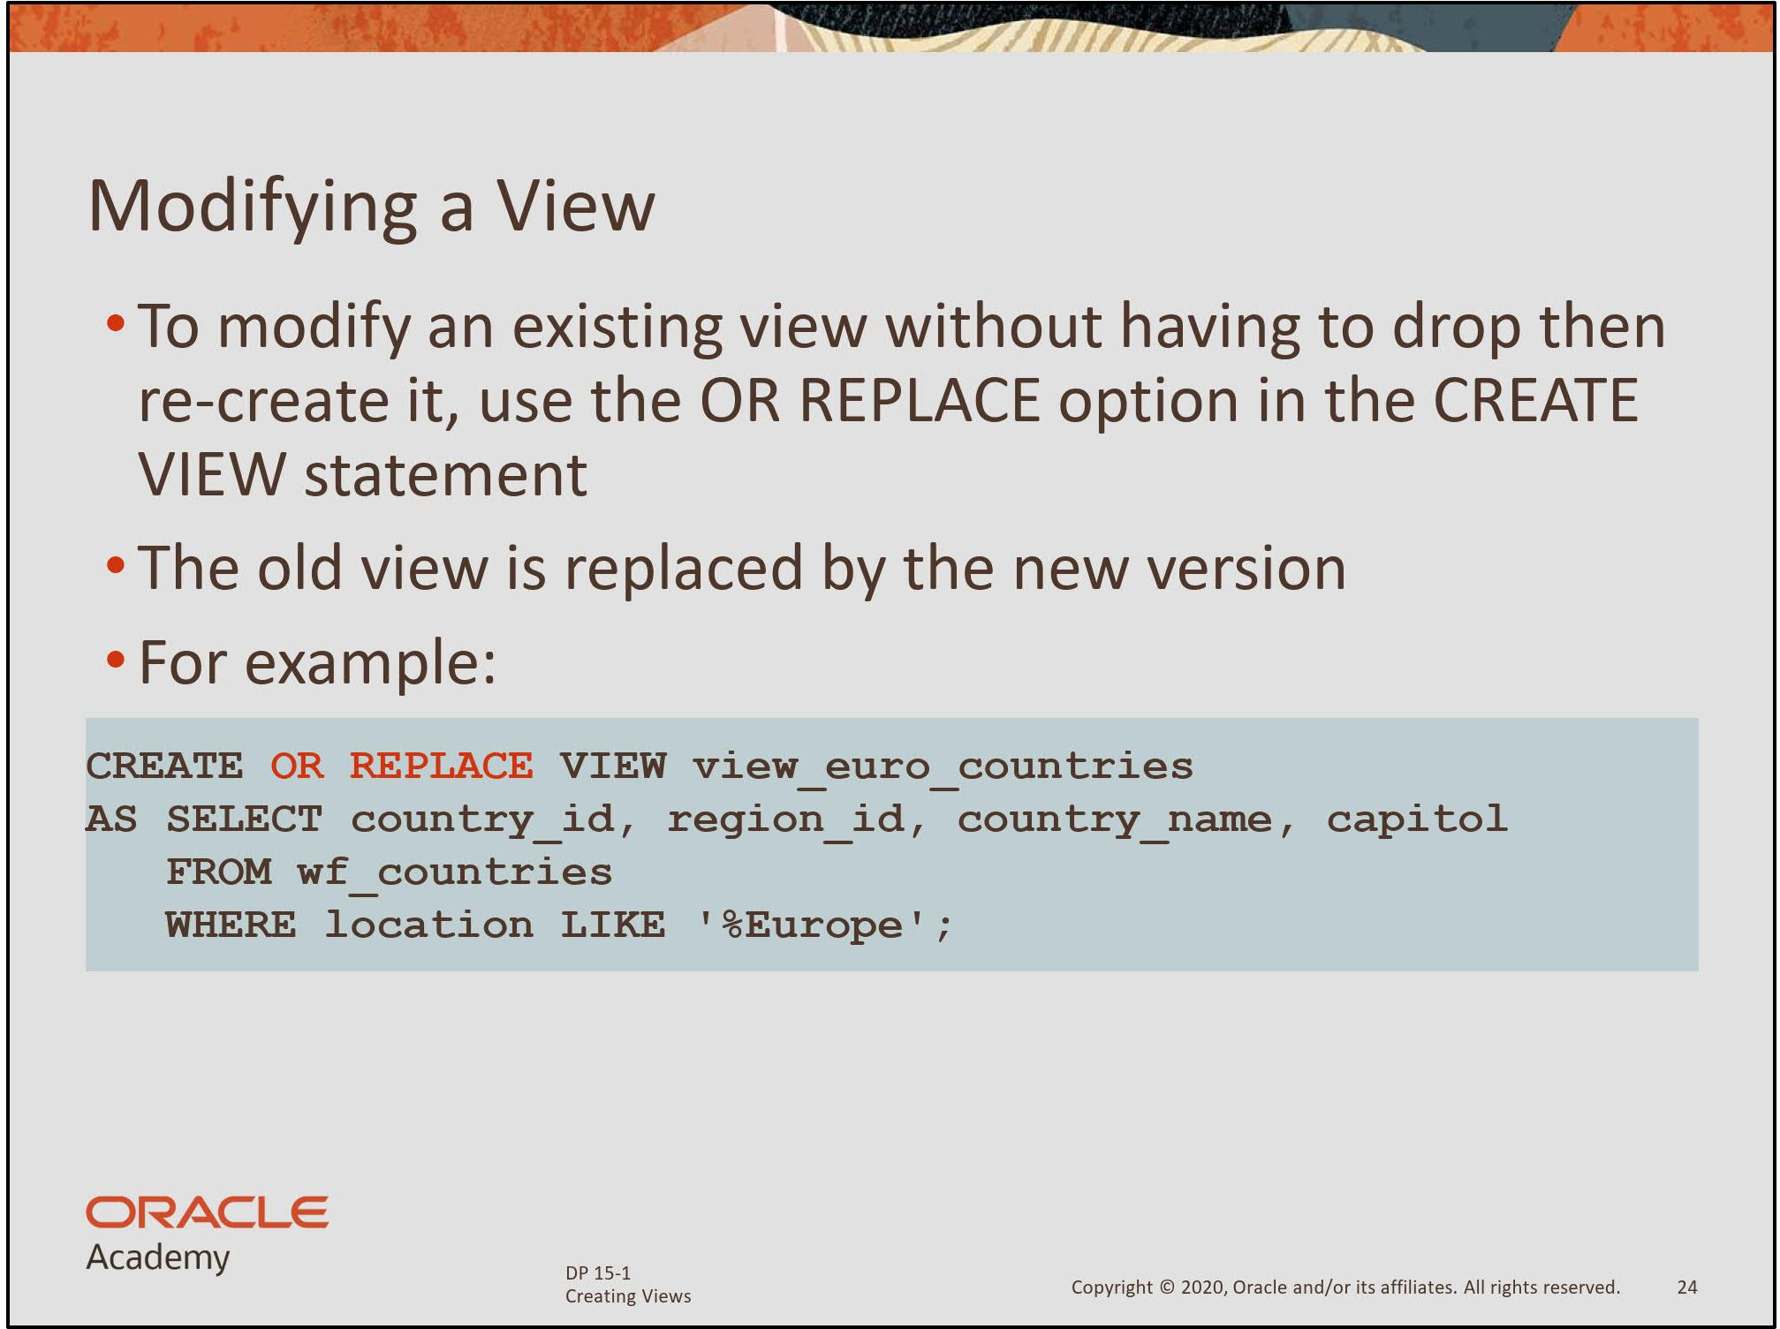

Slide 22
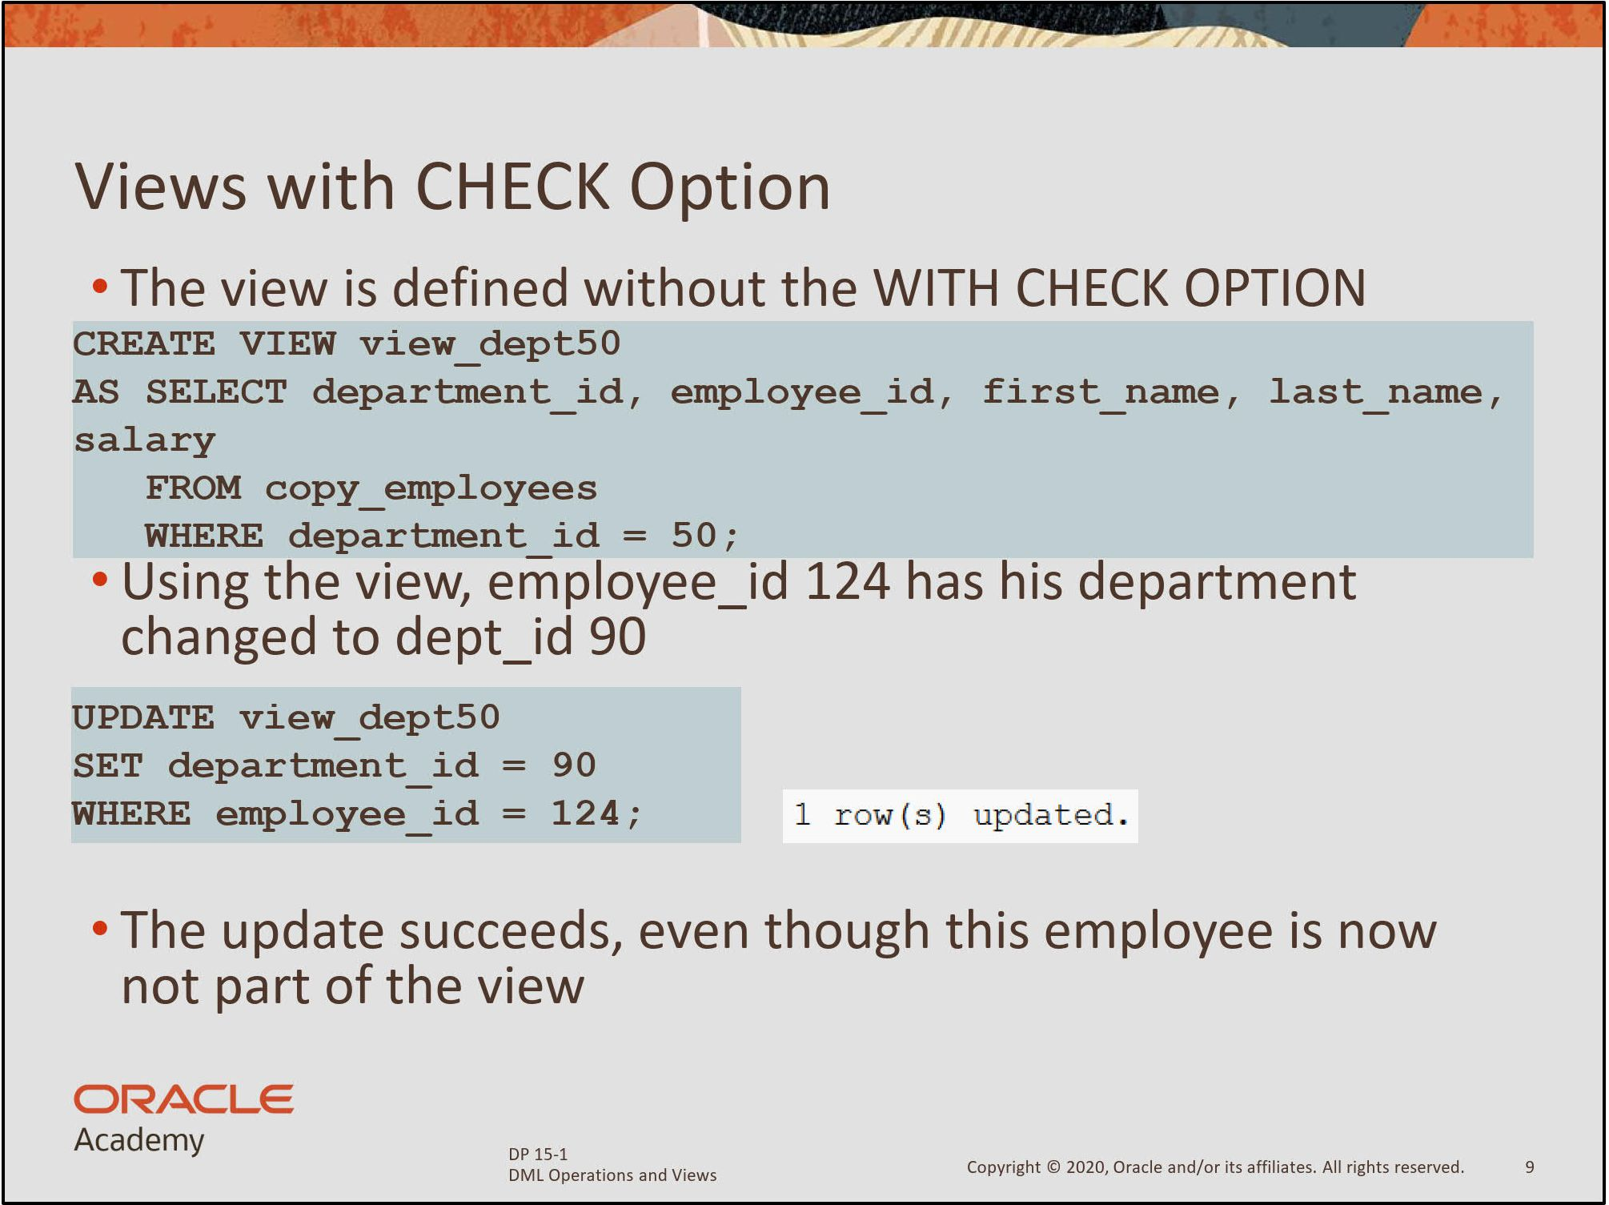

Slide 23
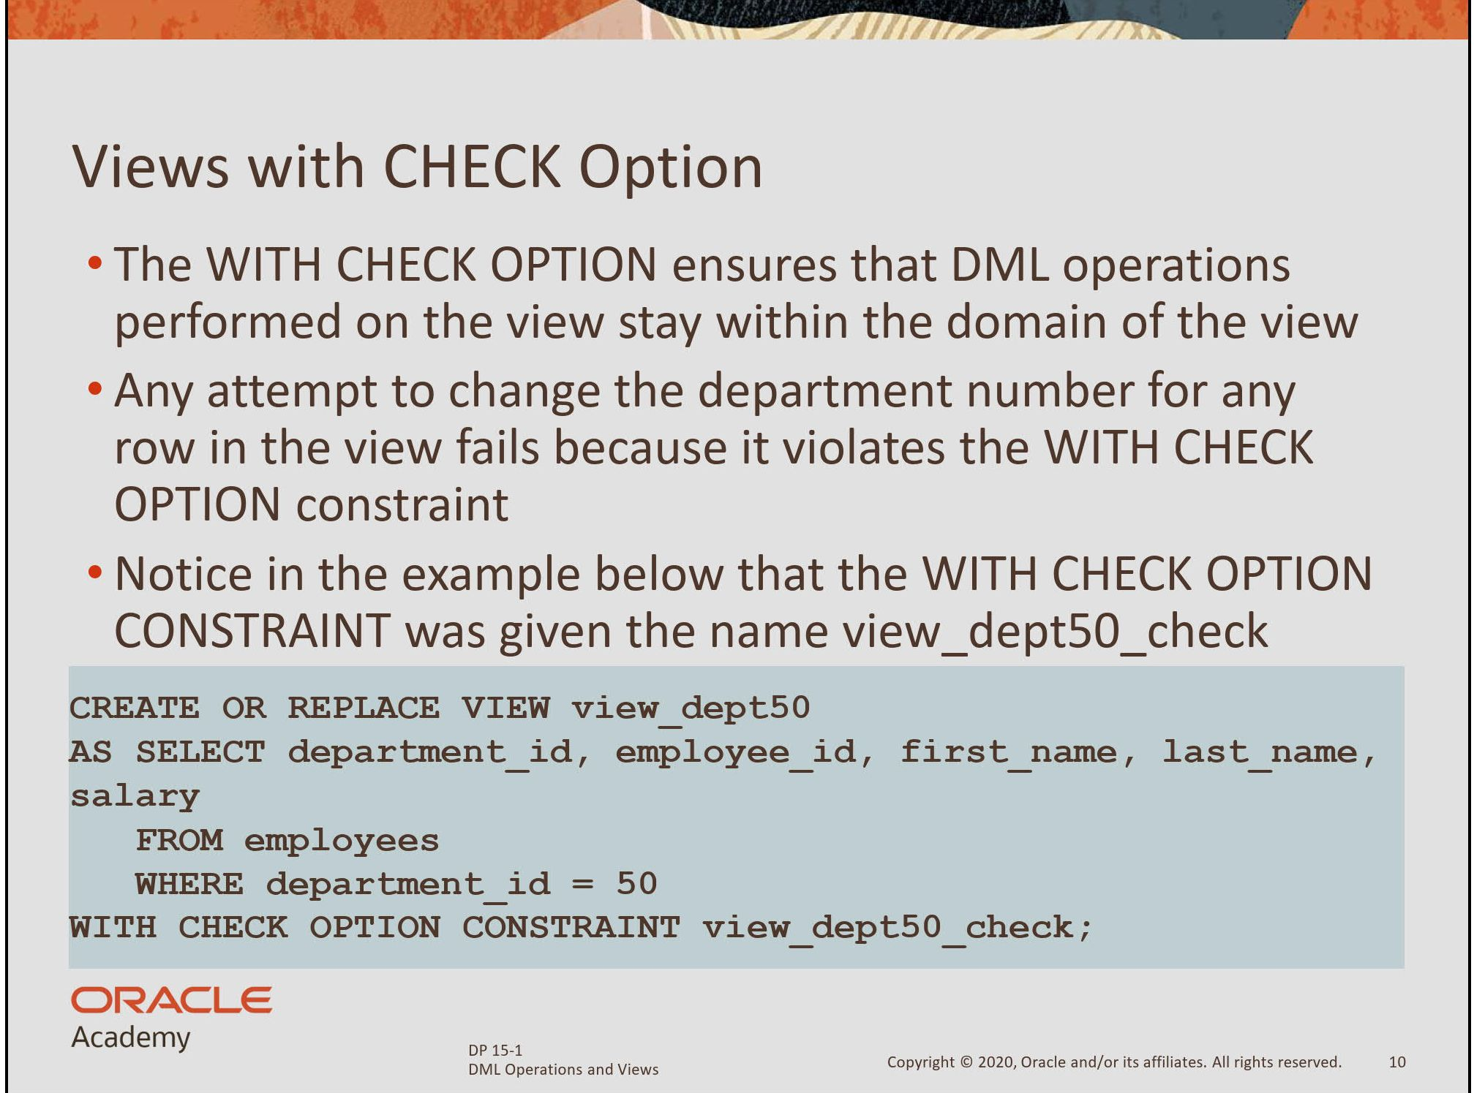

Slide 24
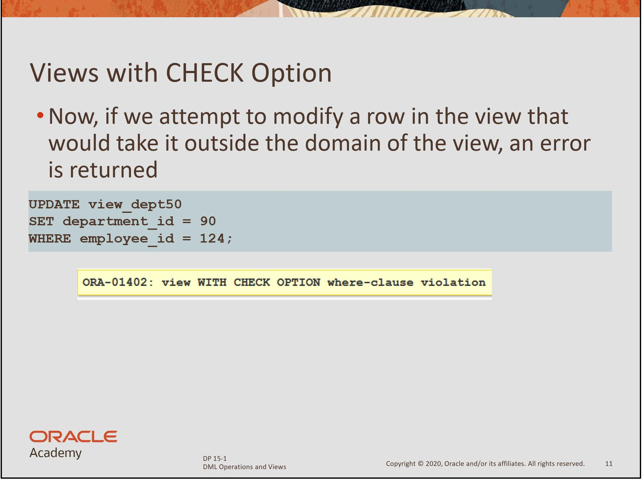

Slide 25
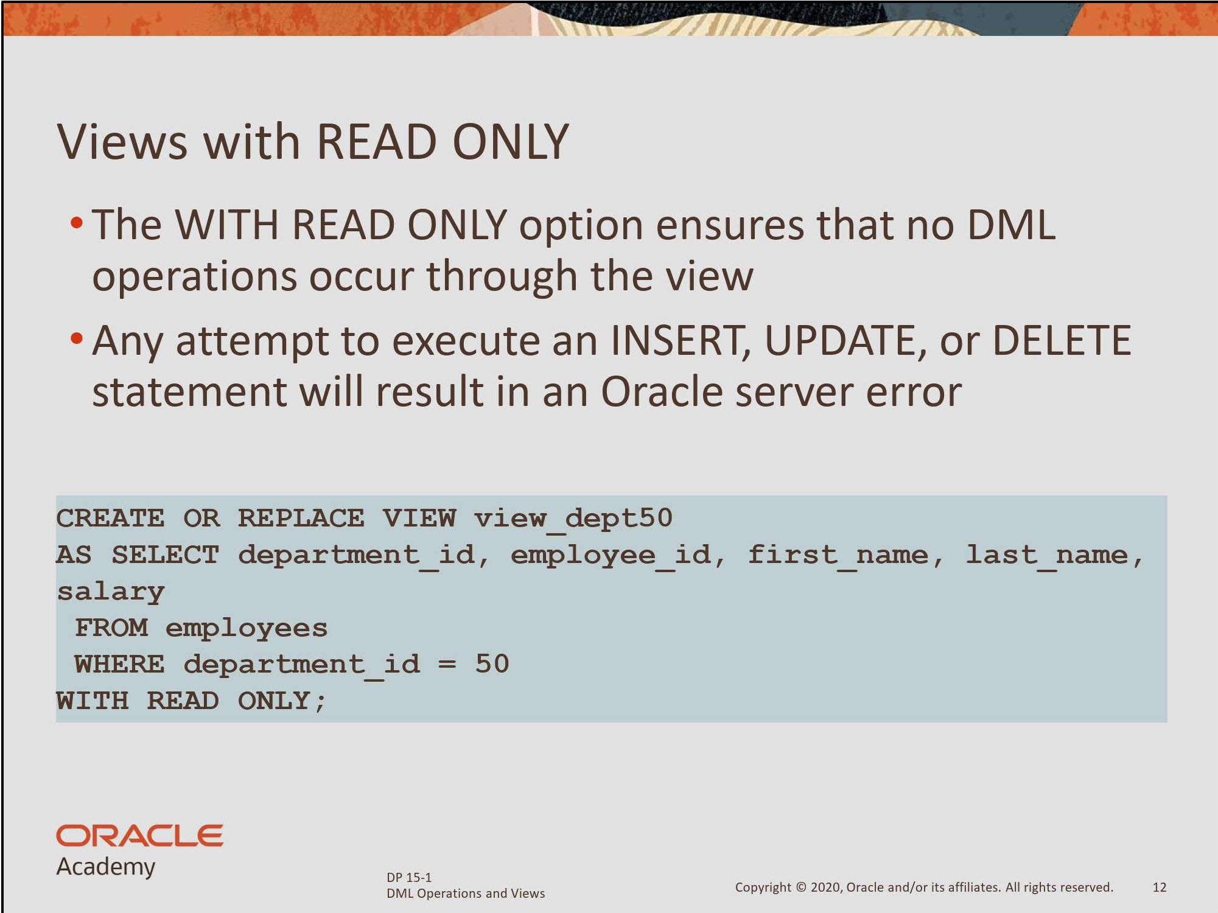

Slide 26
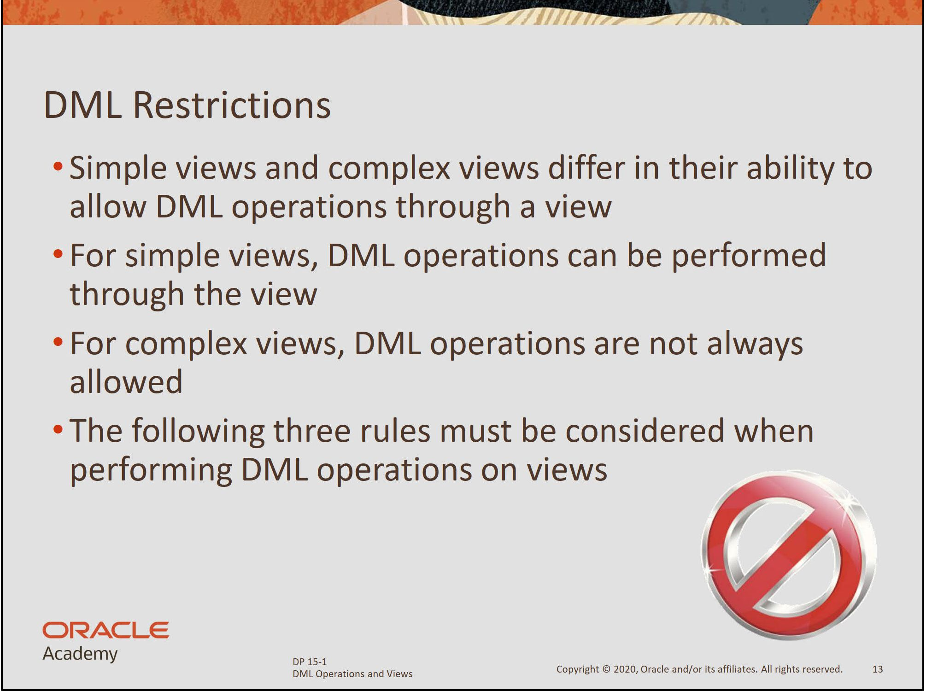

Slide 27
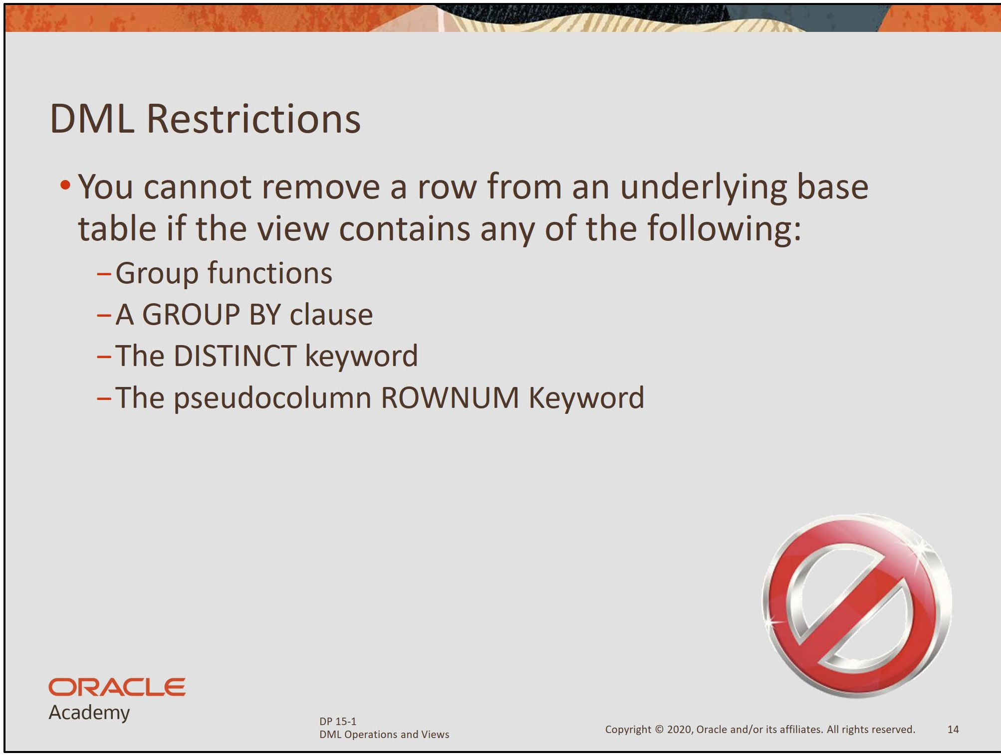

Slide 28
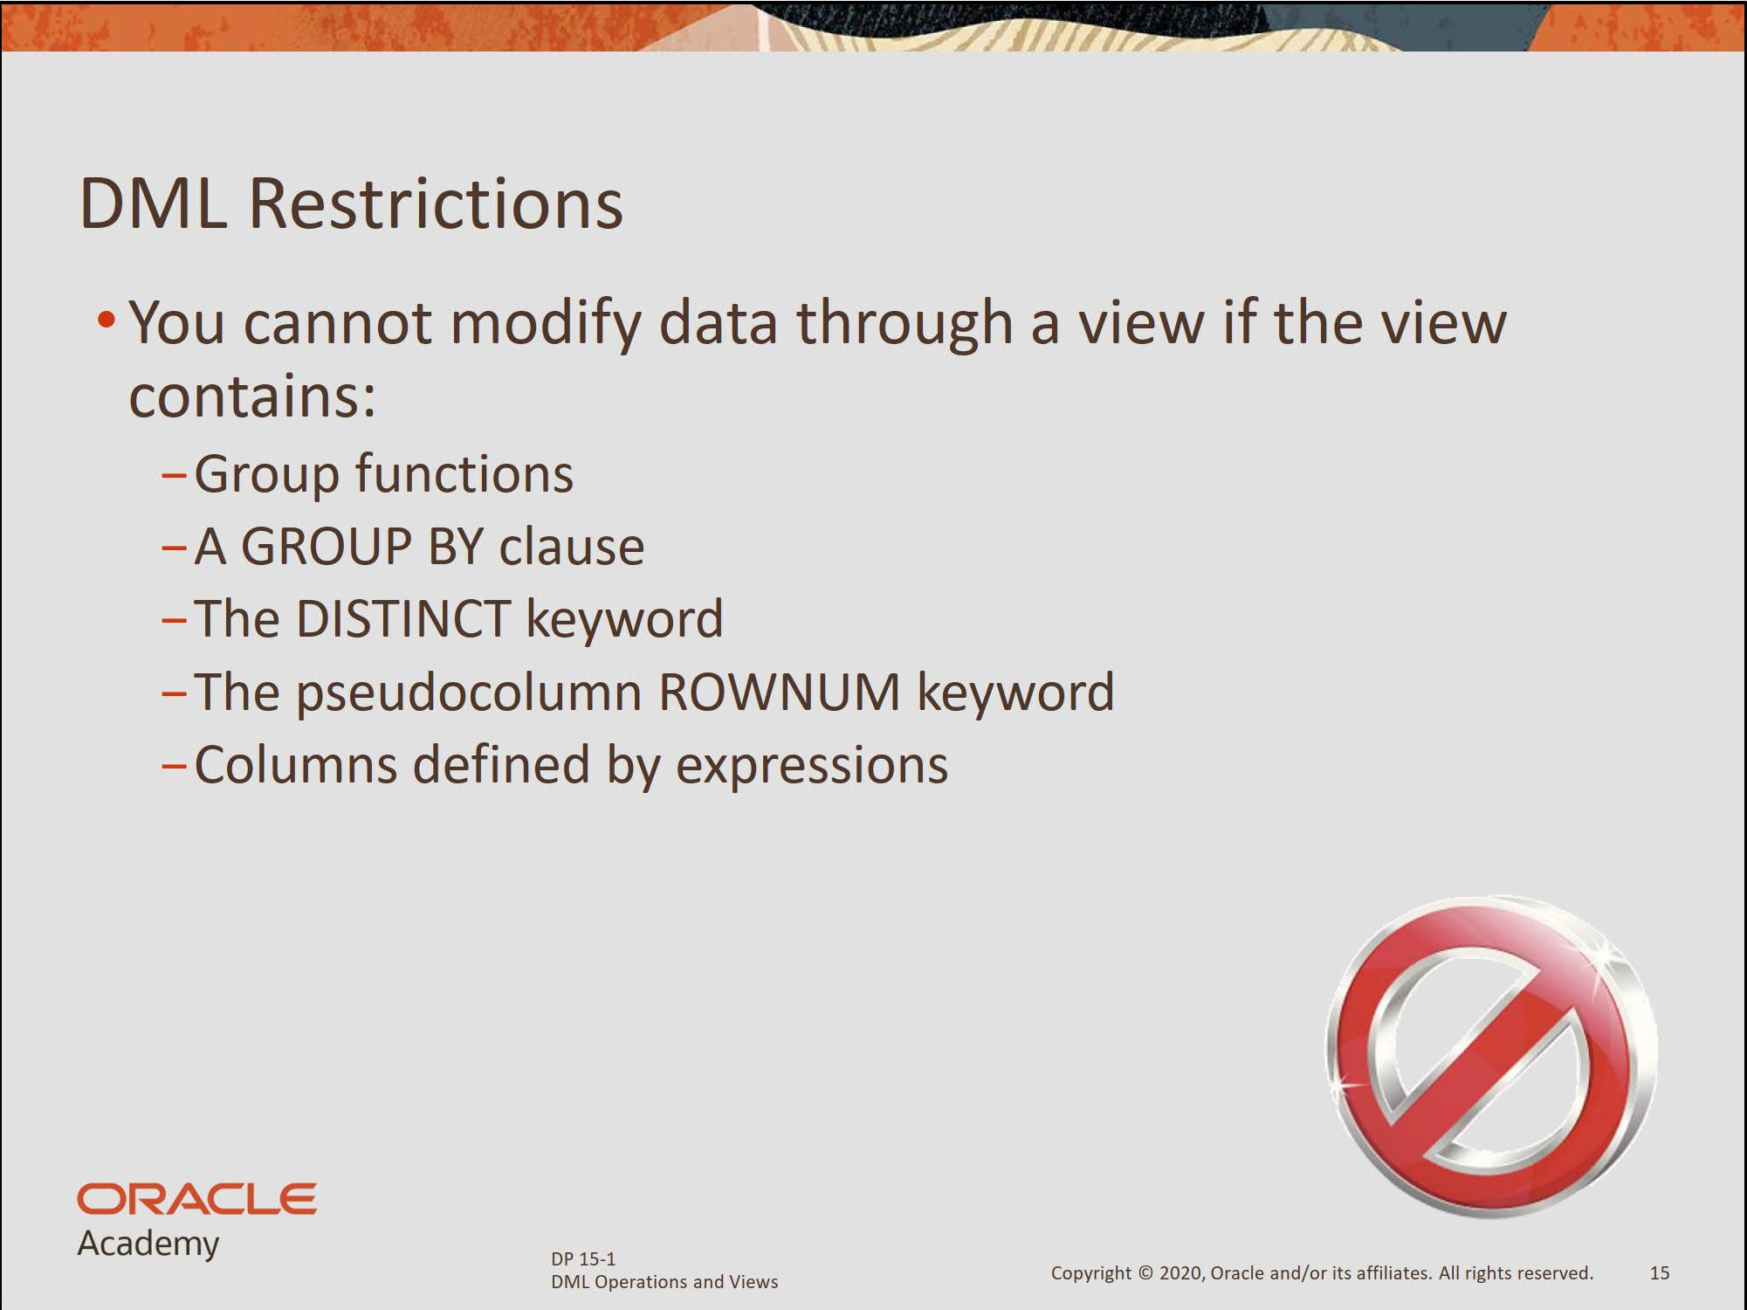

Slide 29
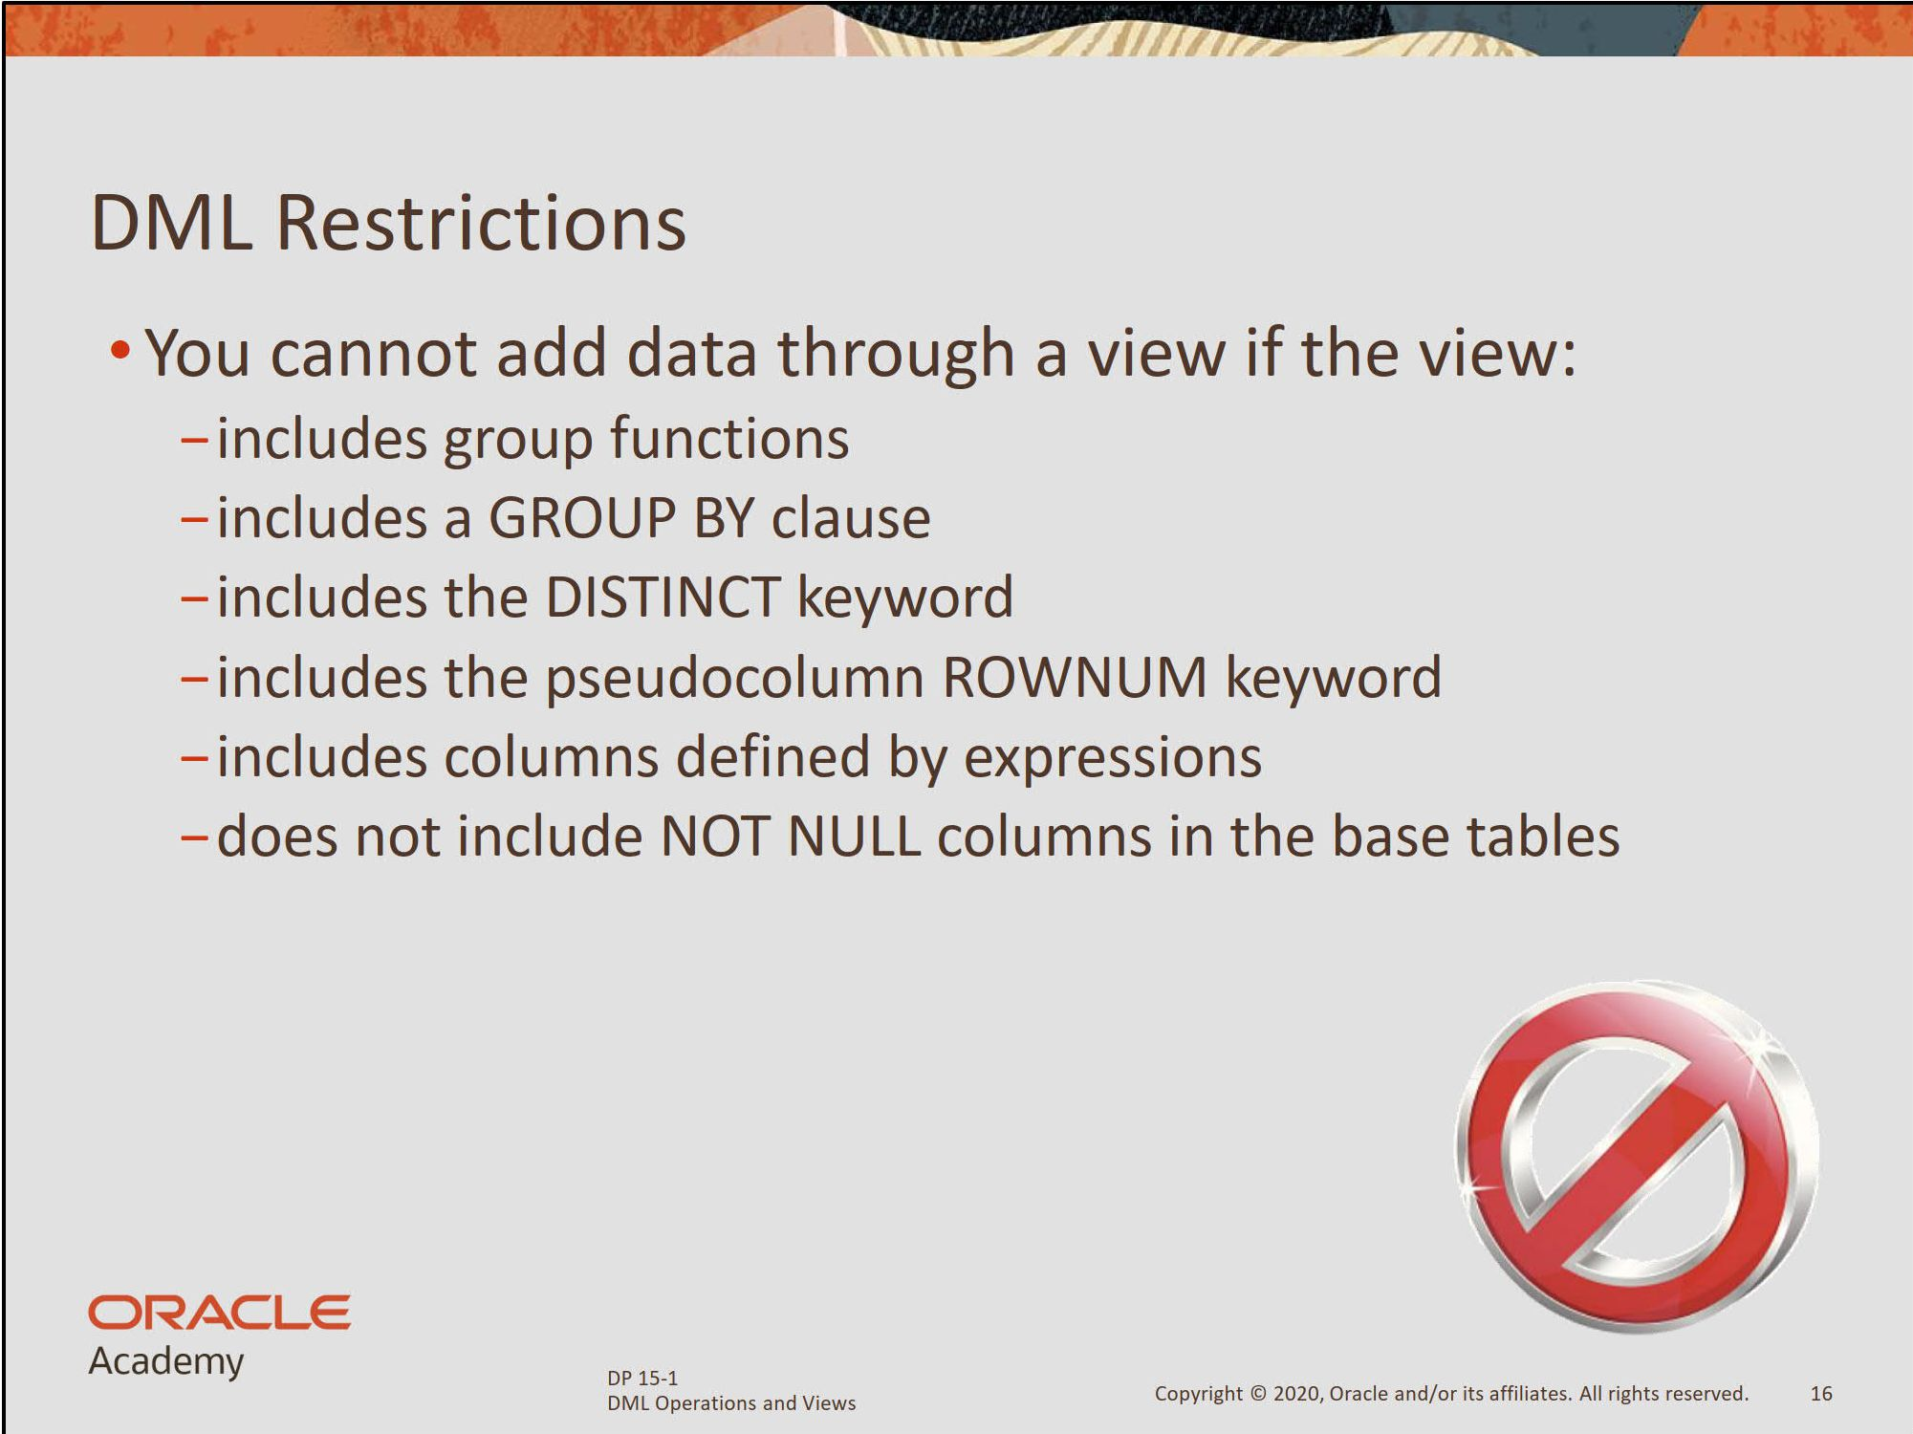

Slide 30
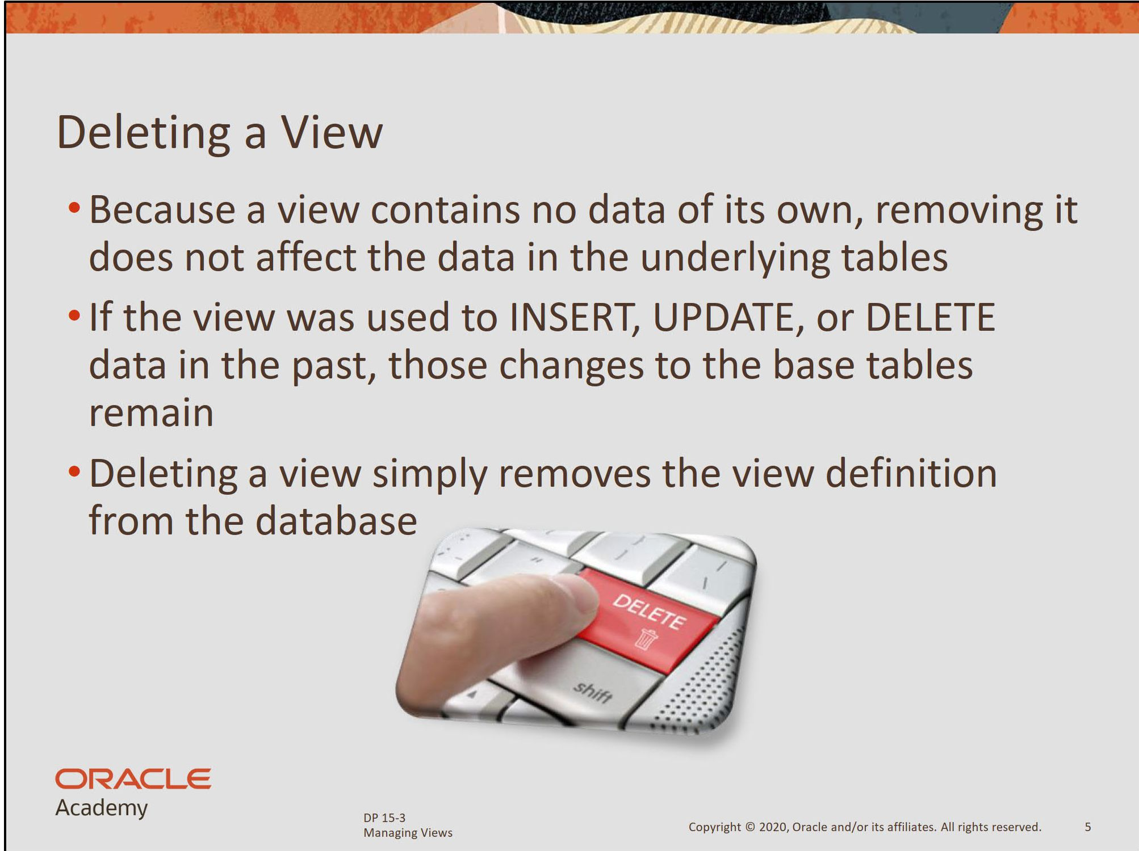

Slide 31
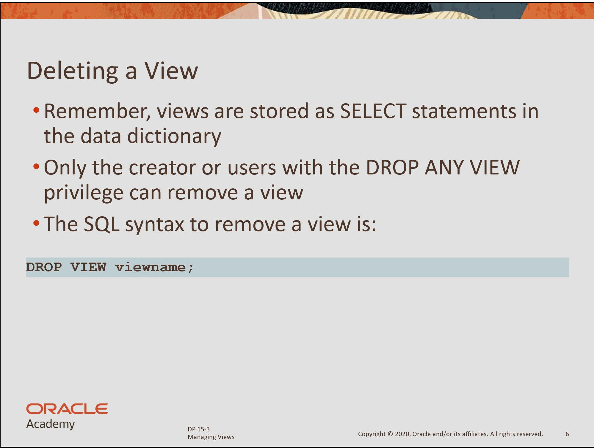

Slide 32
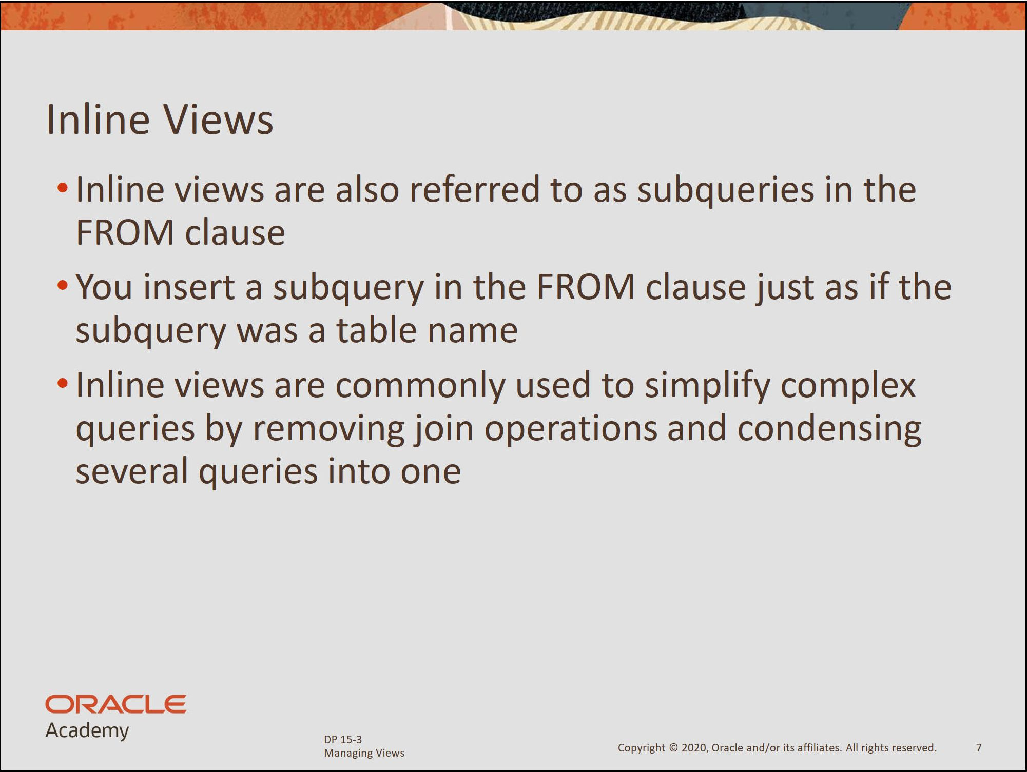

Slide 33
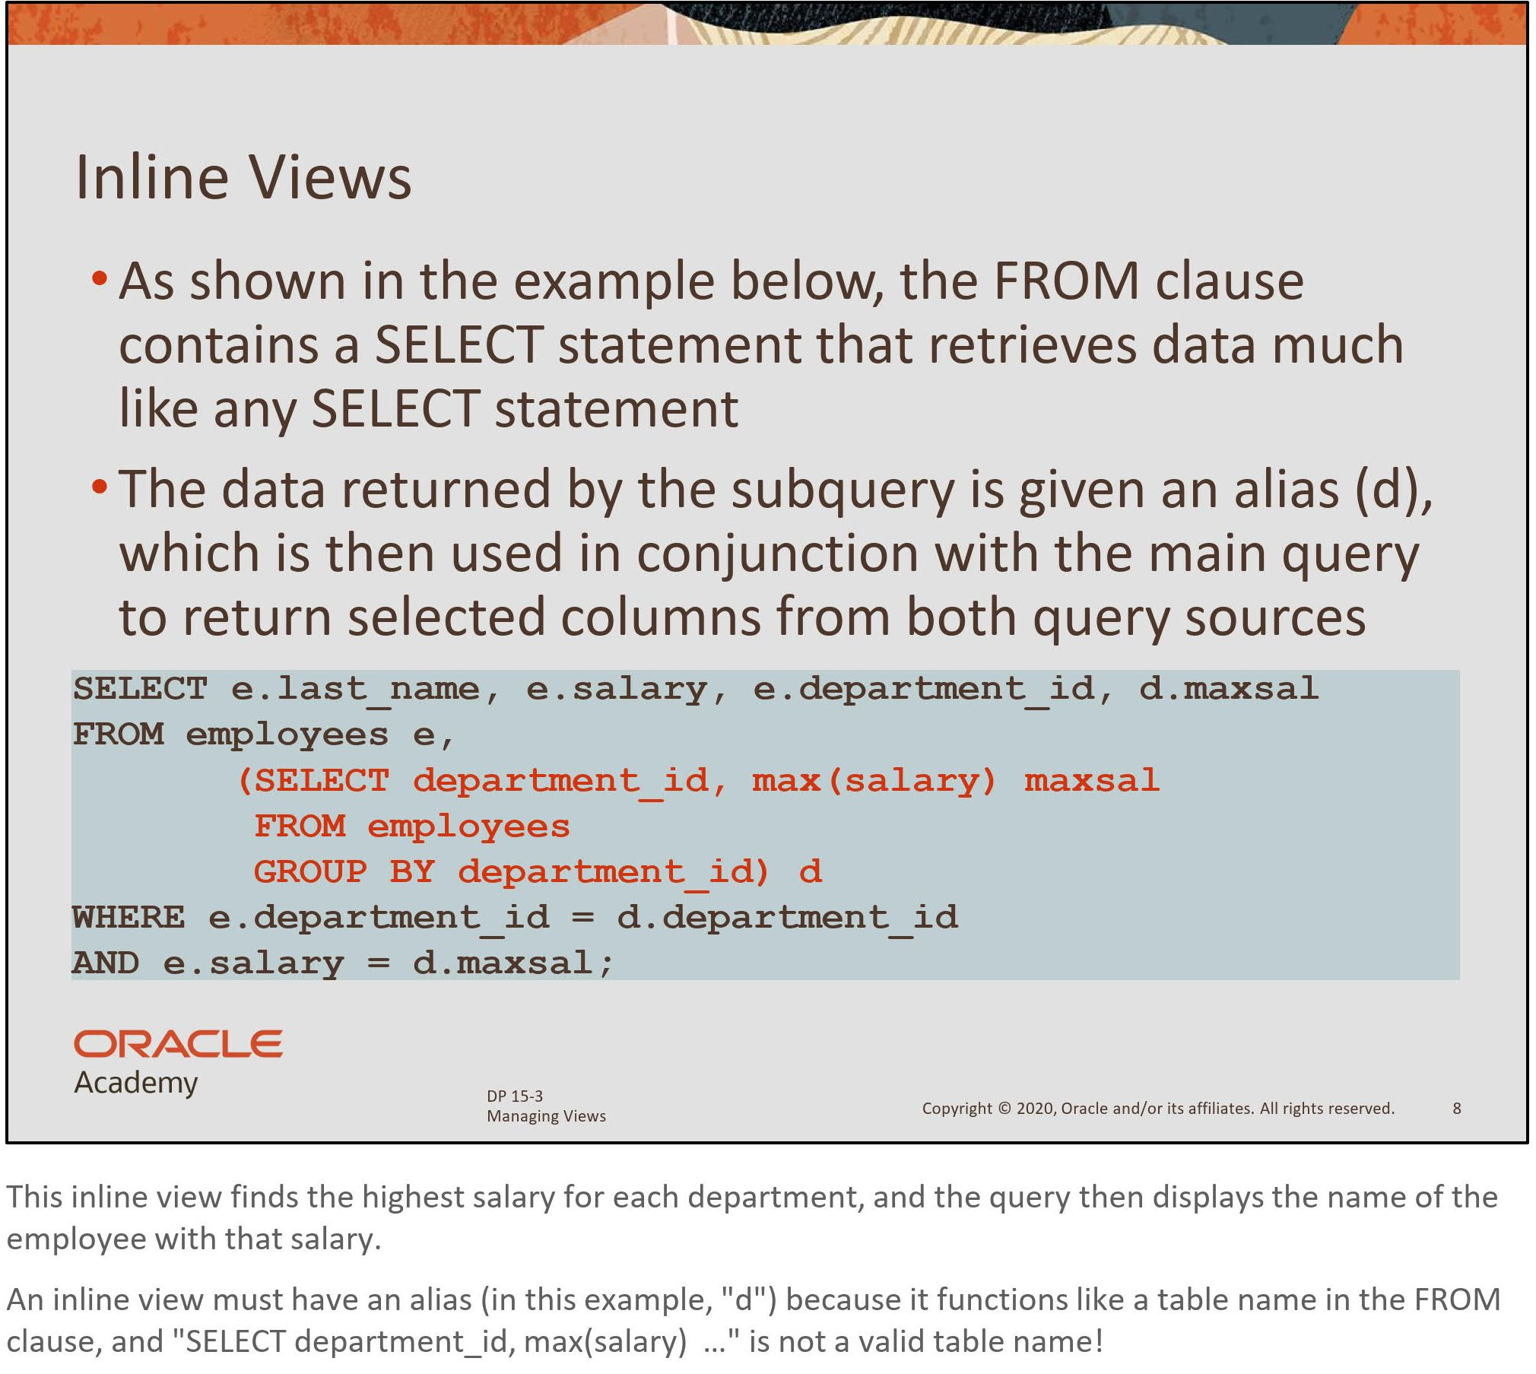

Slide 34
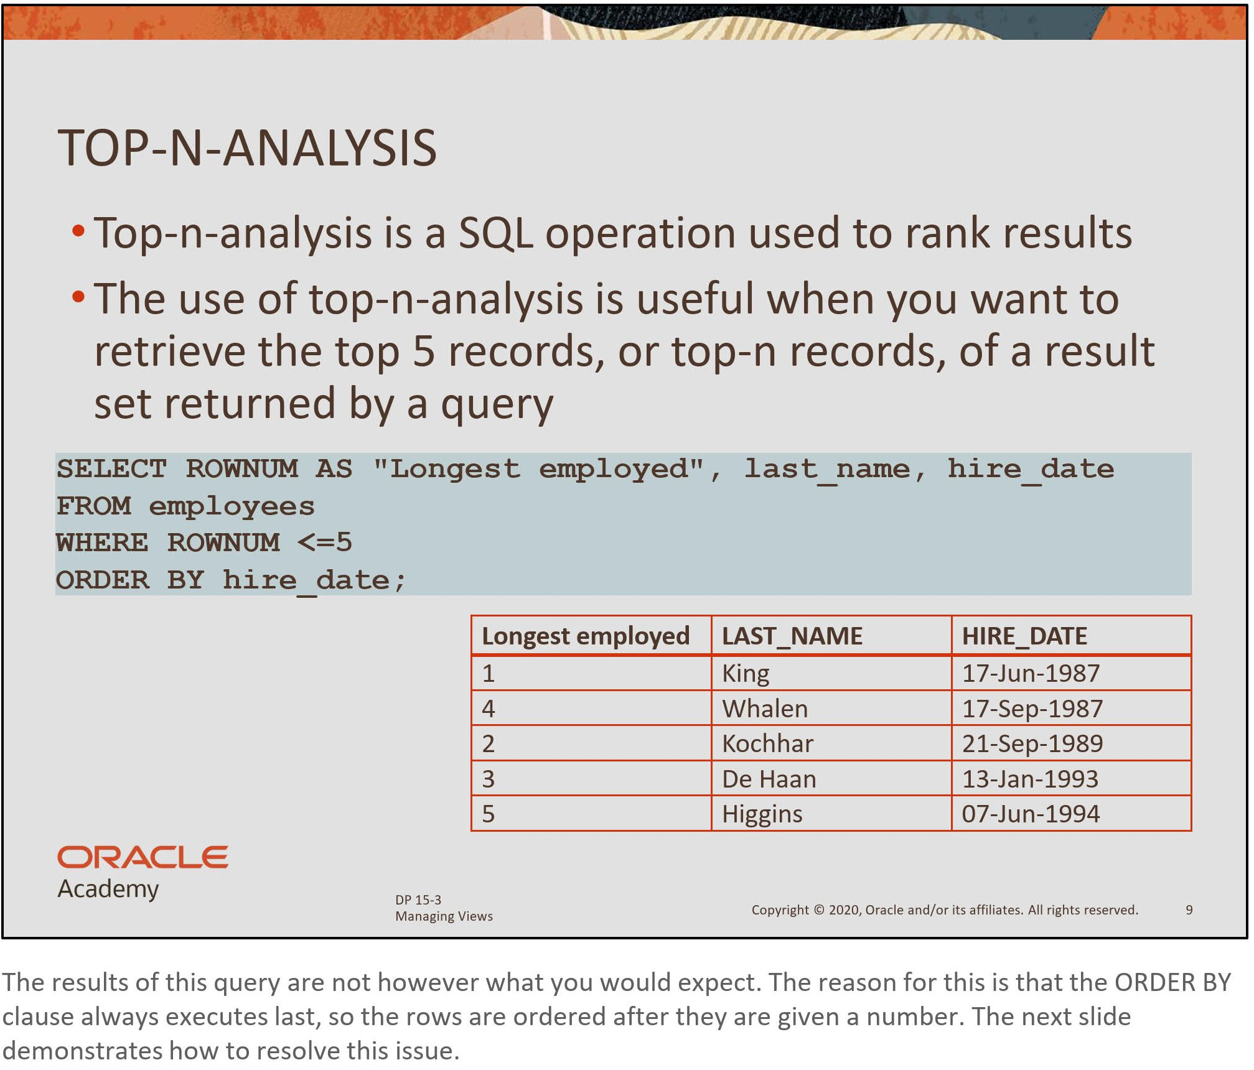

Slide 35
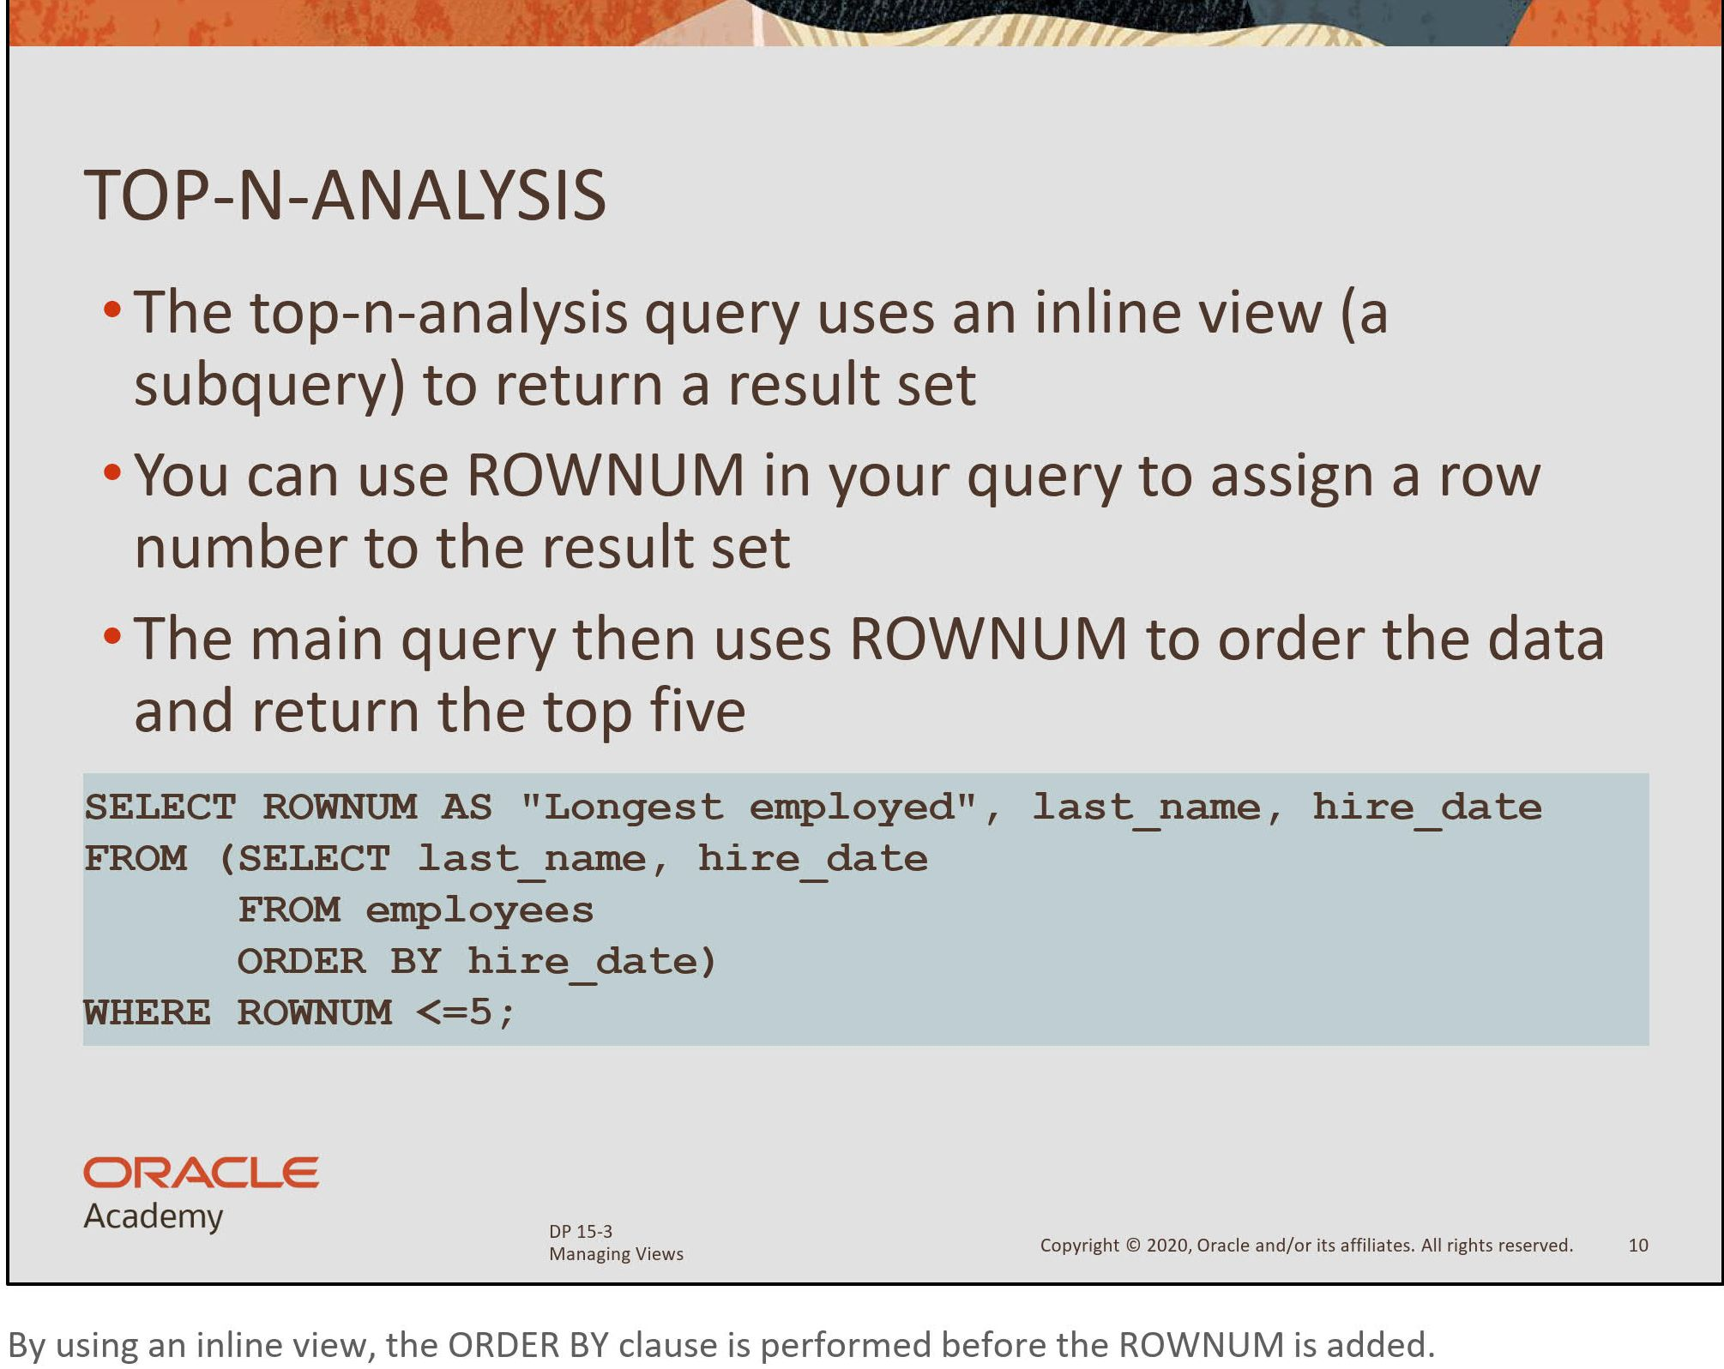

Slide 36
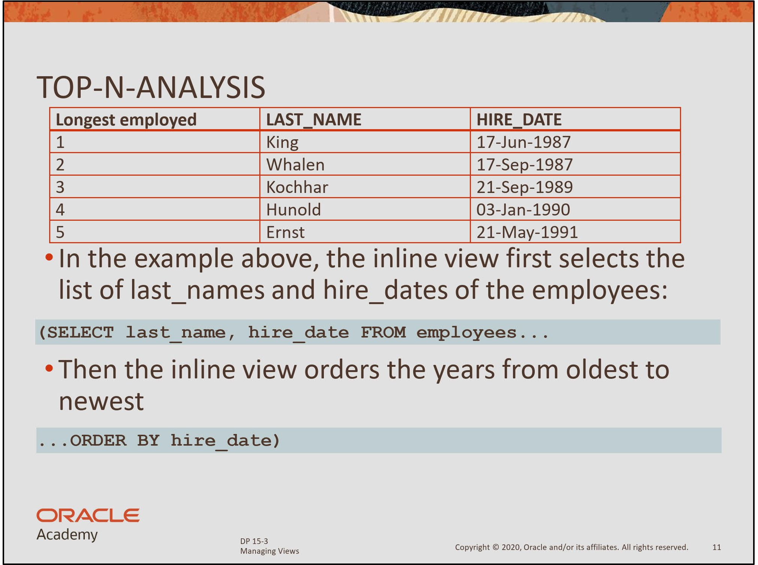

Slide 37
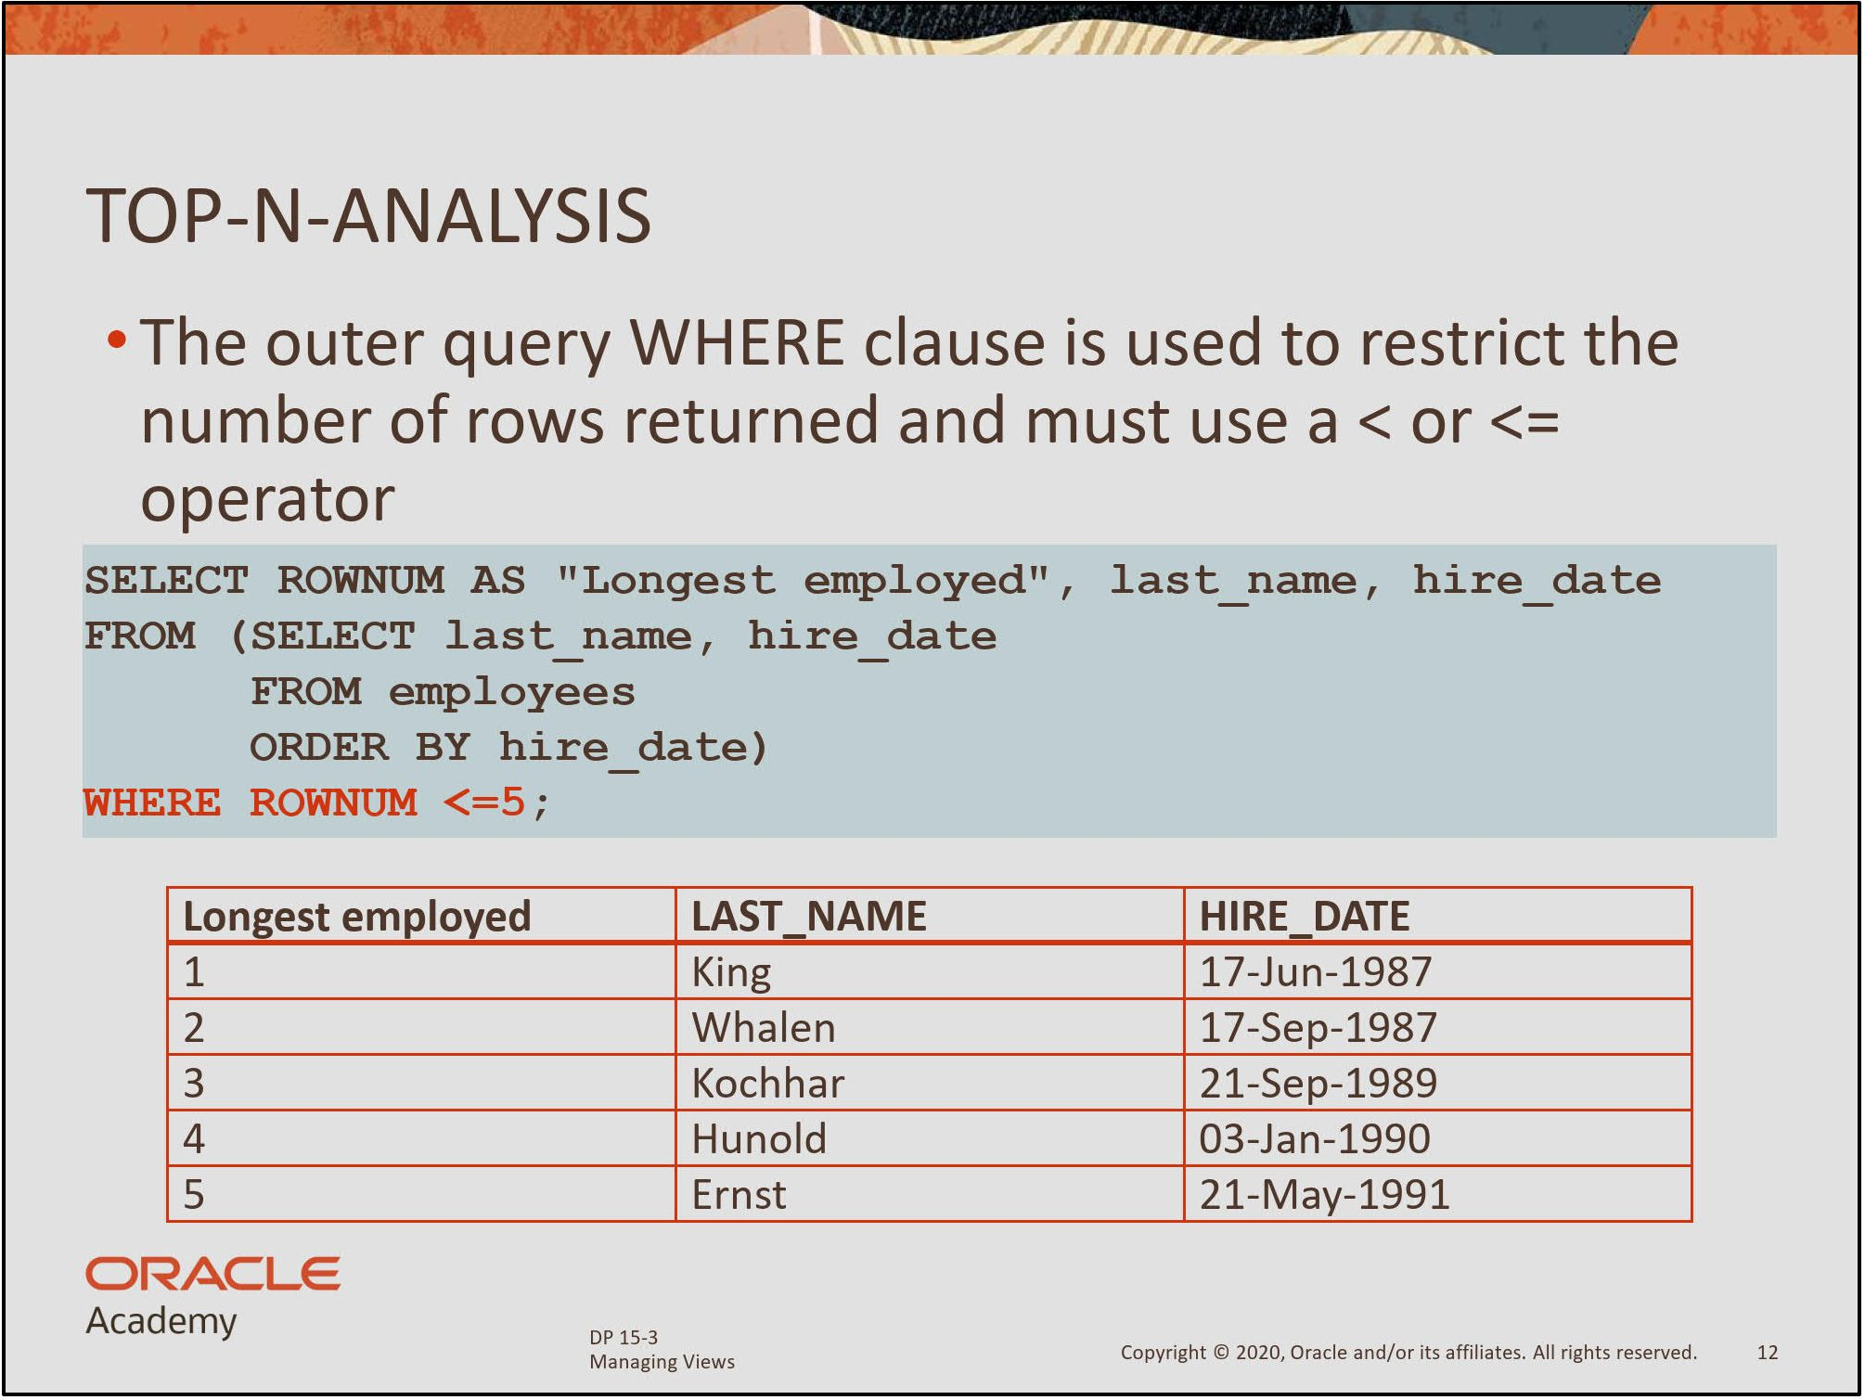

Slide 38
Joining tables with matching and unmatched data

Slide 39
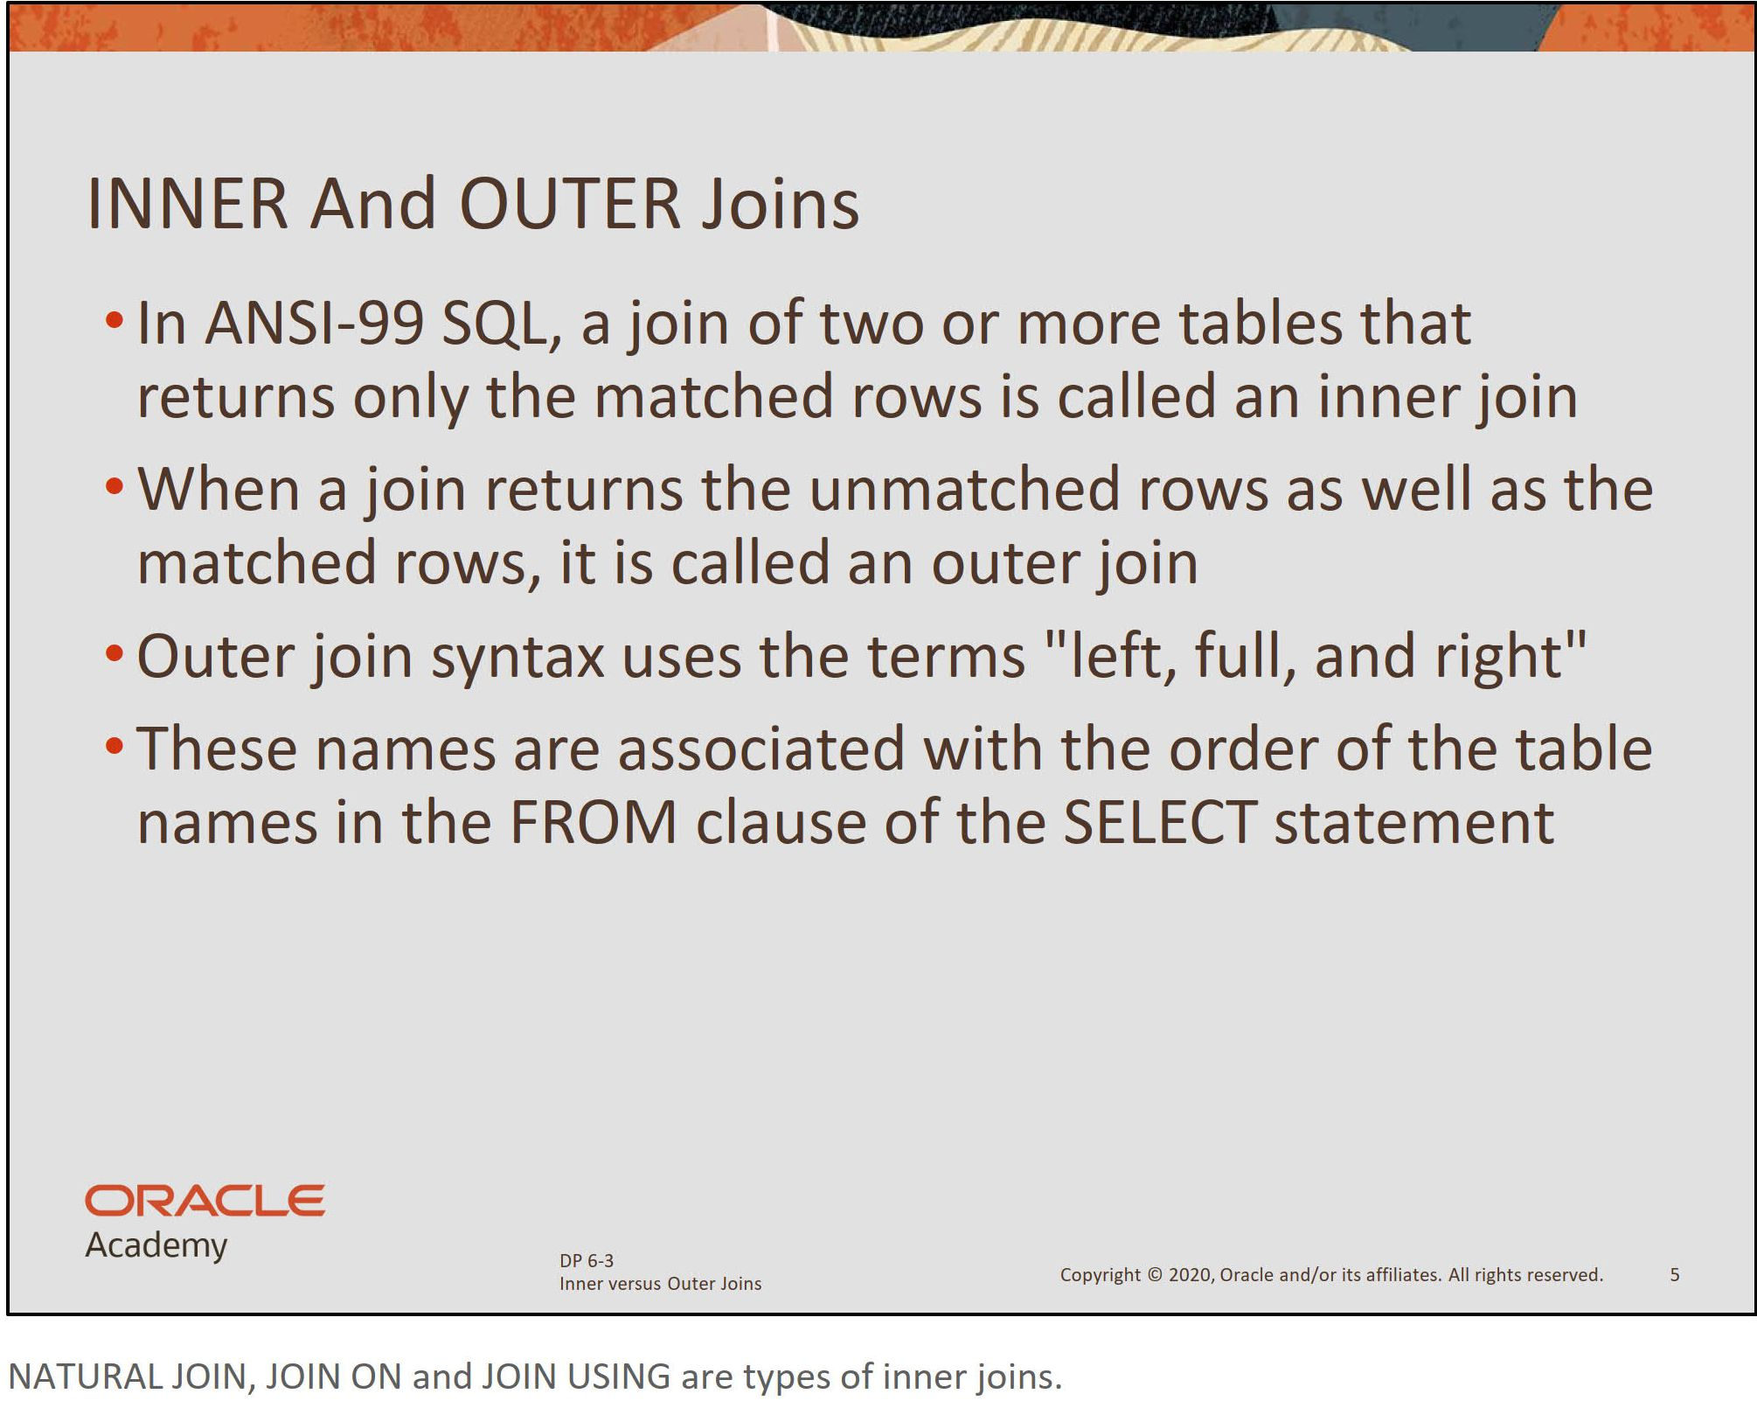

Slide 40
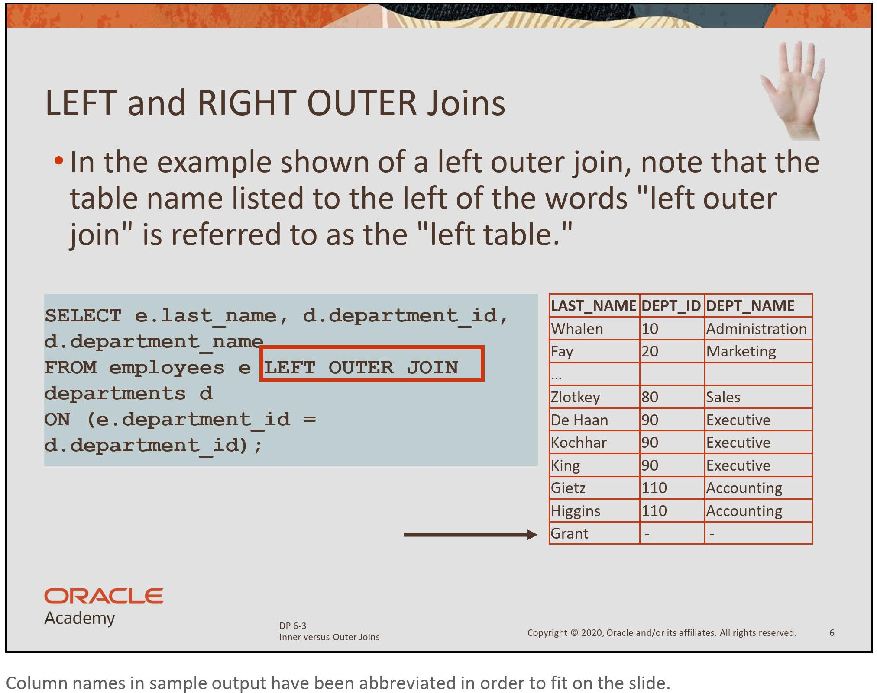

Slide 41
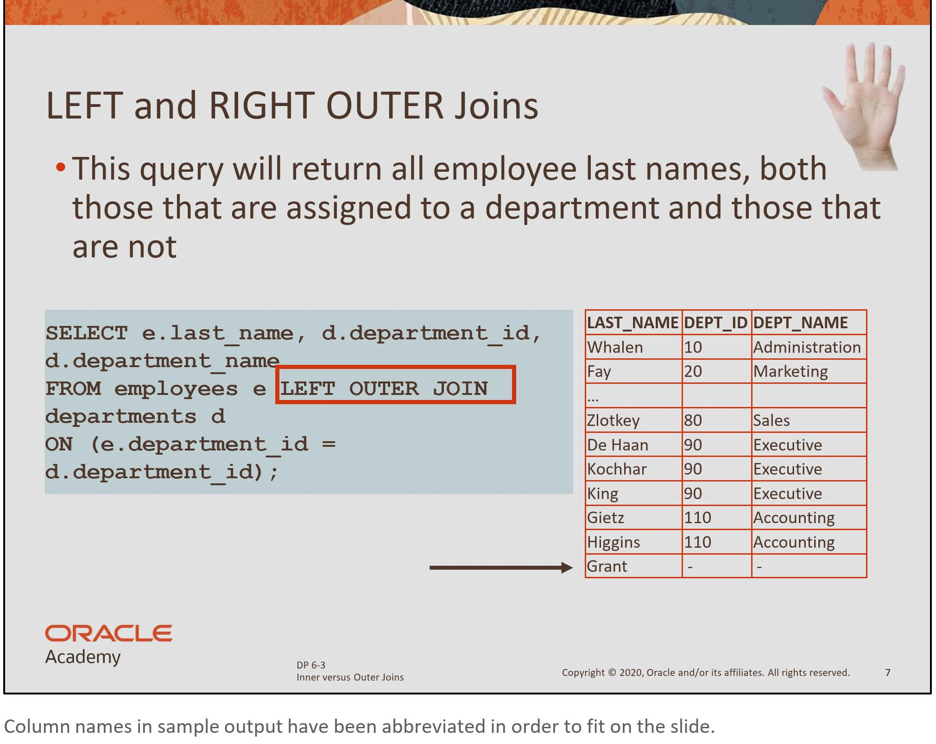

Slide 42
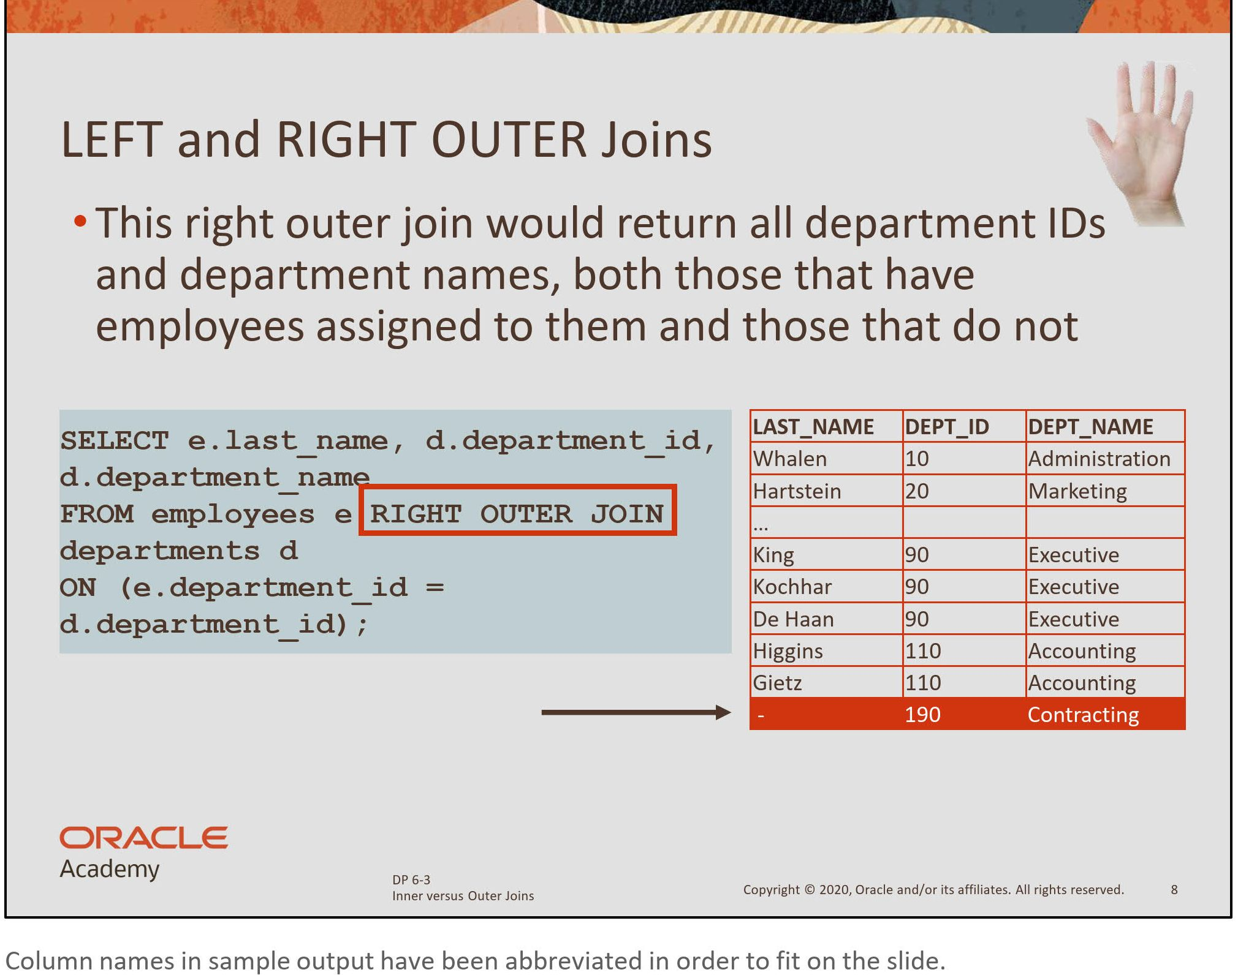

Slide 43
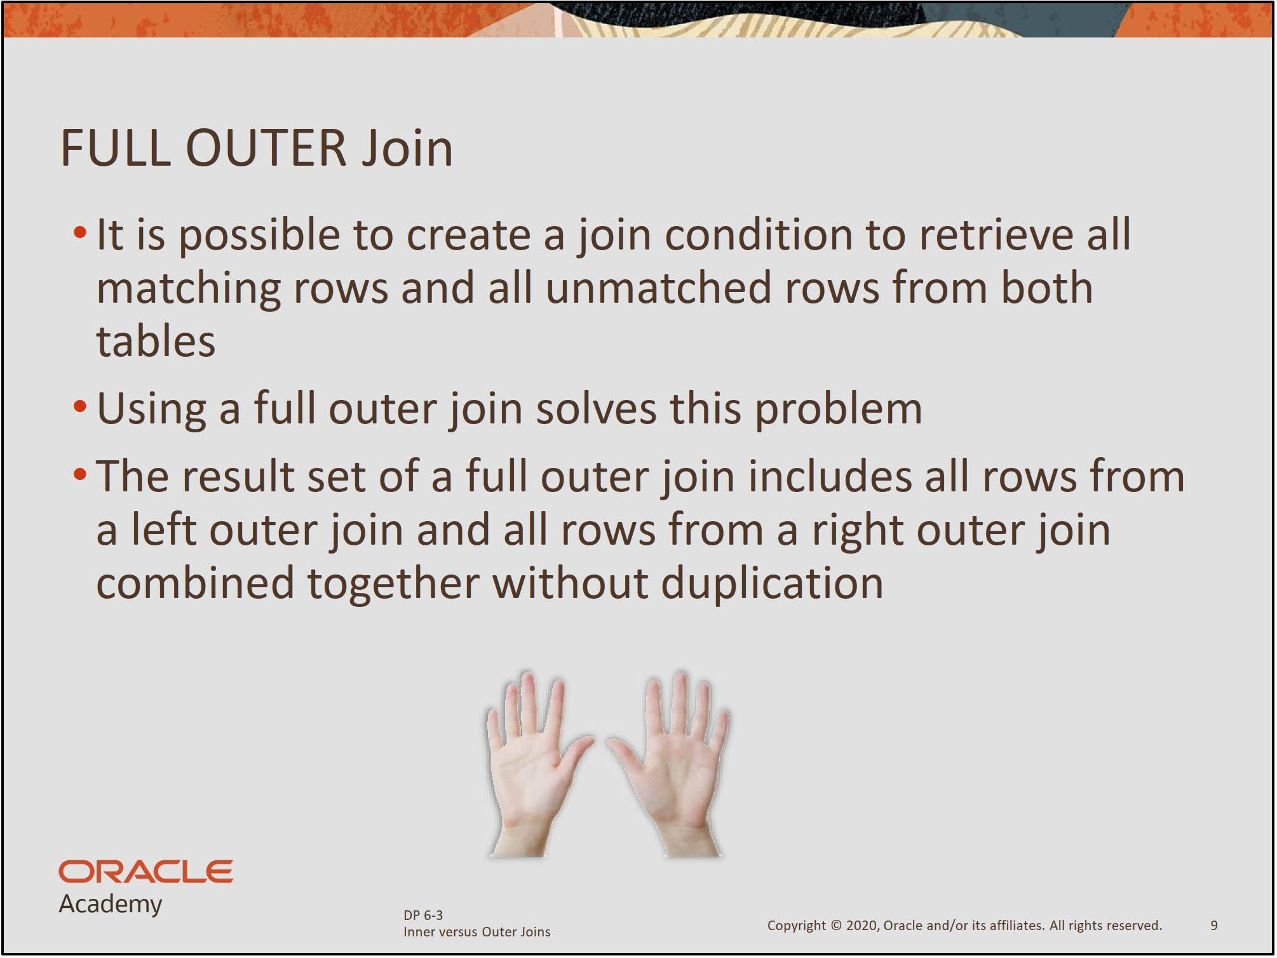

Slide 44
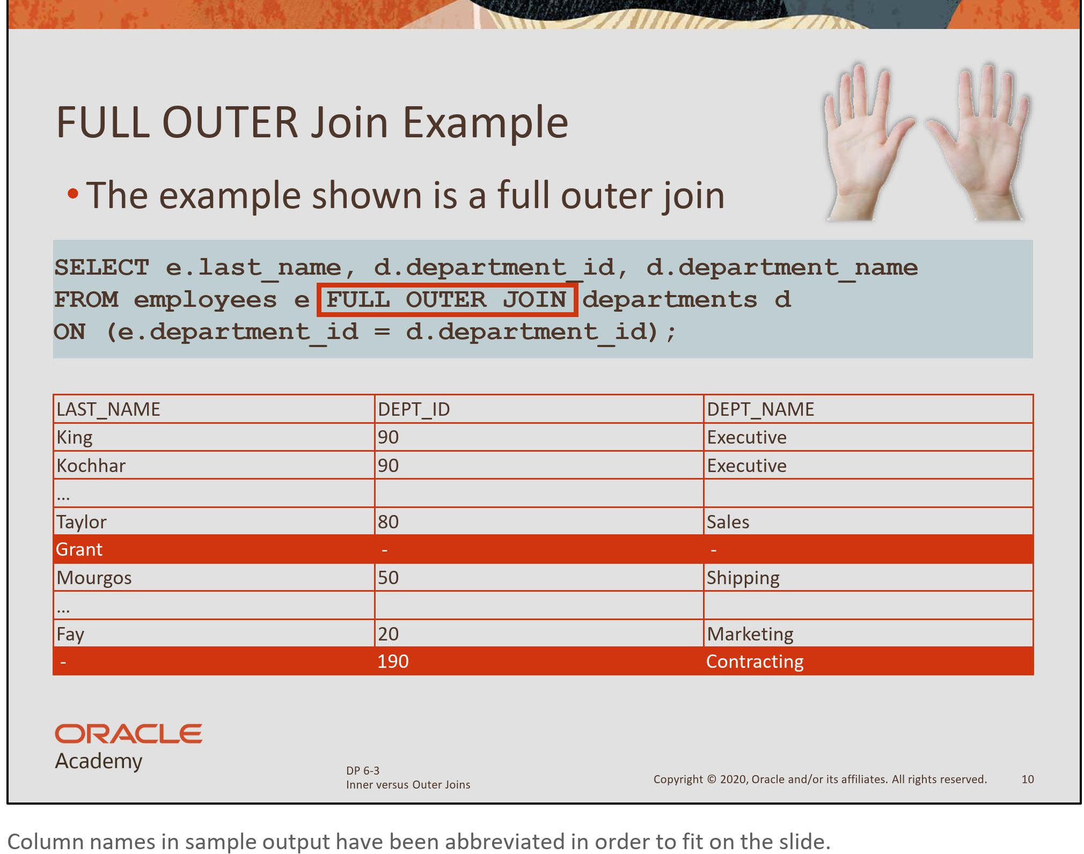

Slide 45
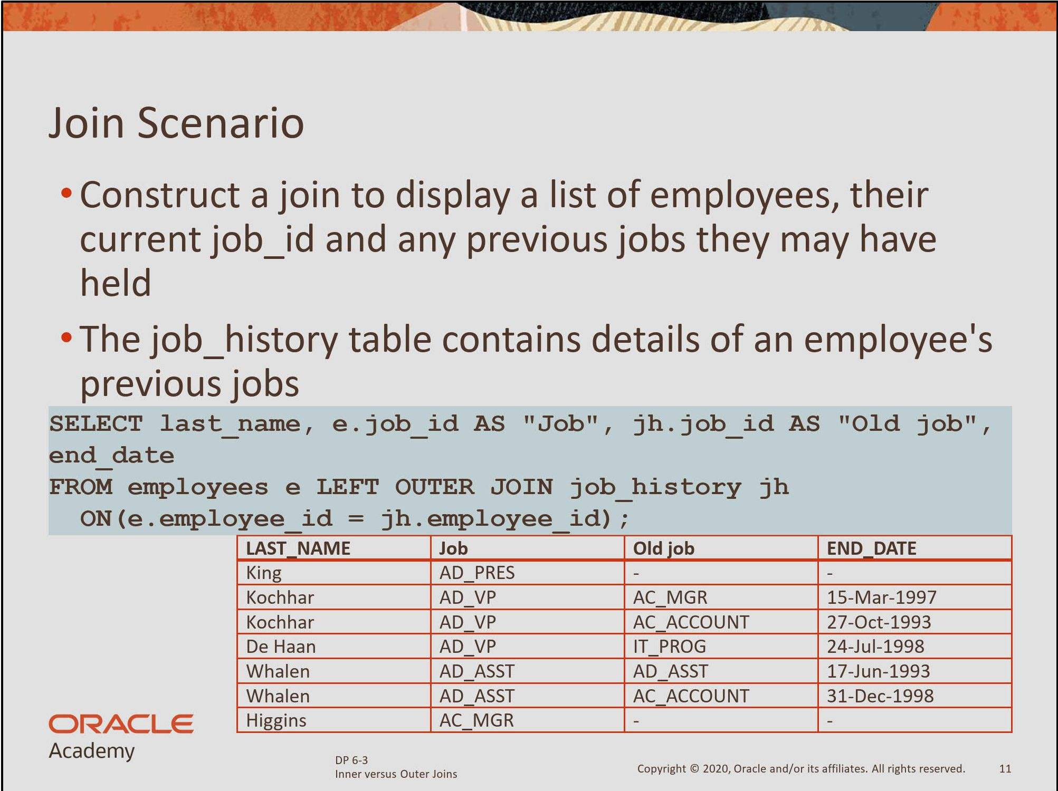

Slide 46
Using the Set Operators

Slide 47
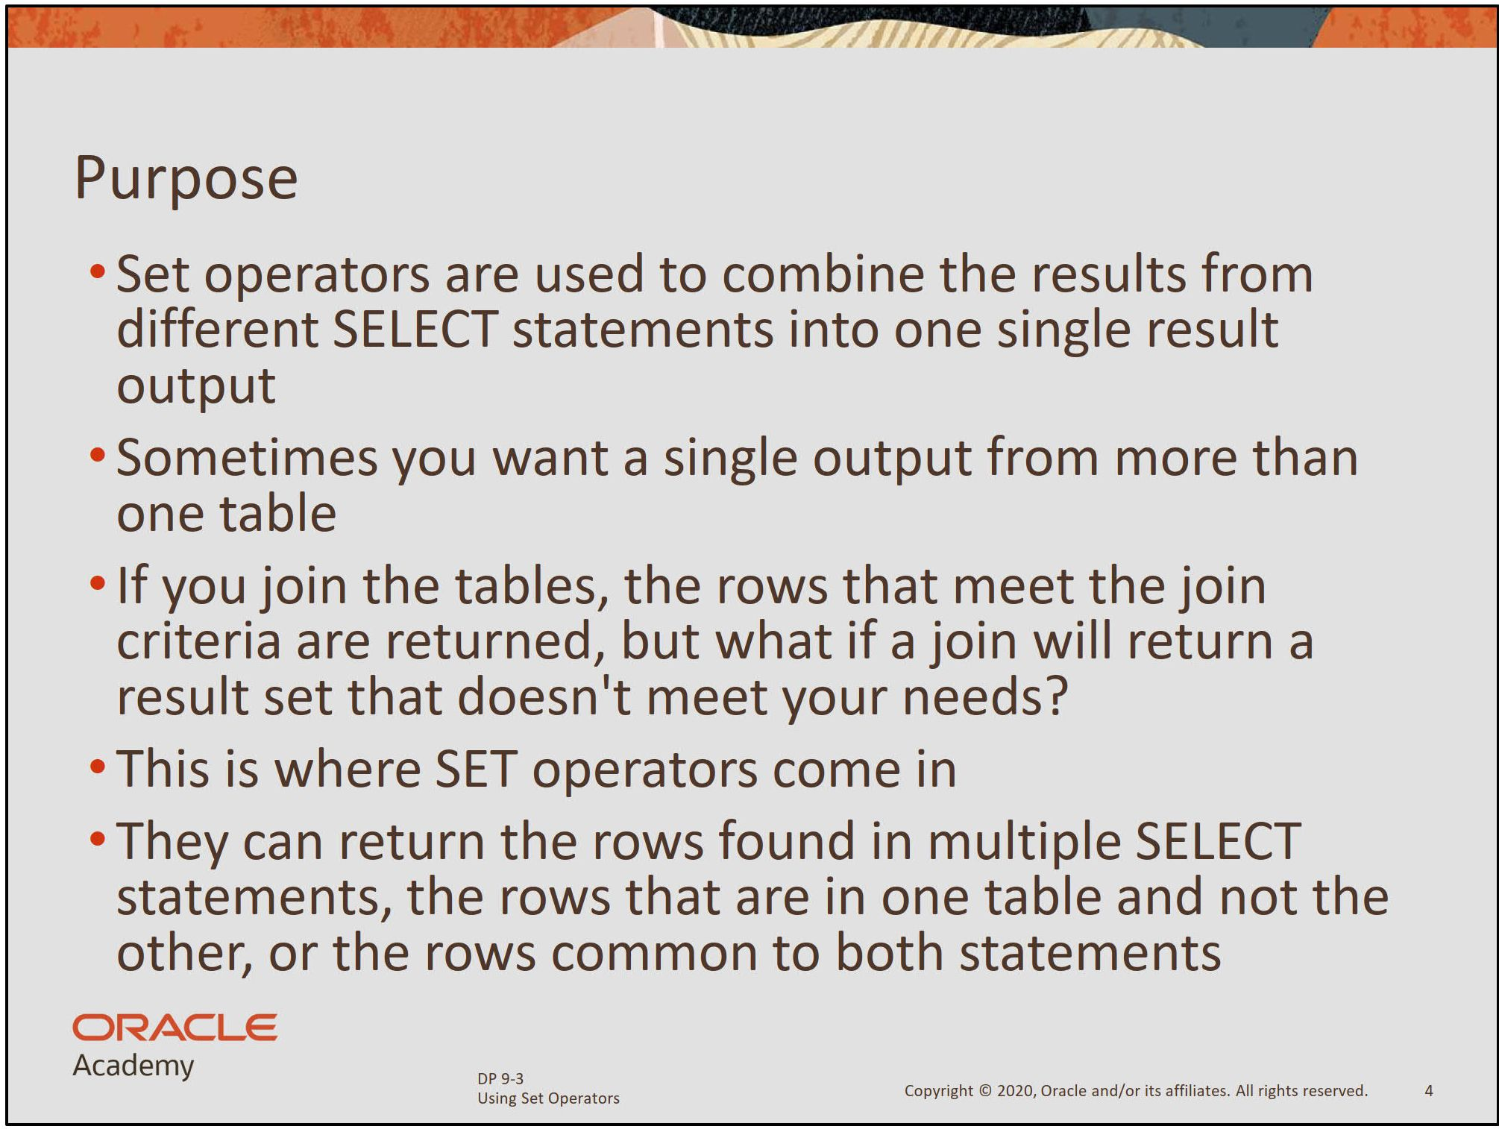

Slide 48
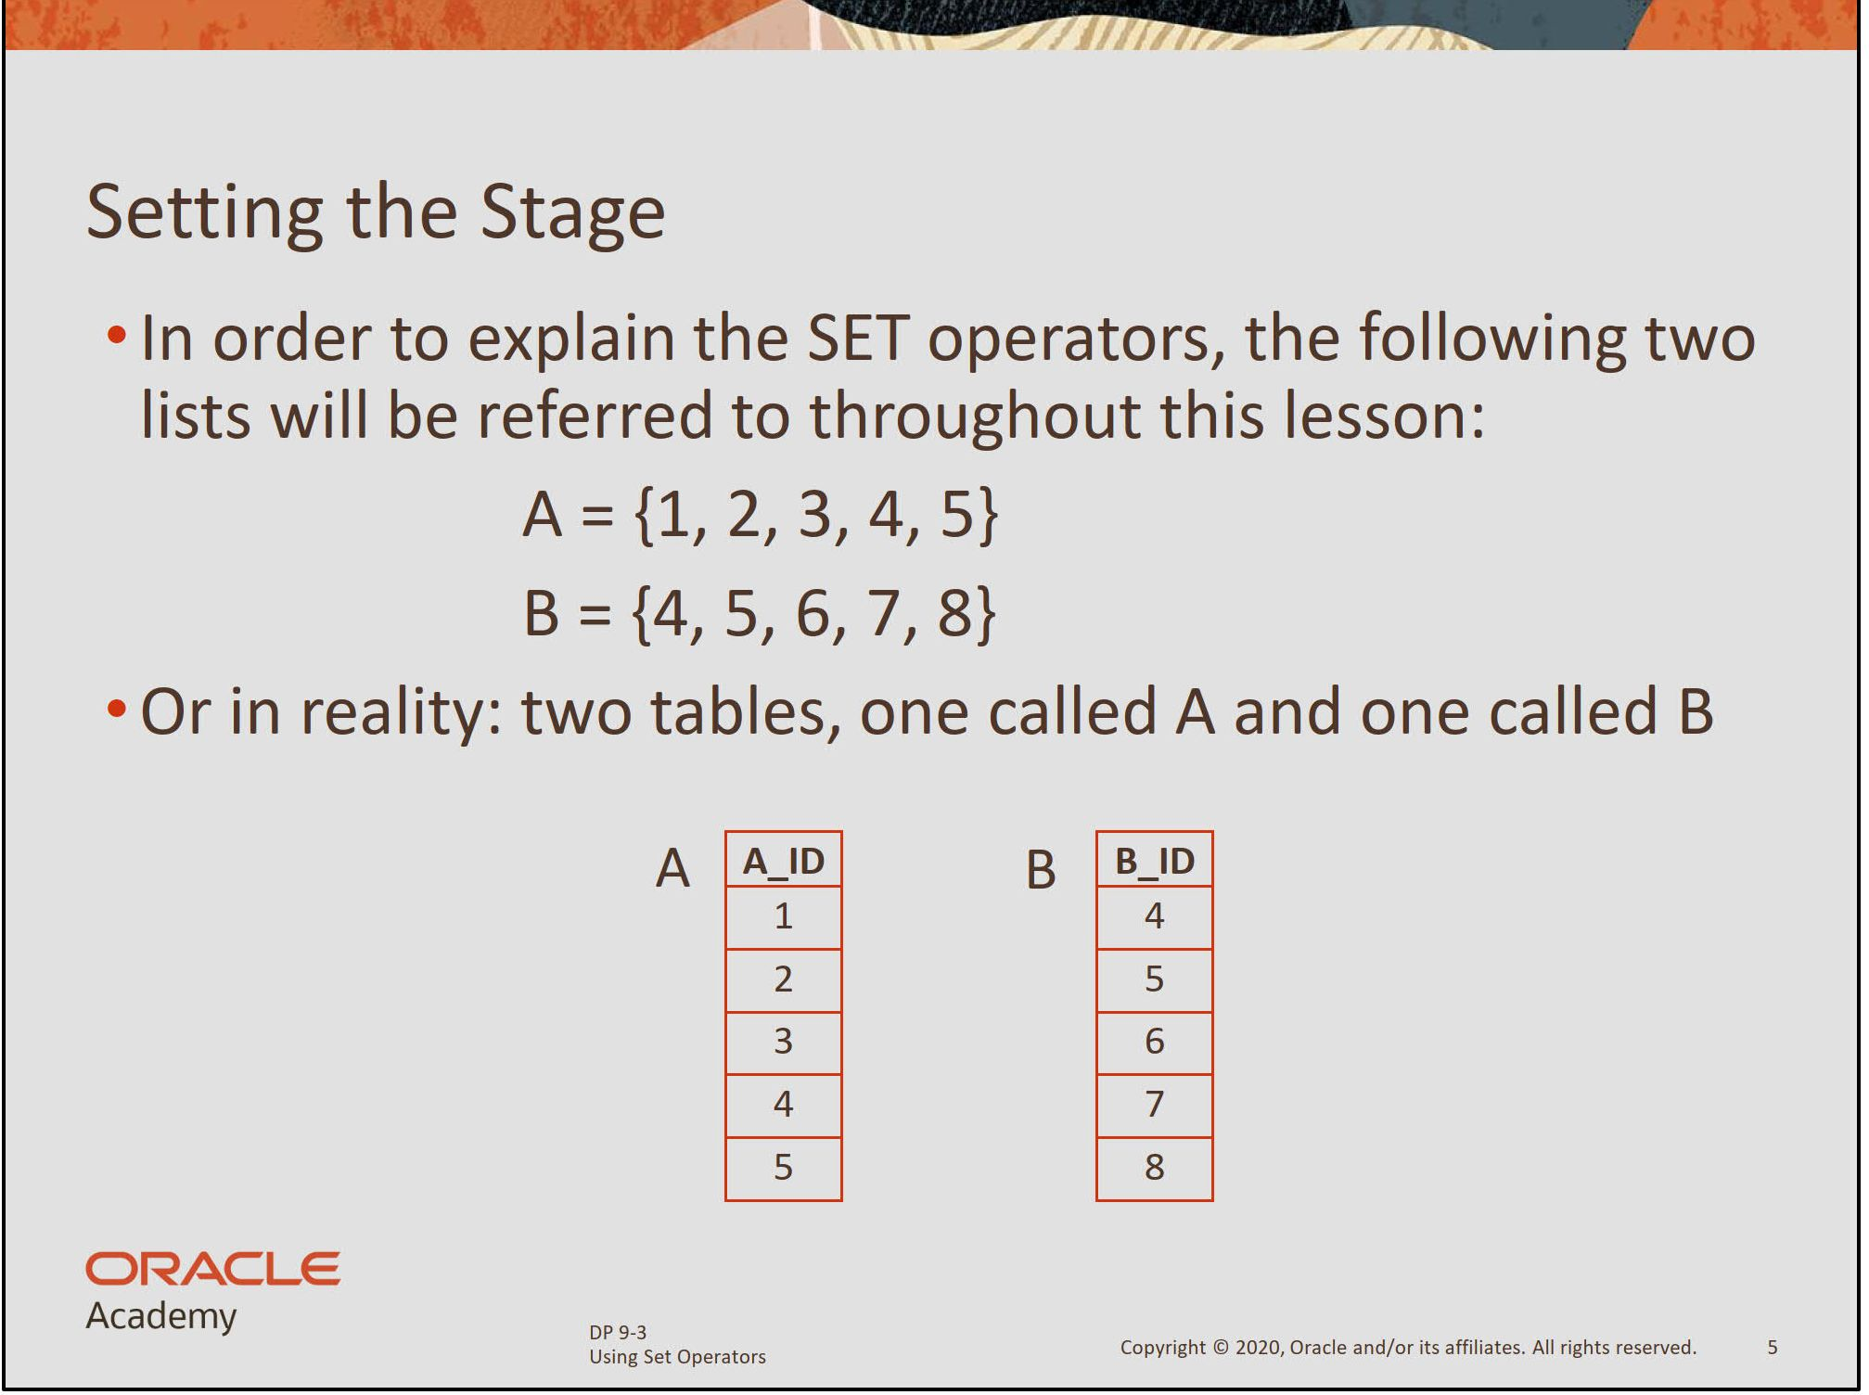

Slide 49
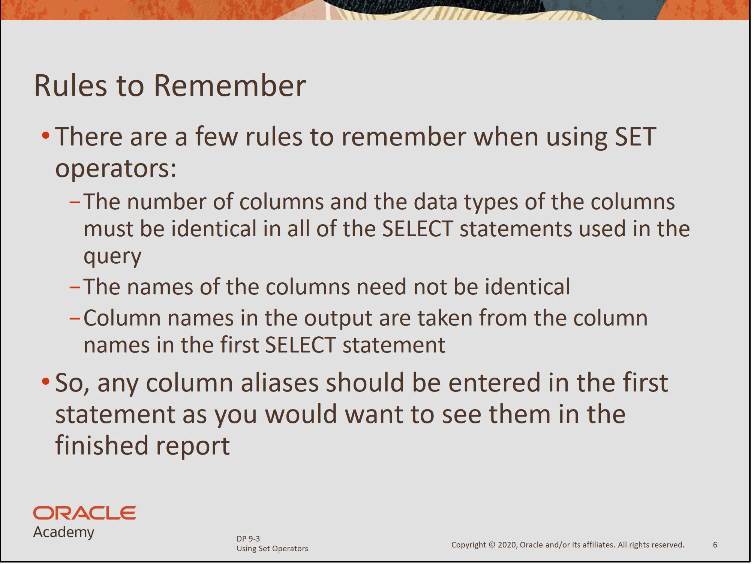

Slide 50
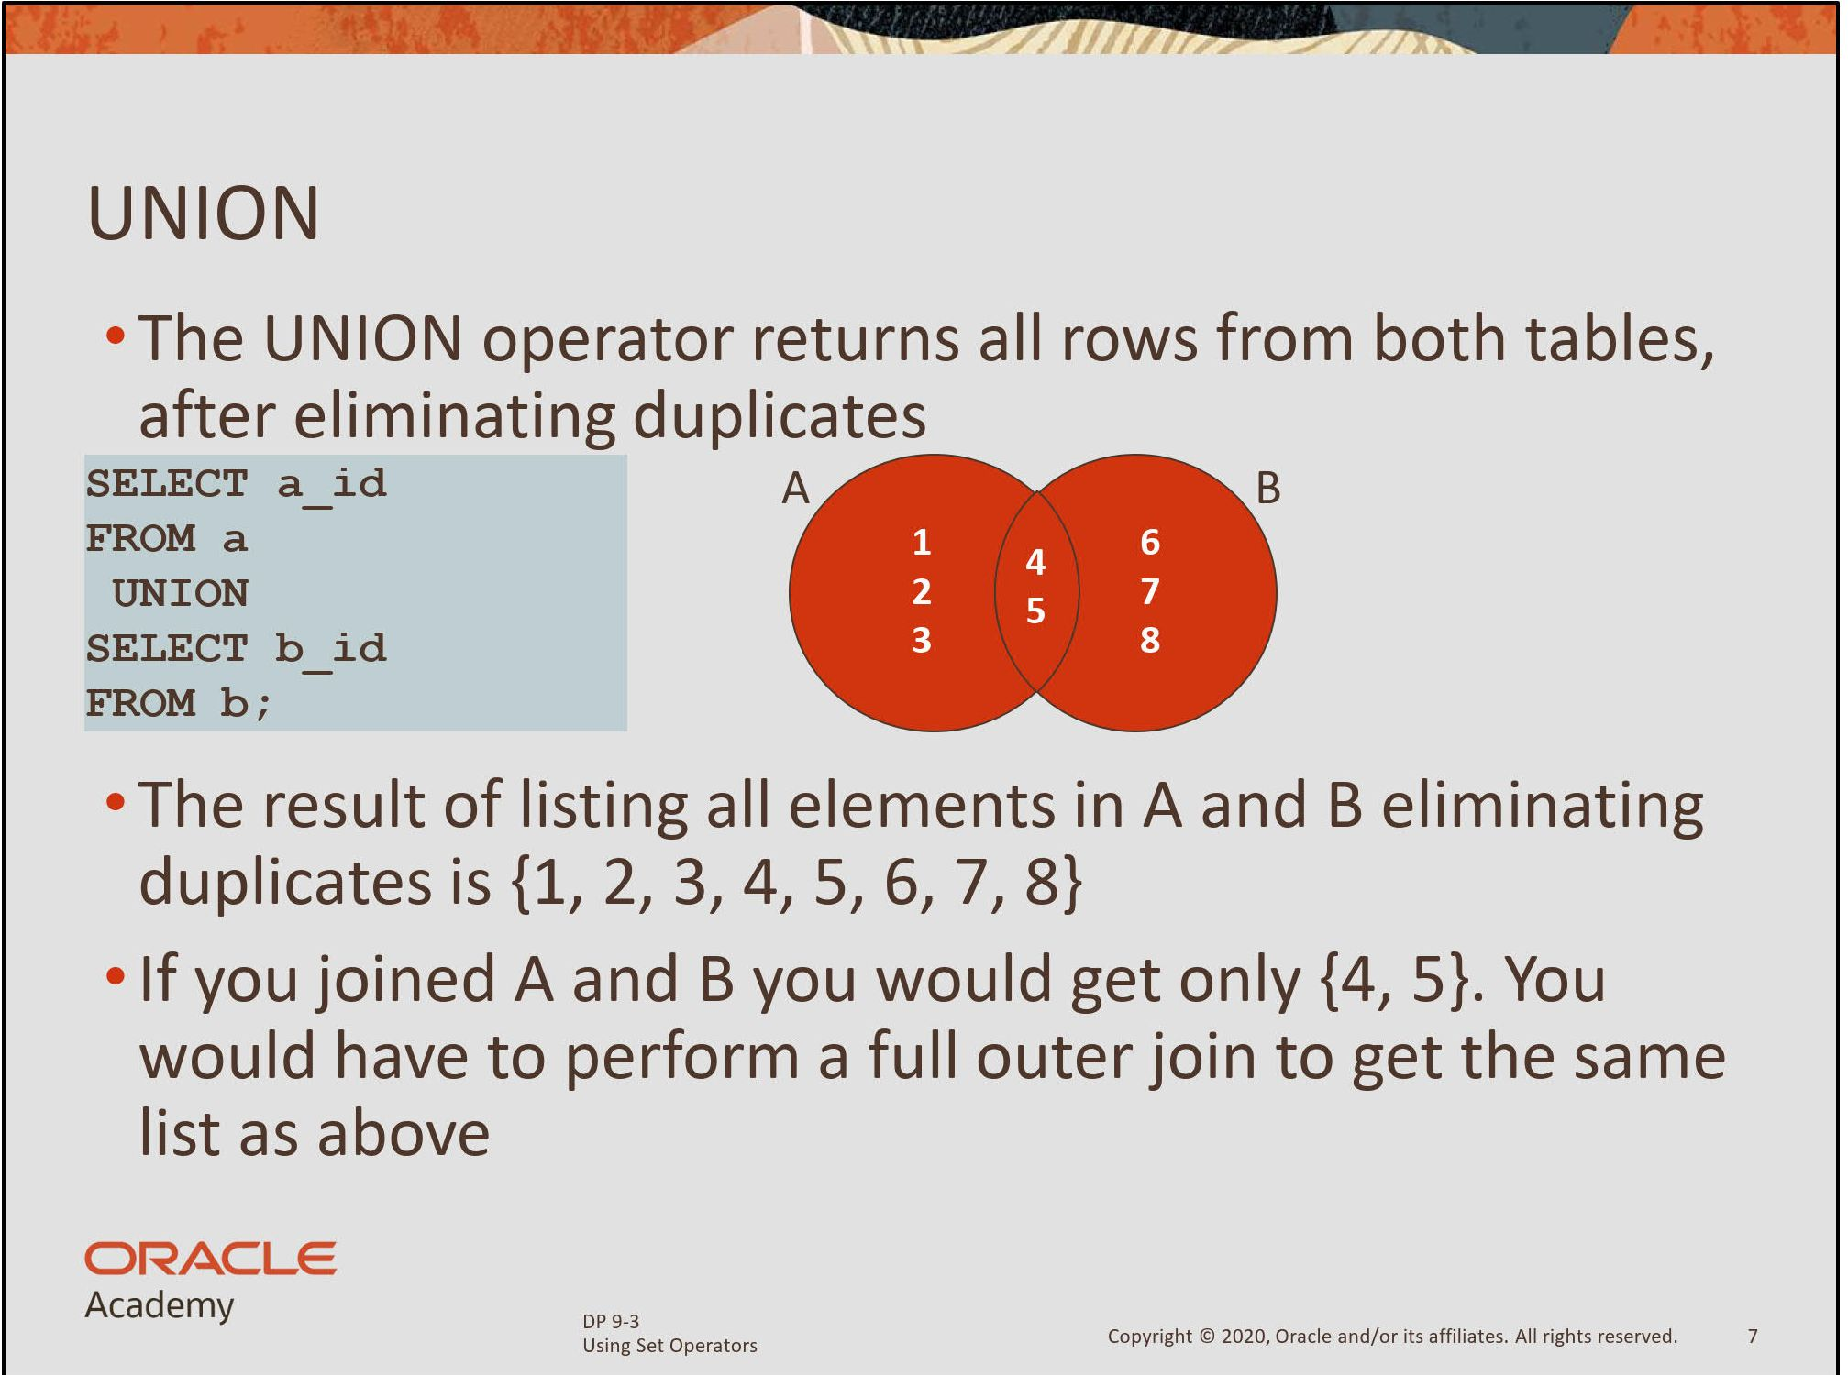

Slide 51
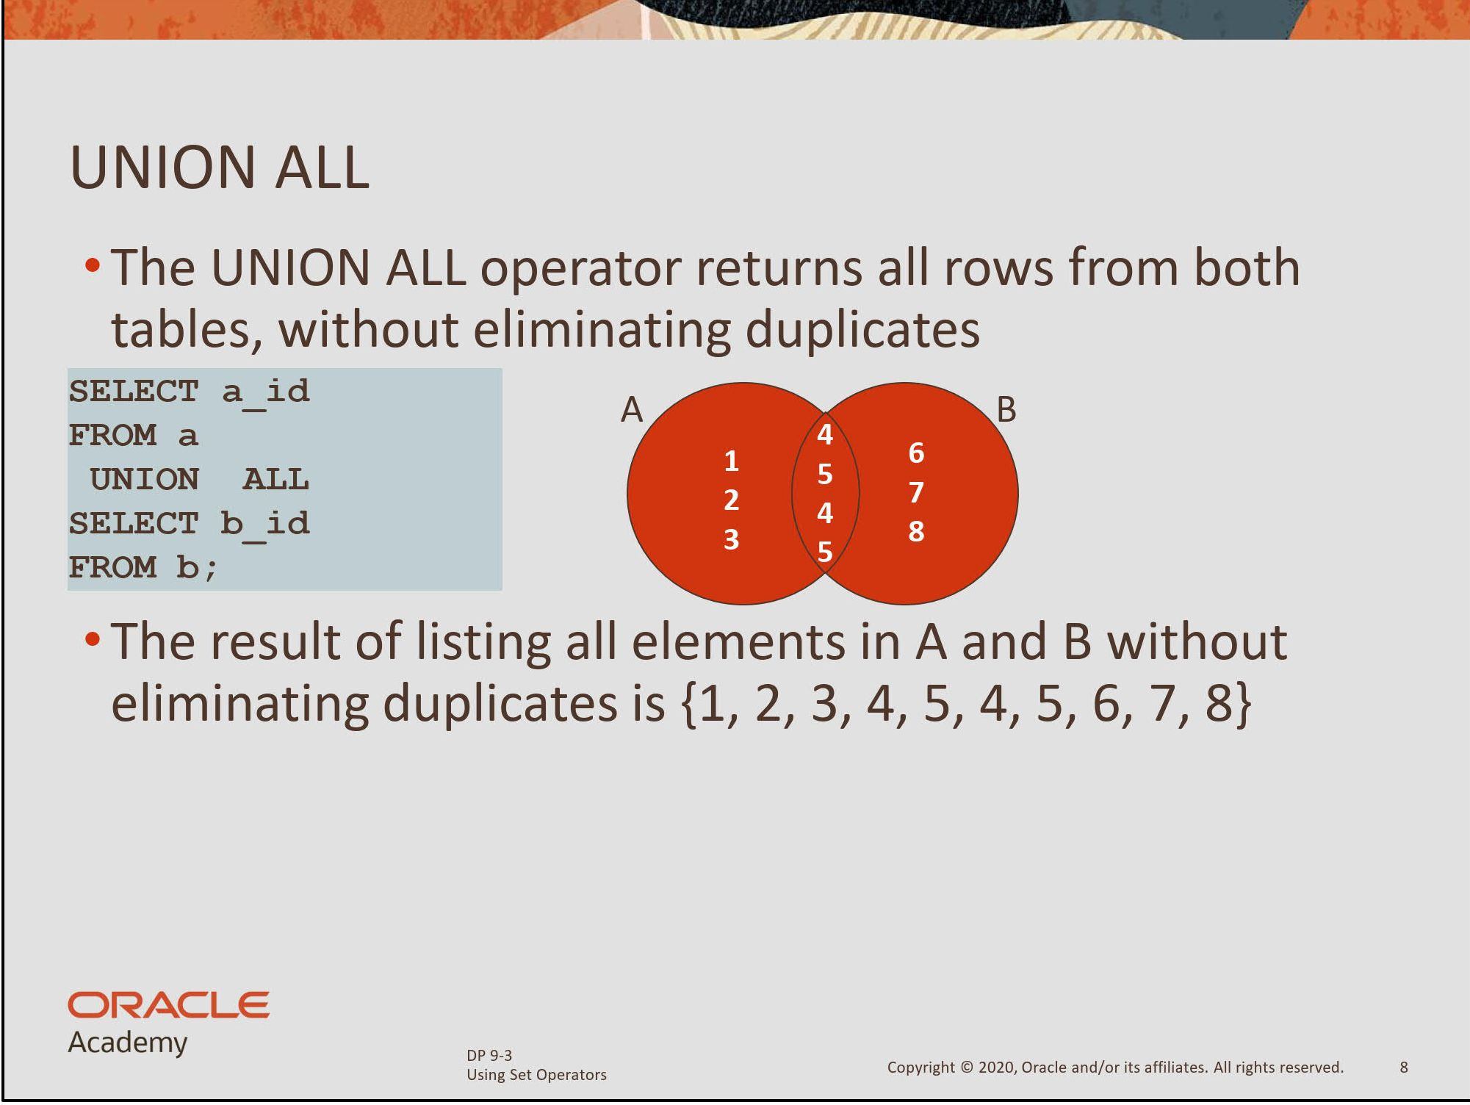

Slide 52
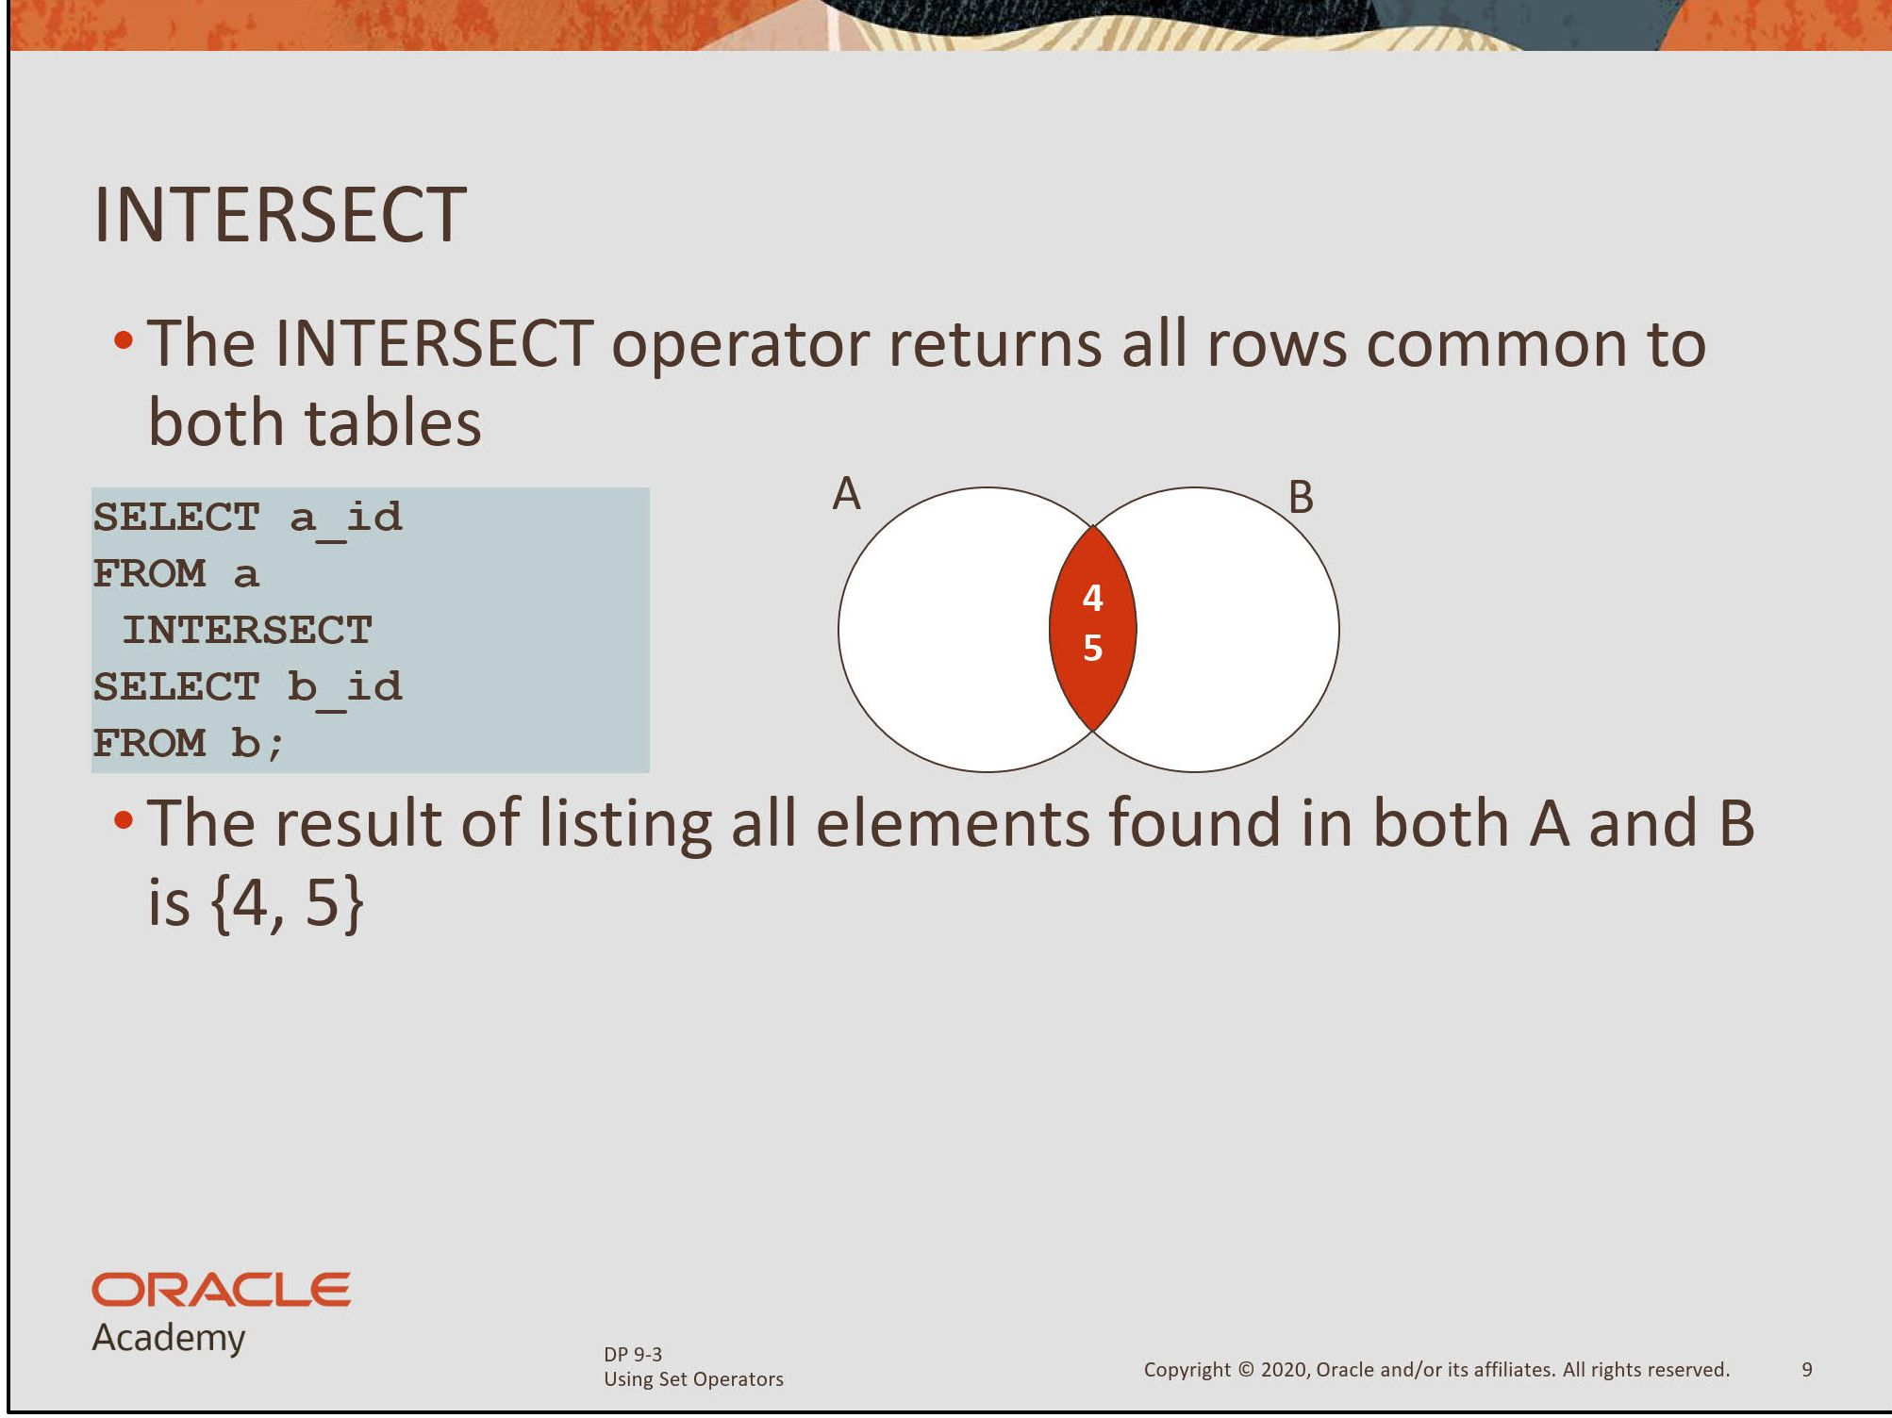

Slide 53
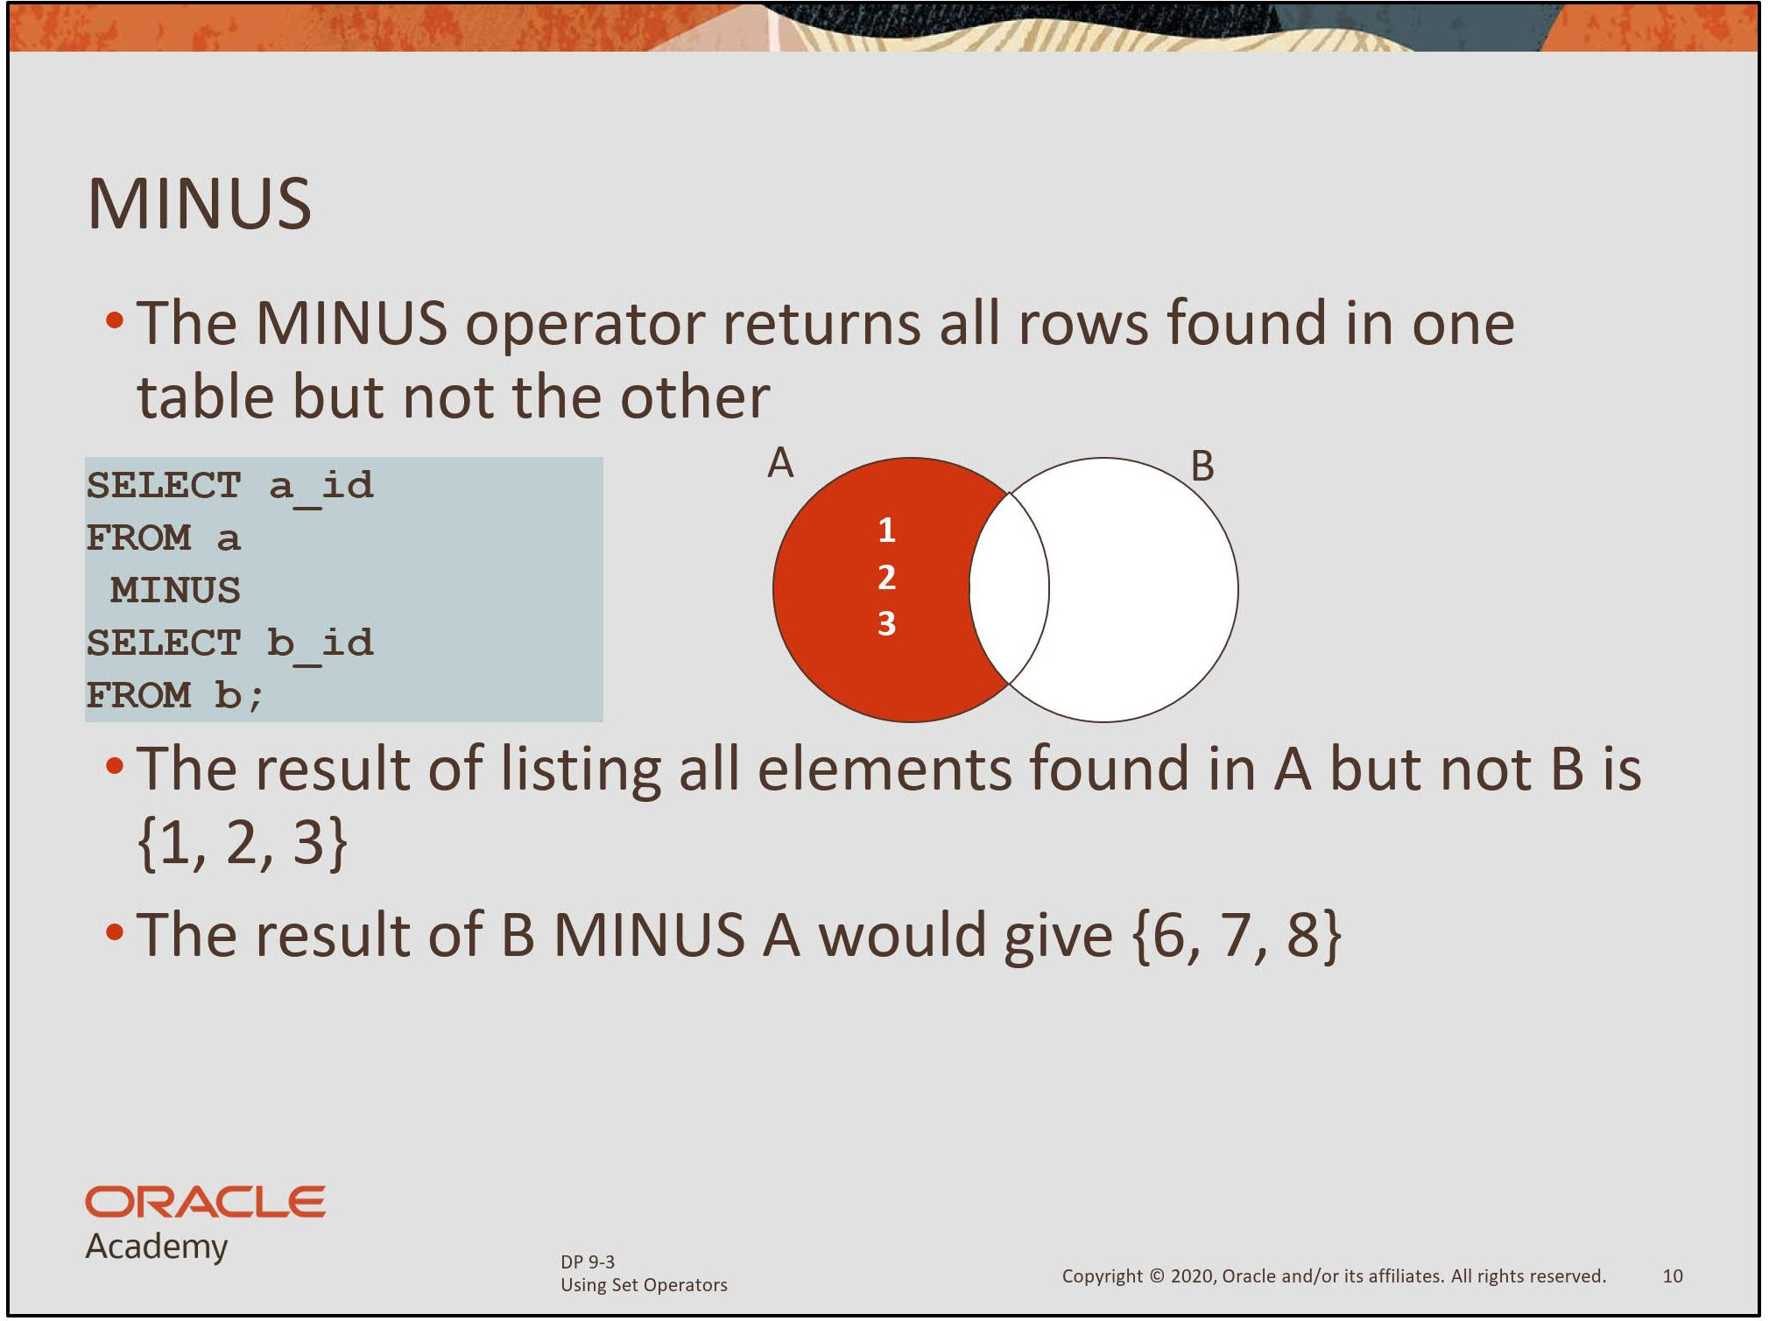

Slide 54
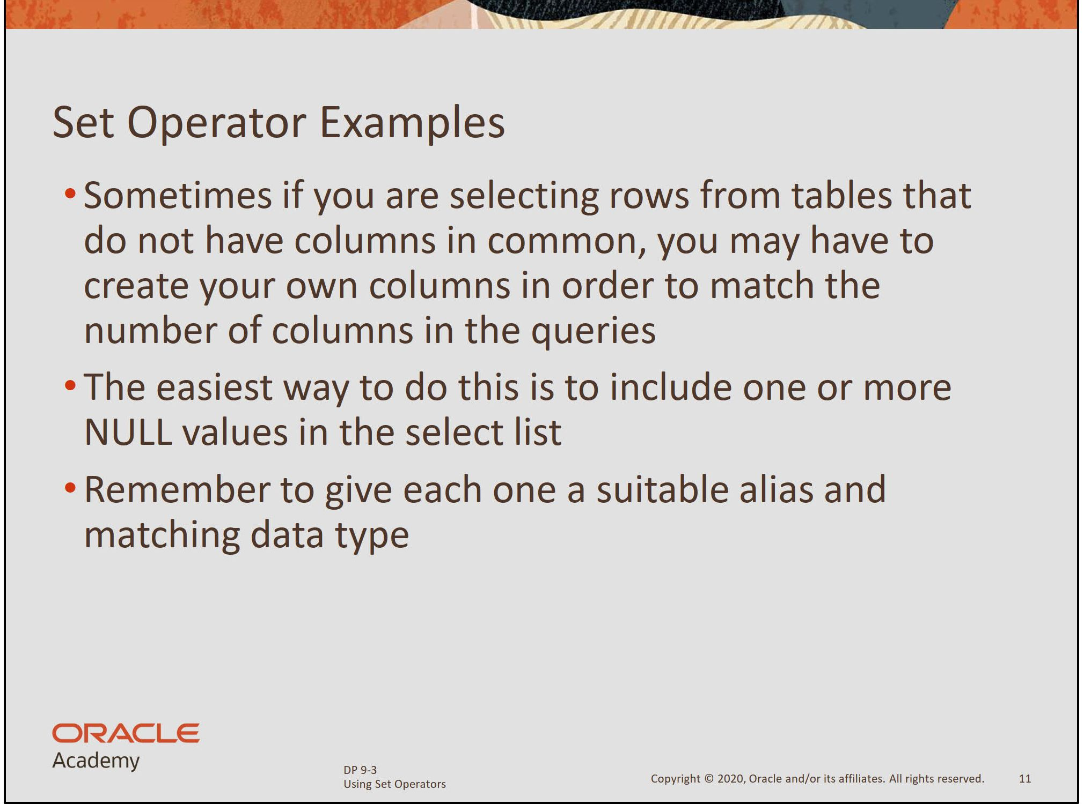

Slide 55
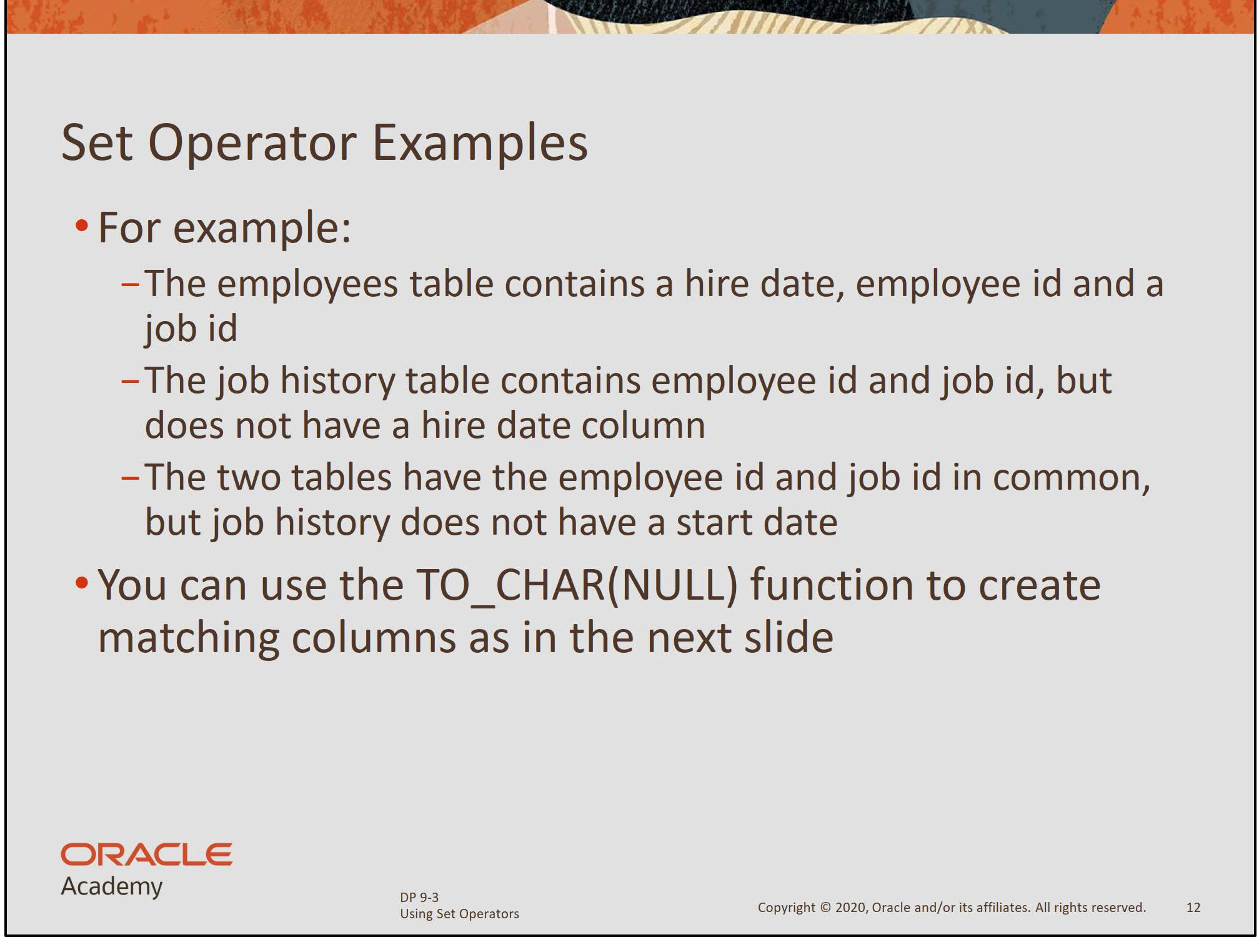

Slide 56
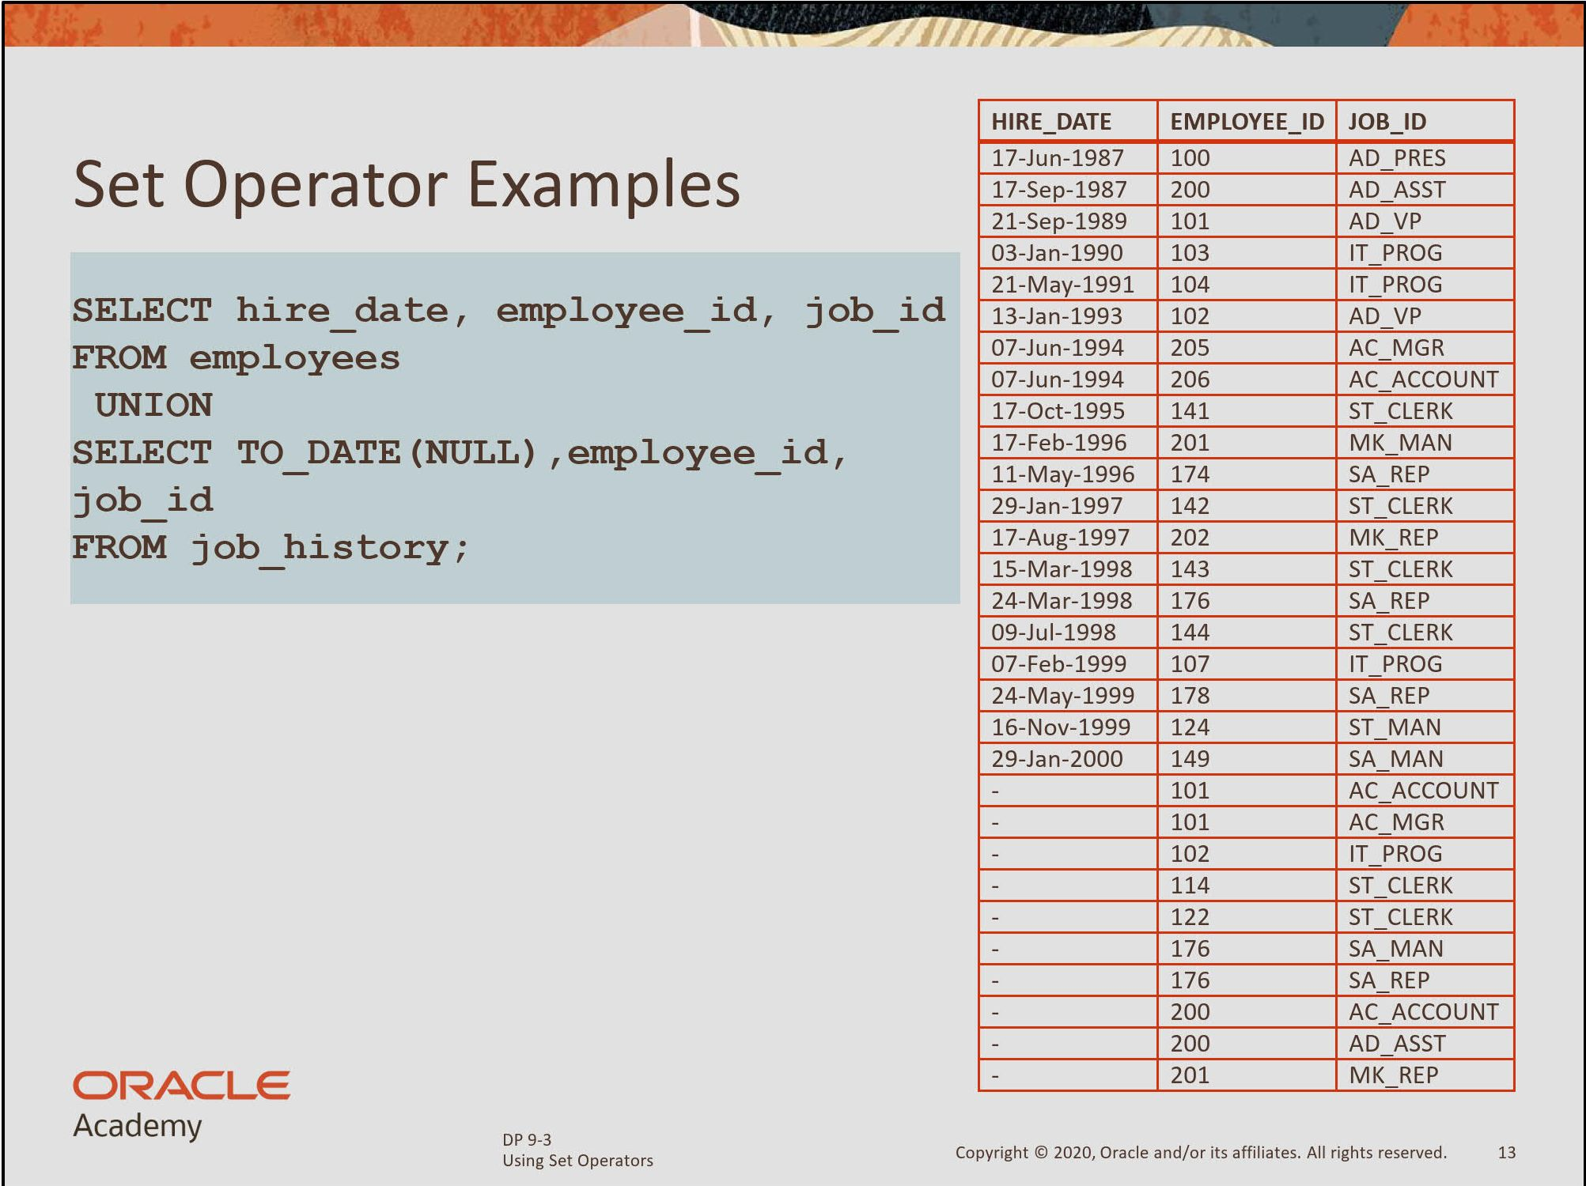

Slide 57


Slide 58


Slide 59


Slide 60


Slide 61


Slide 62
Set Operators
A
B
A
B
UNION/UNION ALL
A
B
INTERSECT
A
B
MINUS
Notes:
Set operators combine the results of two or more component queries into one result. Queries containing set operators are called compound queries.
All set operators have equal precedence. If a SQL statement contains multiple set operators, the Oracle server evaluates them from left (top) to right (bottom) - if no parentheses explicitly specify another order. You should use parentheses to specify the order of evaluation explicitly in queries that use the INTERSECT operator with other set operators.

